Slide 1

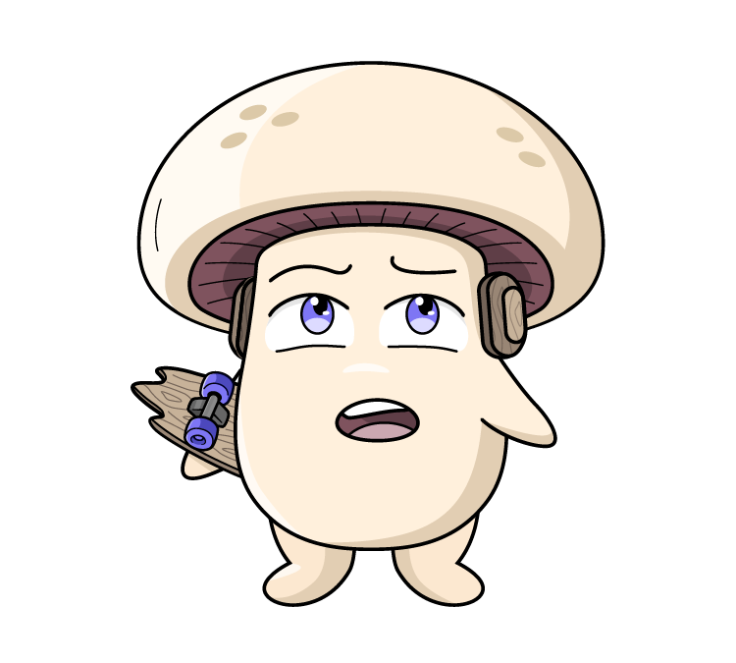



Supporting resource pack
Use this Years 3 – 4 supporting resource pack in conjunction with the teacher guide to seamlessly explore and access all lesson materials.
Proudly brought to you by:
This project has been funded by Hort Innovation using the mushroom research and development levy and funds from the Australian Government.

Slide 2
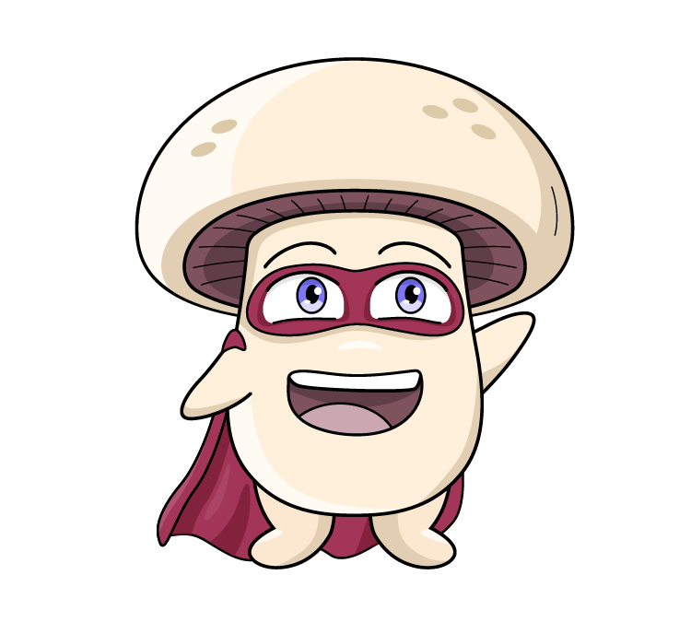

Contents
Lesson 1: Mushrooms are fun-guys
Lesson 2: Let’s visit a mushroom farm
Lesson 3: There’s mush-room for sustainability
Lesson 4: Mushrooms are a superfood
Lesson 5: Mini Mushroom Chefs
Click on the link to complete the pre student survey with your class.
Student survey
2

Slide 3

Vocabulary
The top of the mushroom.
Cap
To look for food, especially in the wild.
Forage
To look for mushrooms, but not eat or touch them.
Foraying
A special group of living things that includes mushrooms. They are not plants or animals.
Fungi
The thin layers under the cap where spores are made.
Gills
Hyphae are like the feathery, hair-like threads that branch out, and form the large network called a mycelium. Each hyphae help the mushroom get food by releasing enzymes to break it down and absorb the nutrients.
Hyphae
The part of a fungus that we can see above the ground, usually with a stem and a cap.
Mushroom
Click on the words to reveal the definition
3

Slide 4
Vocabulary
The tiny, thread-like parts of a mushroom that grow underground or inside something else, like roots. Mycelium is the living organism, which forms into a mushroom.
Mycelium
When very tiny mushrooms, called ‘pins,’ first start to grow and look like little bumps.
Pinning
Think of this like a seed - but instead of being seeds, it's a carrier of the mycelium. Mycelium grows on millet - which is called 'Spawn'. This highly controlled process is done in a sterile lab. Growers add the spawn to the compost, to produce mushroom substrate.
Spawn
A ring of tissue that joins the cap to the stem of the mushroom.
Very tiny, dust-like particles that mushrooms use to make new mushrooms. They are like the seed of a plant.
Veil
Spore
The stalk part of the mushroom, that joins the mycelium to the cap. Like a tree trunk joins roots and branches. Mushroom growers call the stem a stipe.
Stem
Click on the words to reveal the definition
4

Slide 5
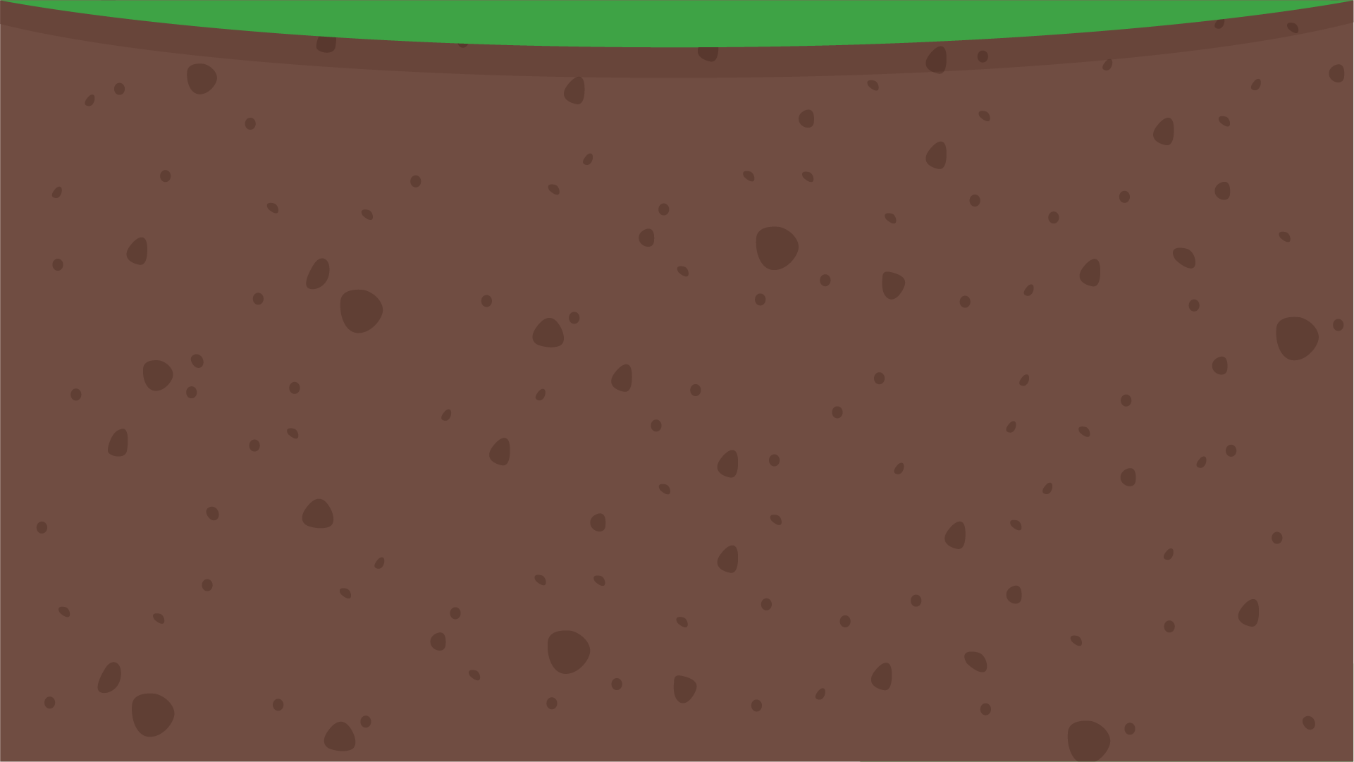


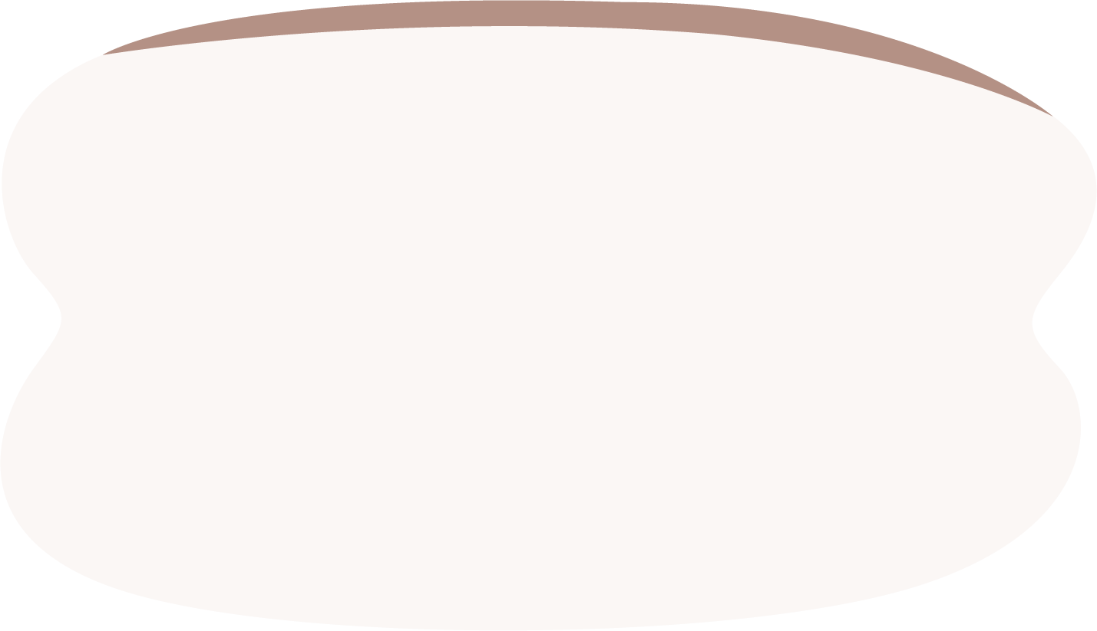

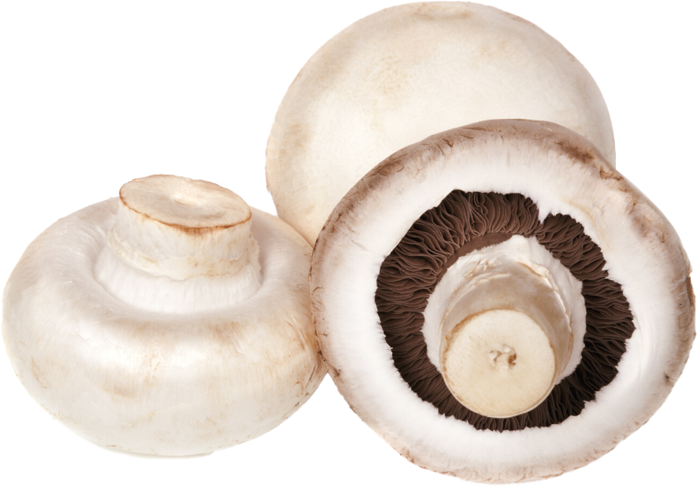
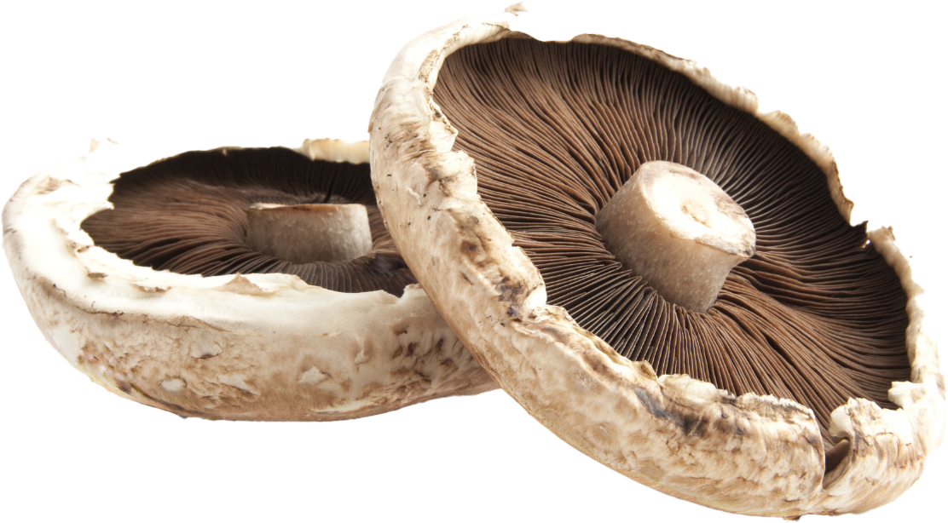
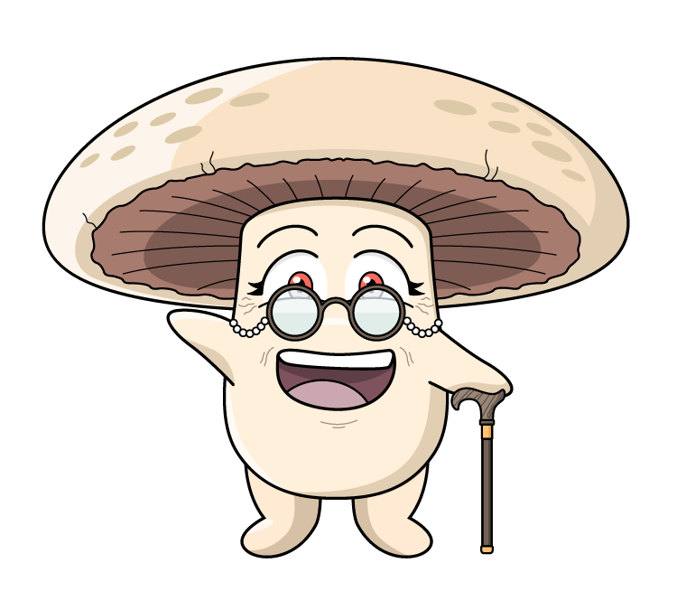
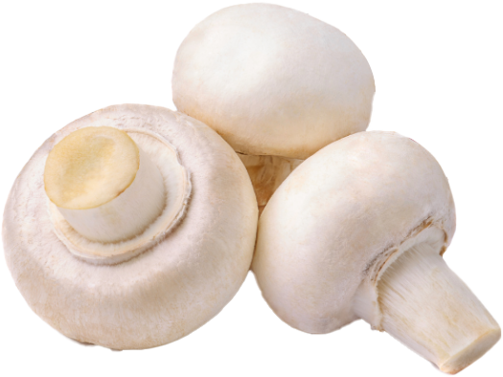
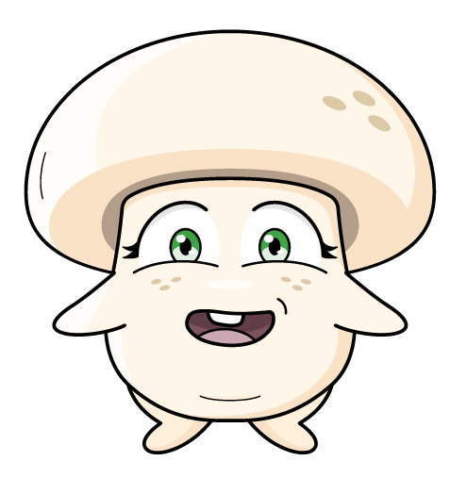
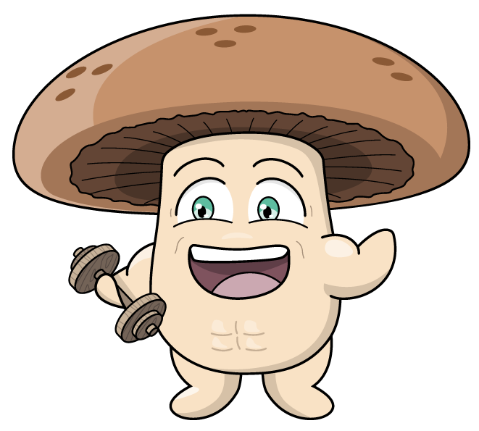
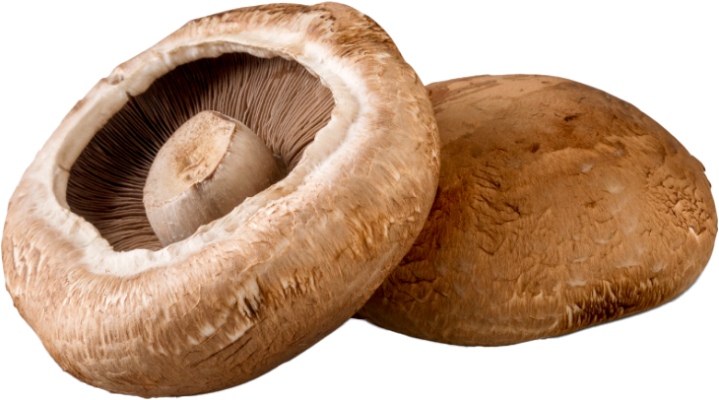
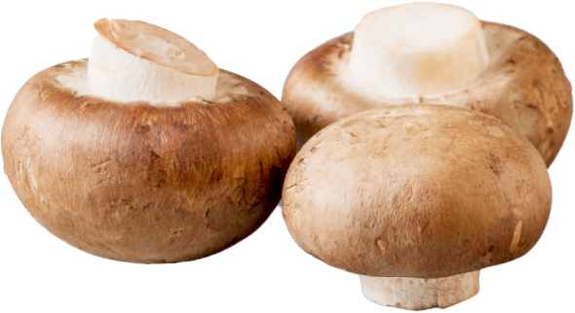
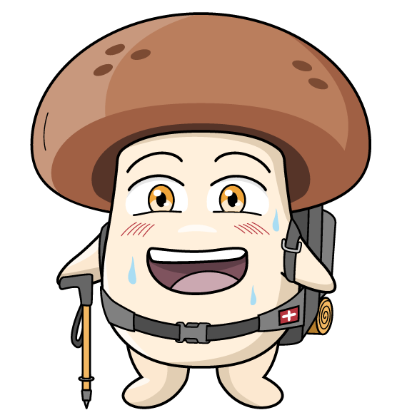
What do you know about mushrooms?
What am I?
Can you name these mushrooms?
These are Agaricus bisporus mushrooms.
Agaricus bisporus - pronounced - Ahh-gar-ikus bye-spore-us
Australian grown mushroom varieties (white, swiss brown and portobello) are the same species Agaricus bisporus! The difference is simply their
stage of harvesting. Mushrooms double in size everyday.
Button
Cap
Flat
The white Agaricus bisporus starts off as a little white button mushroom and grows to become a cup, and then grows to become a large flat mushroom.
The Swiss brown mushroom, grows to become a portobello. The only difference is one is brown in colour, the other is white.
Swiss brown
Portobello
5

Slide 6
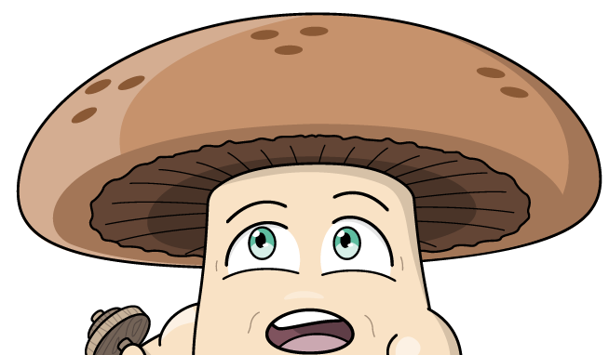
KWL
Mushrooms
K - What do I know | W- What do I want to know | L - What I learnt
6

Slide 7

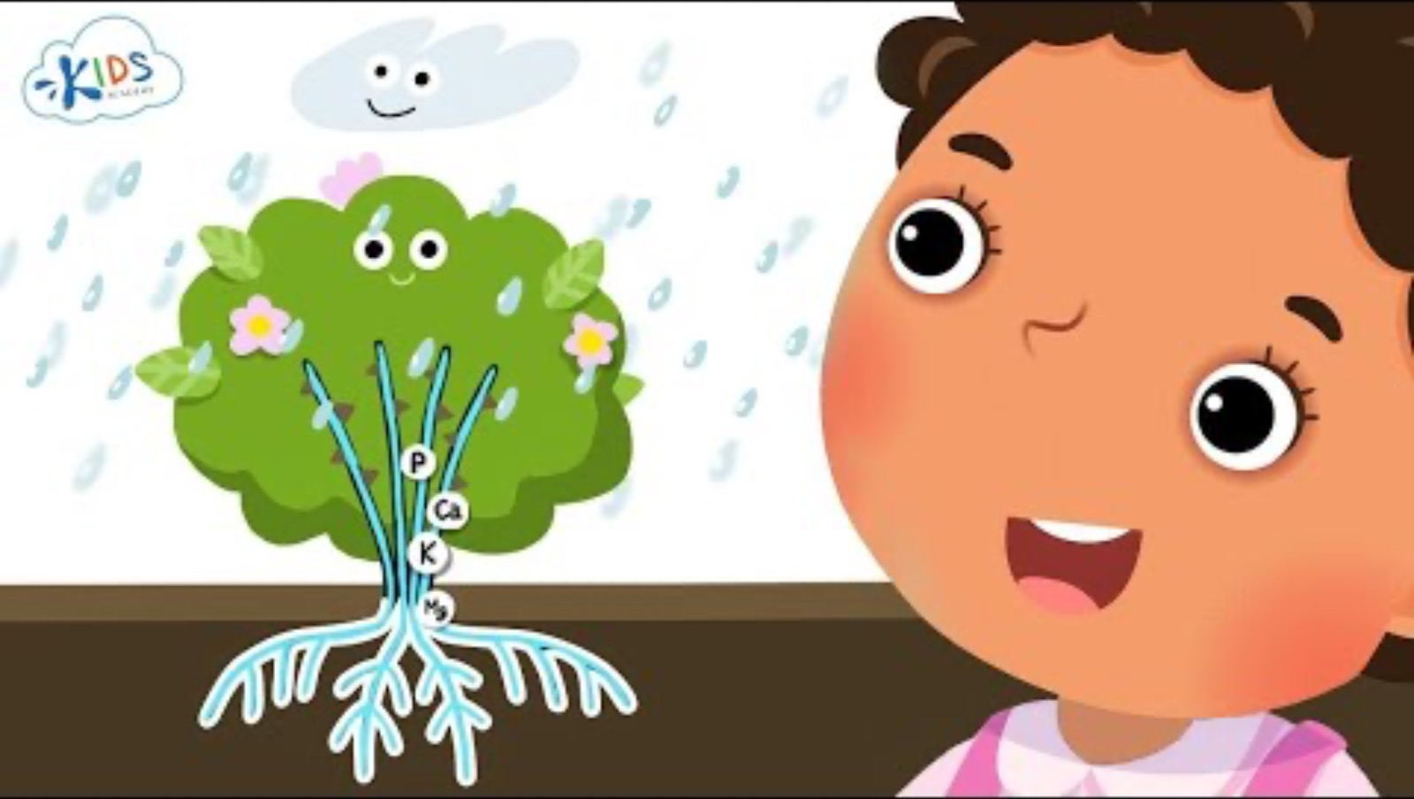

What do plants need to grow?
Plants need soil, sunlight, air and water to survive.
The following things are also important for plants to grow and survive: temperature and space.
What interesting fact did you learn?
7

Slide 8
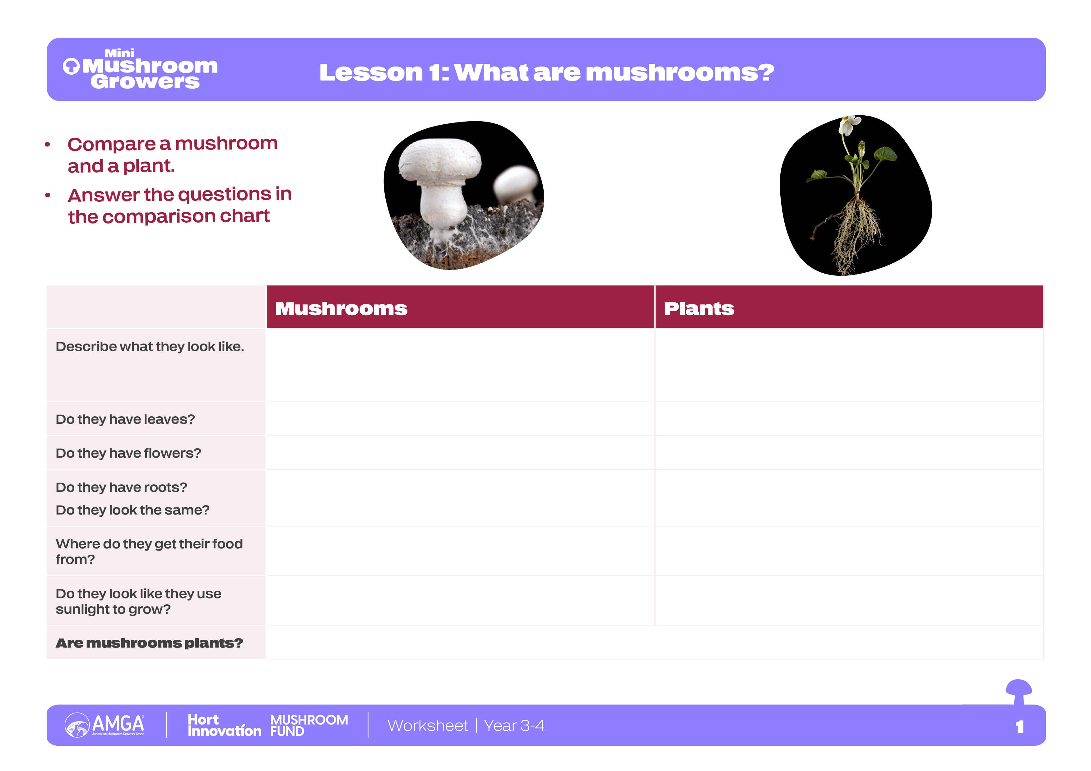
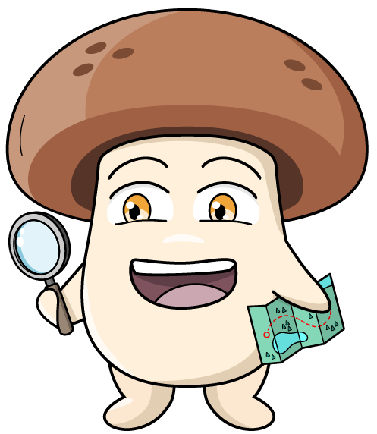
Worksheet
8

Slide 9
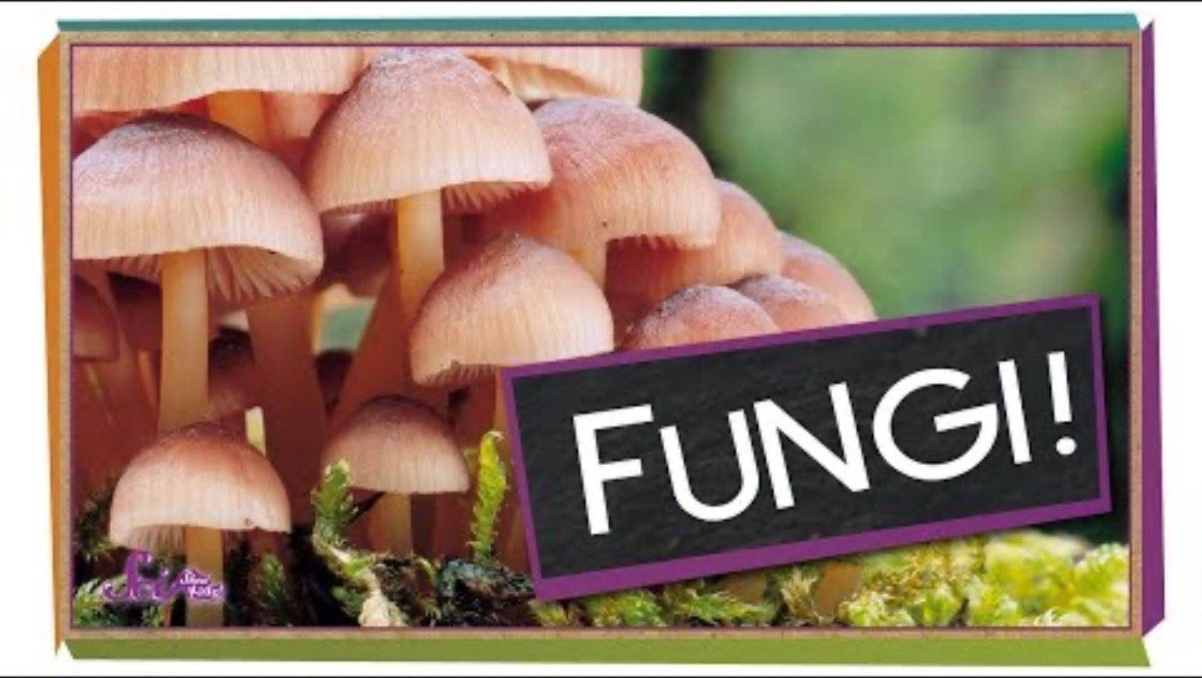
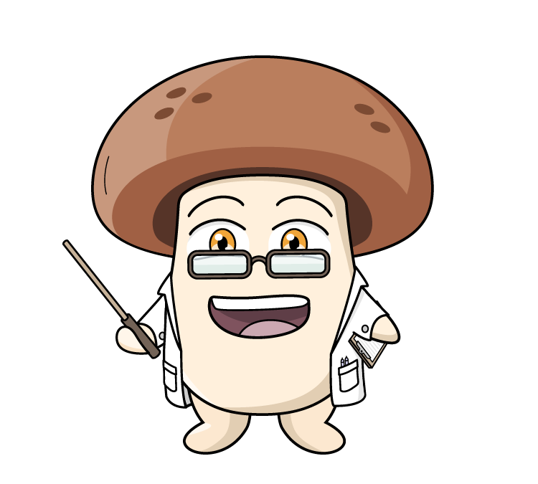
Mushrooms’ role in the ecosystem
How they are different to plants?
9

Slide 10

How they are different to plants?
Unlike plants that make their own food from sunlight, fungi get their food from breaking down other living things. They can grow in the dark because they don’t need sunlight.
Fungi are not plants or animals. They belong to a separate biological kingdom to plants and animals.
Fungi grow by breaking down their food, like leaves, compost and other substrates.
The mushroom or fruiting body appears on the top of the substrate.
10

Slide 11
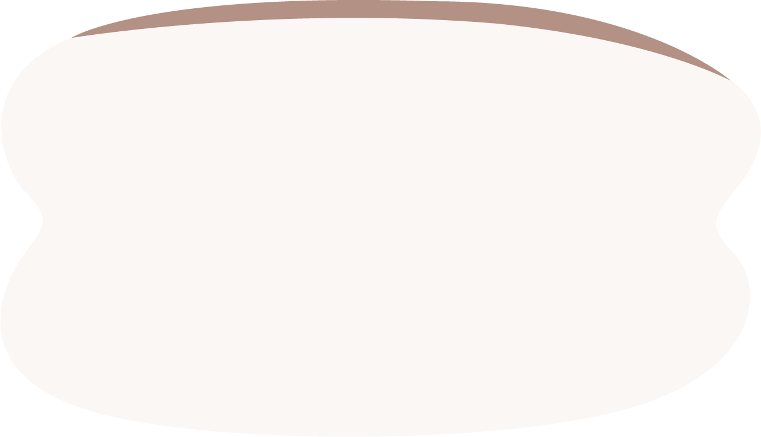
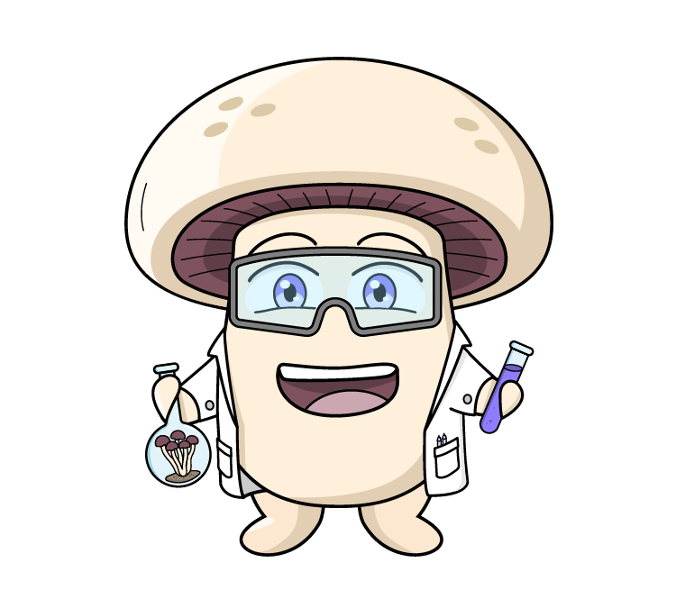
Fascinating fungi facts
The living organism is the mycelium. When the mycelium reaches a point of maturity or if it thinks it is going to die (like a change in temperature, moisture or Co2), the mycelium goes through its fruiting stage - it shoots up a mushroom - so it can grow to release the spores. It’s a survival mechanism, and the reproductive cycle of the fungus.
Mycelium are the tiny, thread-like parts of a mushroom that grow underground or inside something else, like roots. Mycelium is the living organism, which forms into a mushroom.
Mushroom mycelium is the immune system of the Earth! It supports the health of the surrounding ecosystem by providing nutrients to its surrounding environment.
You should NEVER pick wild mushrooms- there are so many different varieties and some will make you very sick.
Mushrooms that you buy from the shops are safe to eat, are very healthy and delicious.
Mushrooms are the fruiting bodies of fungi. Like an apple on a tree.
11

Slide 12
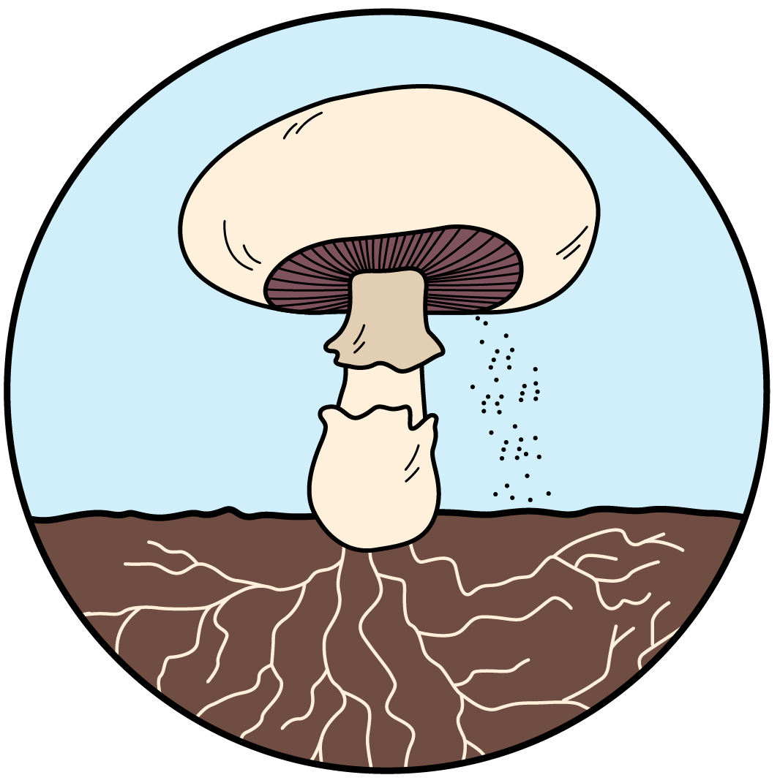
Parts of a mushroom
Gills
are the thin layers under the cap. This is where spores are made.
Cap
is the top of the mushroom. It protects the spores.
Stem
holds up the cap.
Veil
this is a ring of tissue that connects the mushroom stem and the cap.
Volva
is a layer of tissue that protects the mushroom as it grows out of the ground.
Spores
are similar to a seed.
Mycelium
are the underground part of the fungus, like roots.
12

Slide 13
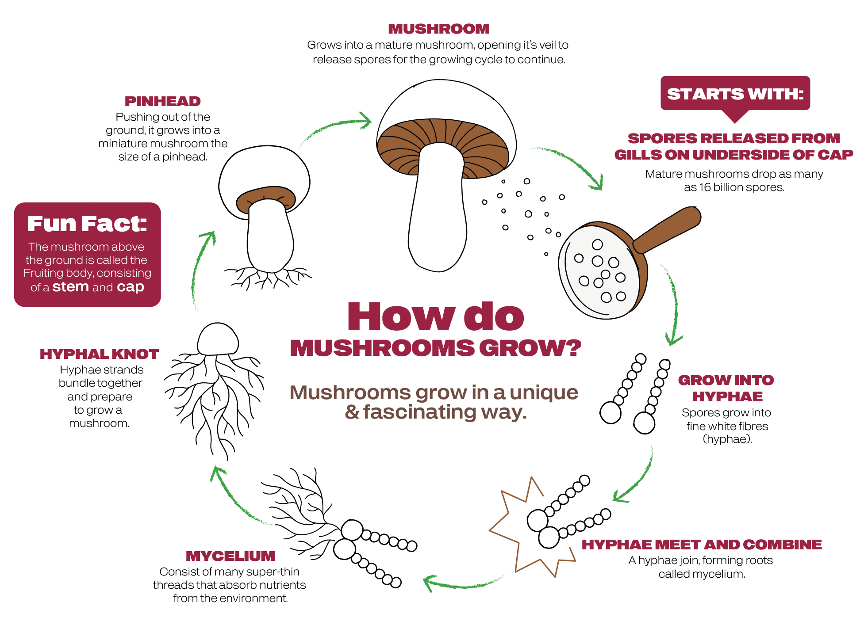
Life cycle of a mushroom
13

Slide 14
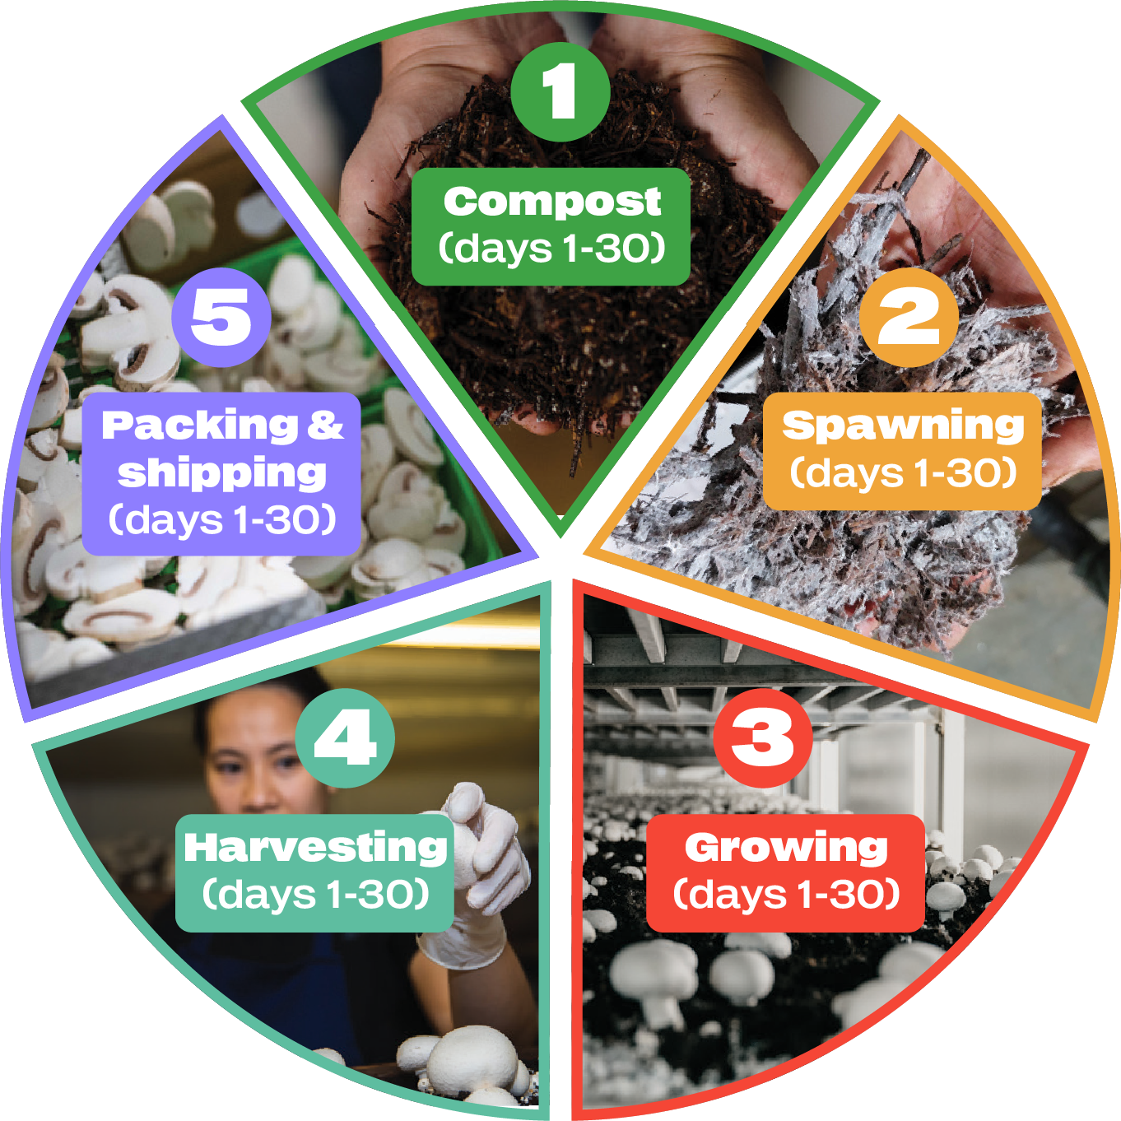



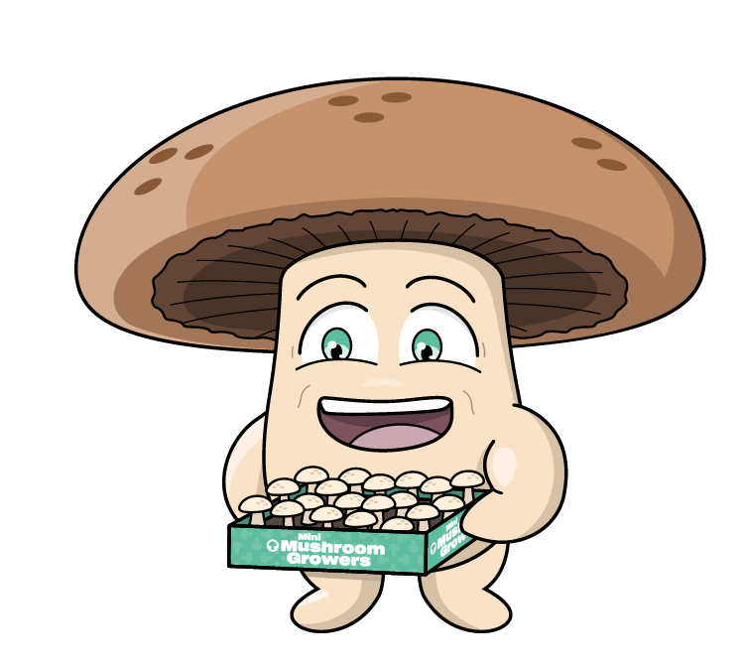


Life cycle of a mushroom
Recycled waste from other farms (straw and poultry manure) is made into compost (which growers refer to as substrate) which is pasteurised before use for mushroom growing. At the end of mushroom production, compost is sold to other farms or nurseries for use as a growing medium for other crops.
Commercial mushroom growers use spawn that is propagated from mycelium onto a sterilised cereal grain, which are produced under controlled conditions.
The spawn is mixed through the compost. Mycelium then colonises the compost, after which, the mushrooms form.
Click the + buttons to learn more
Mushrooms are packed and immediately refrigerated. Shipped within 24 hours of being harvested.
Substrate removed and on sold as a growing medium for other crops.
At harvest end, growing rooms are steamed at 65°C to eliminate pest contamination.
Carefully harvested by hand.
Mushrooms double in size daily.
Growing rooms have long shelves called growing beds, stacked 4 to 8 beds high.
Colonised compost is extruded into the beds. A casing layer is applied on top, to promote the mushroom fruit body.
14

Slide 15

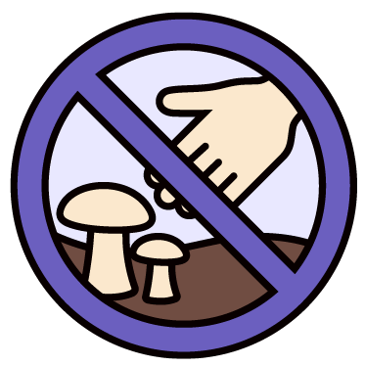
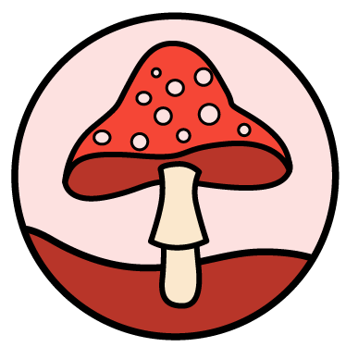


Don’t touch! Don’t eat!
What are the dangers of foraging for mushrooms in the wild?
Not all mushrooms are safe to eat:
Just because a mushroom looks pretty or looks like one from a shop doesn't mean it's safe.
Never touch or pick wild mushrooms:
Never touch or pick any mushrooms you see growing outside, even in your own garden.
If you see a wild mushroom, tell a grown-up:
That way the adult can make sure everyone stays safe.
Only eat mushrooms from the shop:
These mushrooms have been grown by experts and are safe to eat.
Mushrooms are special living things:
While some wild mushrooms are dangerous for humans to eat, they are still important parts of nature for other animals and plants.
Don’t forage - enjoy foraying – look but don’t touch!
15

Slide 16
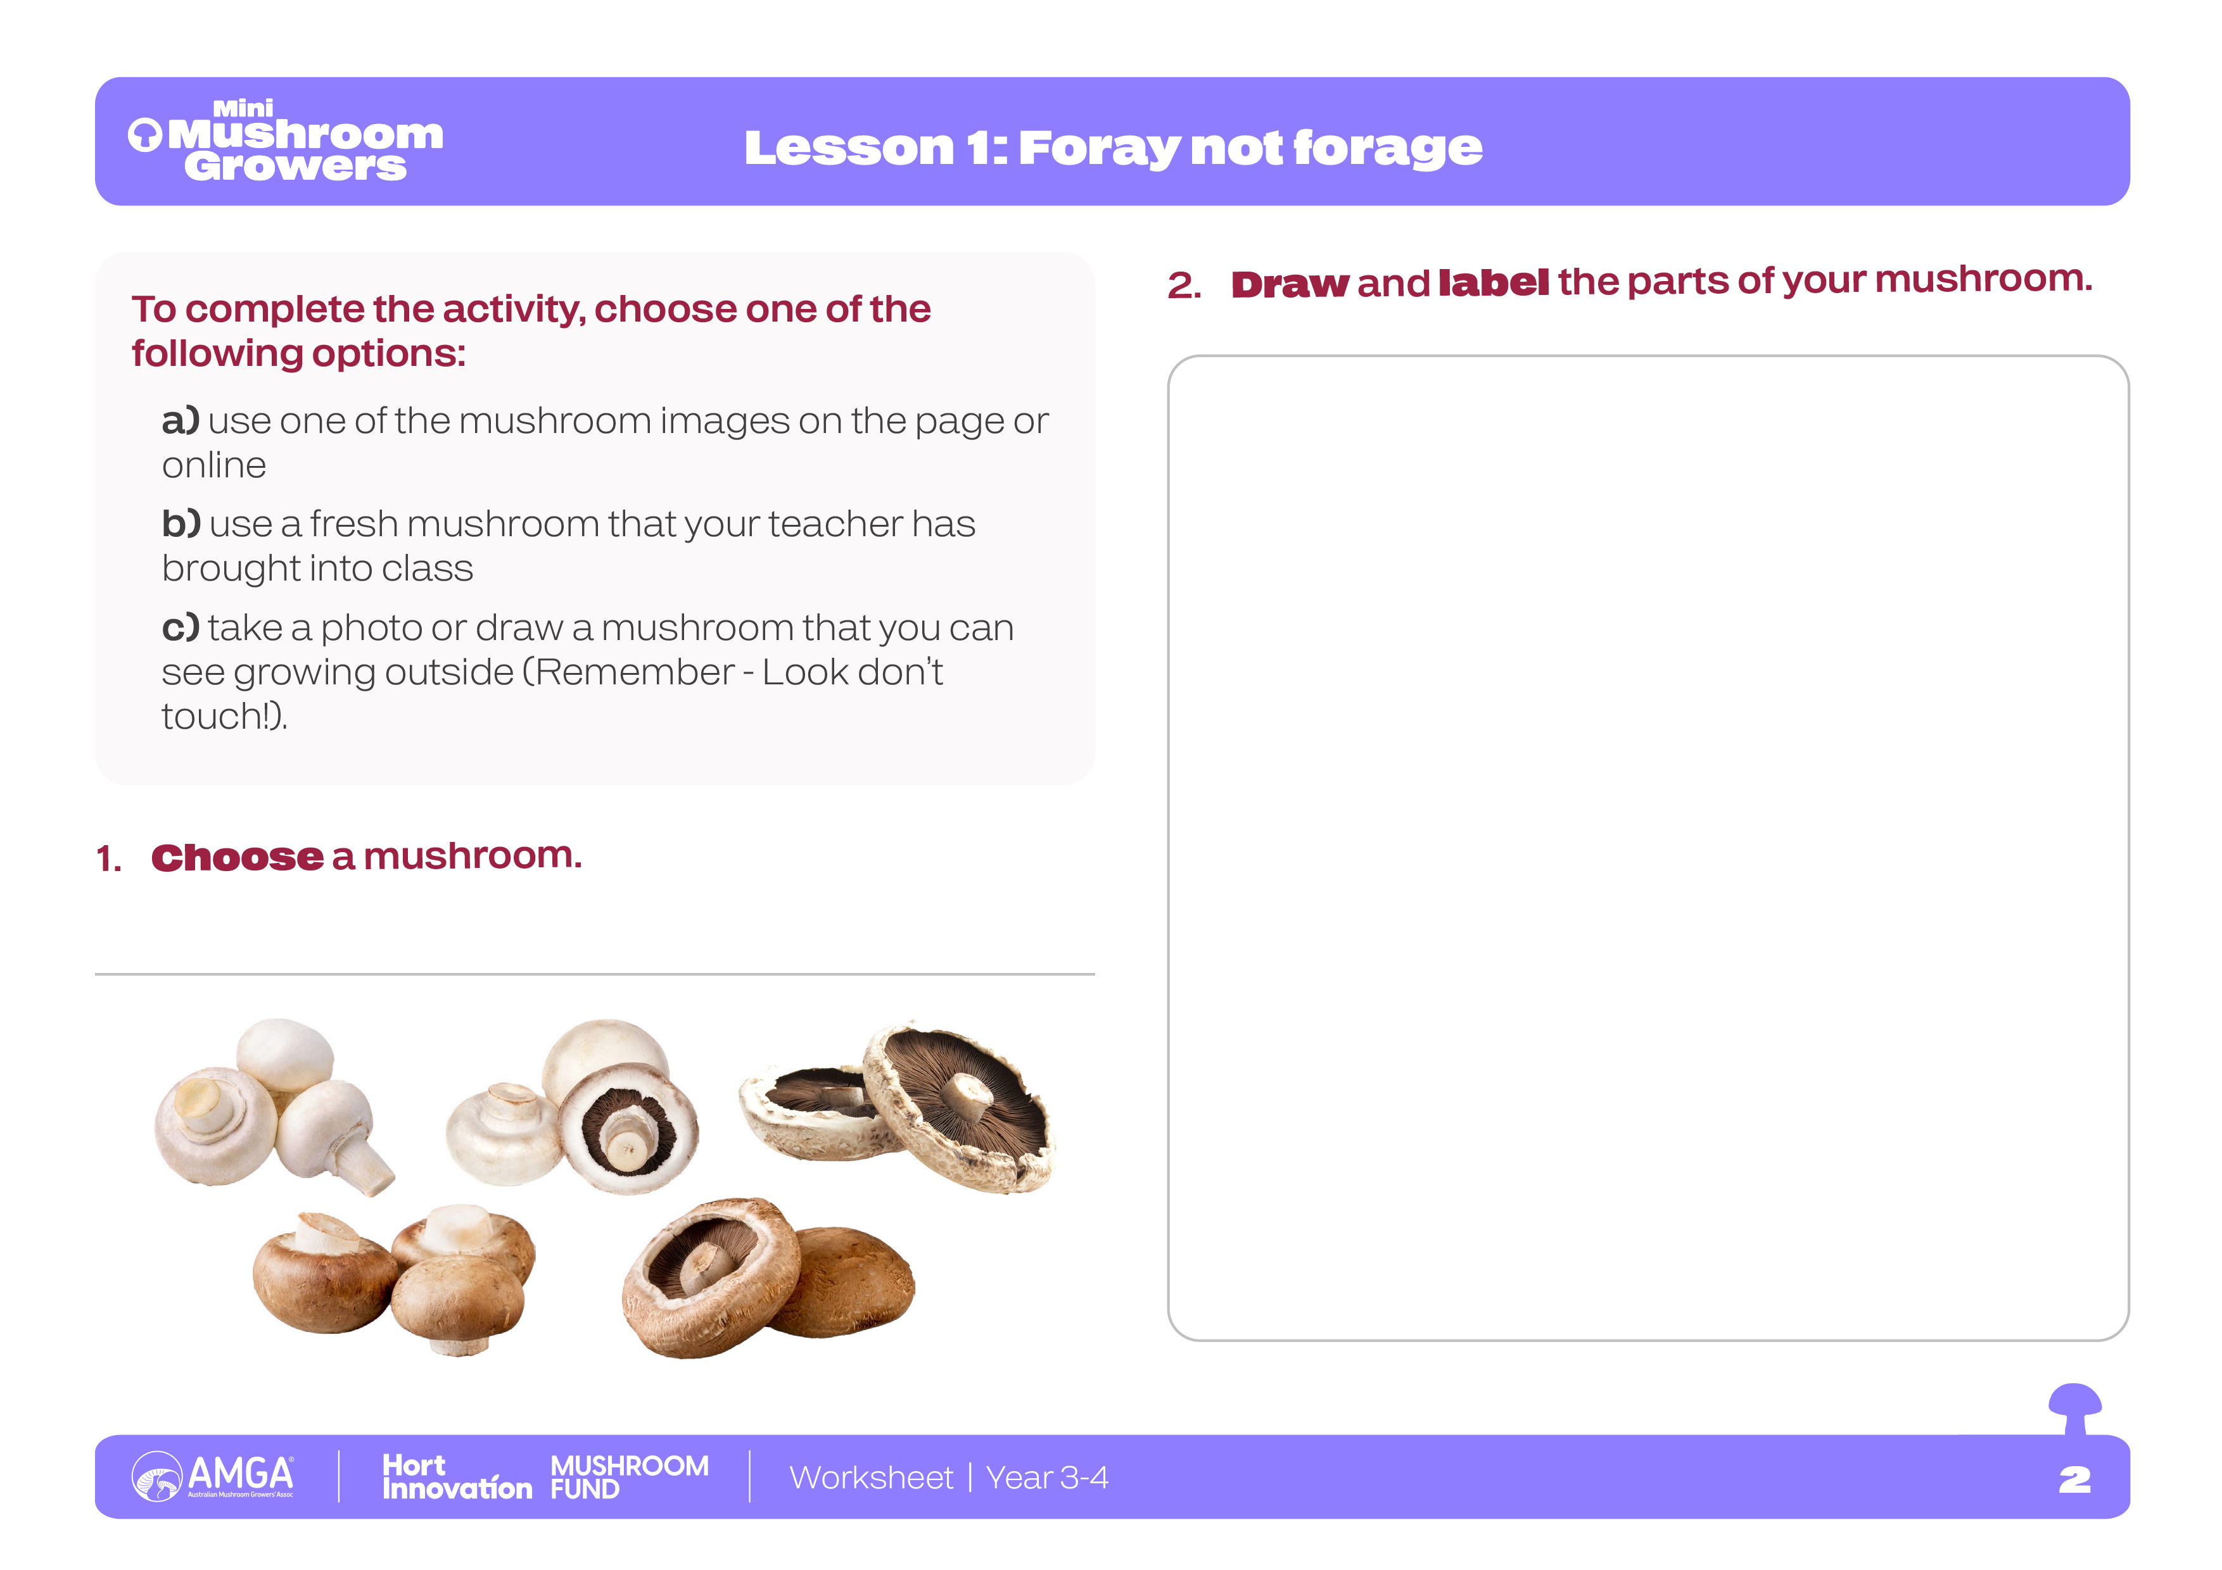
Worksheet
16

Slide 17
Vocabulary
An invisible gas that mushrooms, humans and animals breathe out, and plants use it to grow.
Carbon dioxide
A special layer of soil or material that is put on top of the mushroom compost or substrate.
Casing
When water turns into an invisible gas and goes up into the air.
Evaporation
To pick or collect something that has grown, like mushrooms or vegetables, when it's ready to eat.
Harvest
How much invisible water vapour there is in the air, making it feel damp or sticky.
Humidity
When something is little bit wet, but not soaking wet.
Moist
Click on the words to reveal the definition
17

Slide 18
Vocabulary
Packaged
When things are put into containers or wrapping, like a box or bag, so they can be kept safe and carried easily.
Production
Making or growing something, like when a farm grows lots of mushrooms.
The special material or food that mushrooms grow on, like wood or compost.
Substrate
When something is moved from one place to another, like mushrooms being moved from the farm to the shop.
Transported
How much invisible water vapour there is in the air, making it feel damp or sticky.
Ventilation
Click on the words to reveal the definition
18

Slide 19
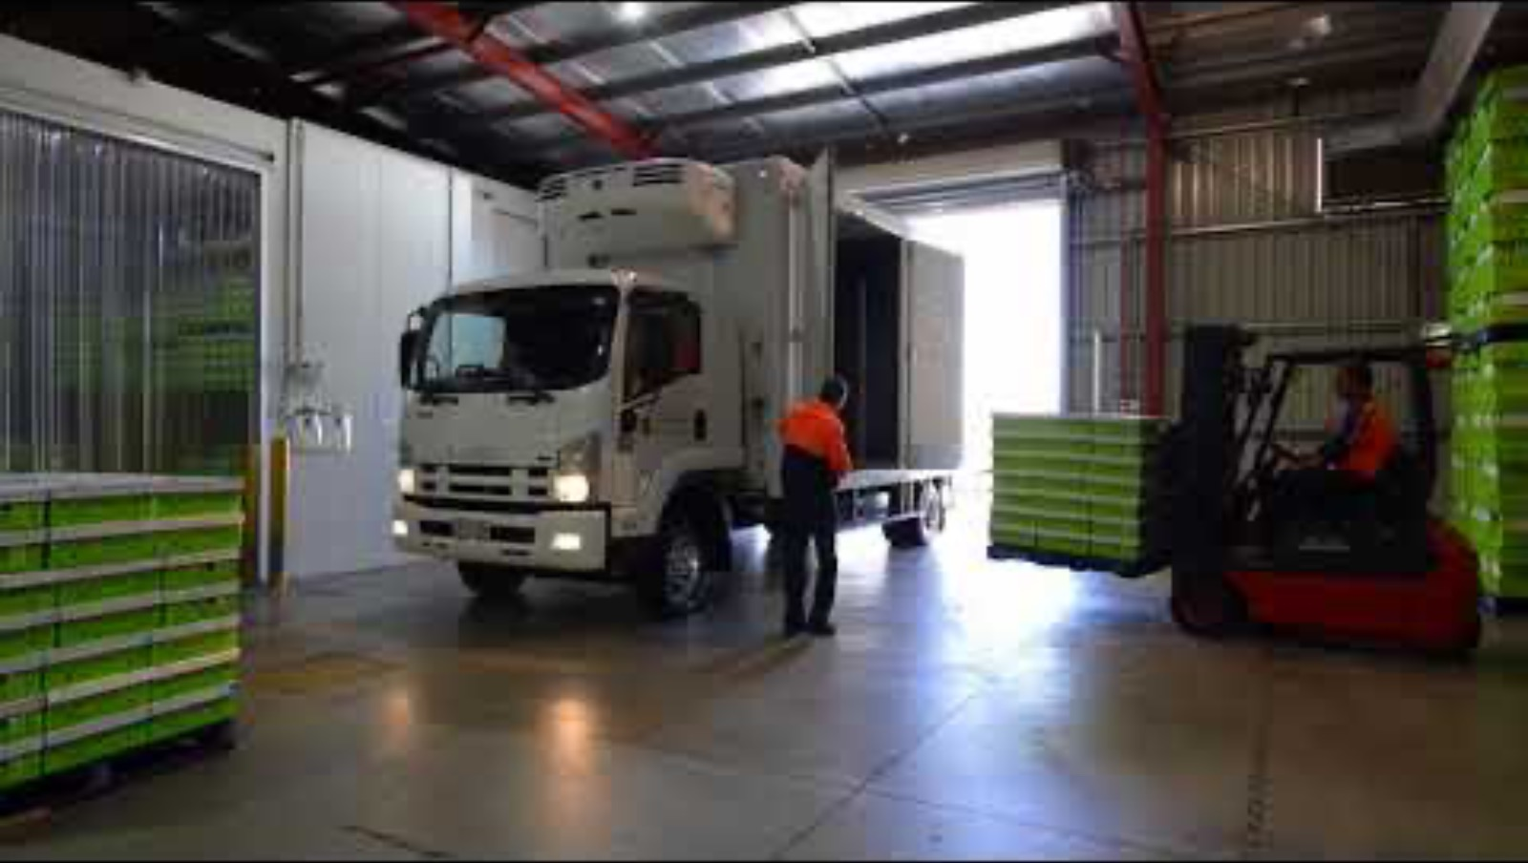
The steps to mushroom farming
What have we learned about the steps to mushroom farming?

Slide 20

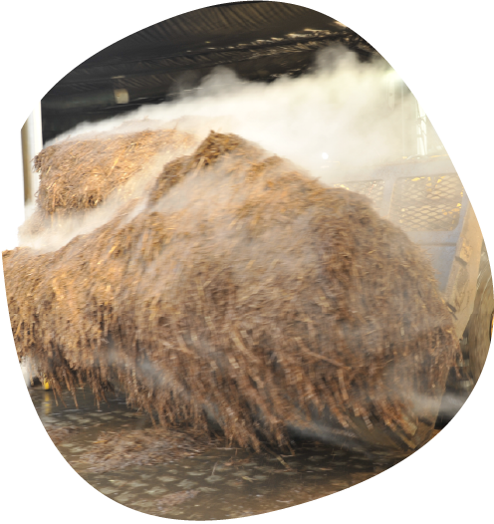
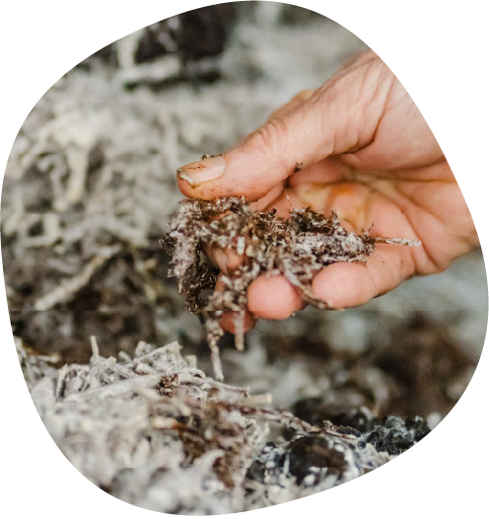
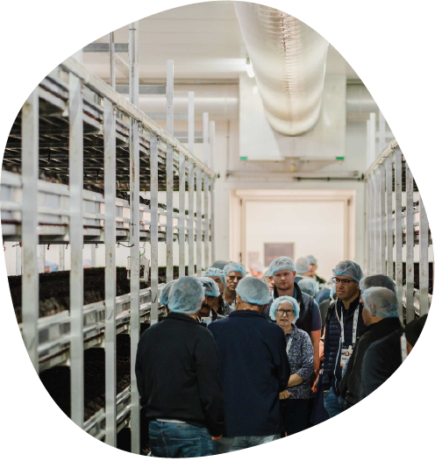
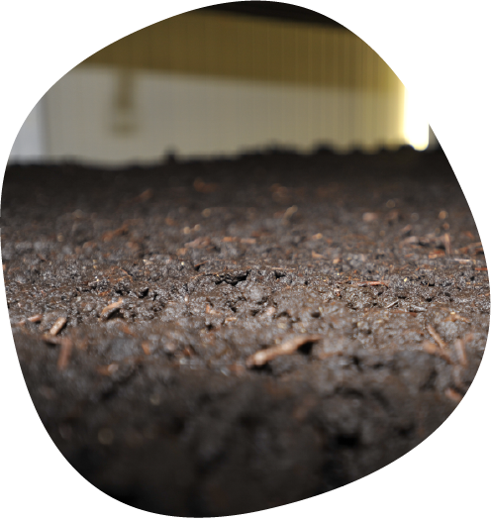
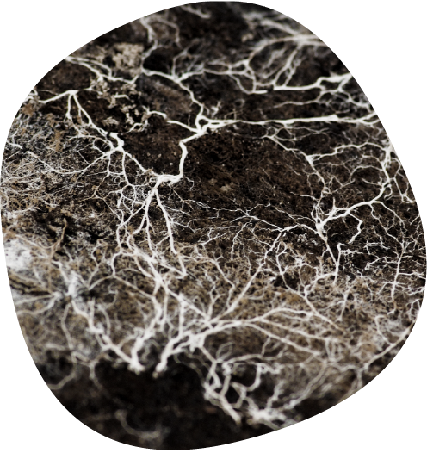
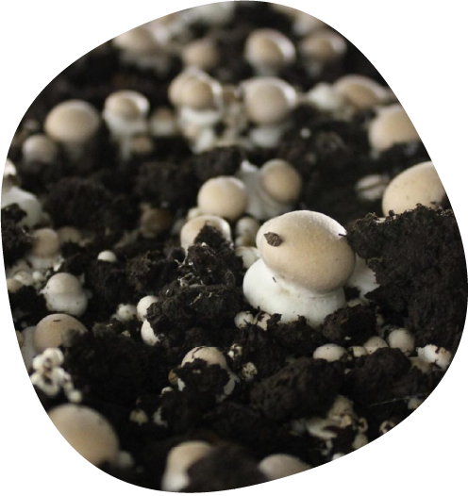
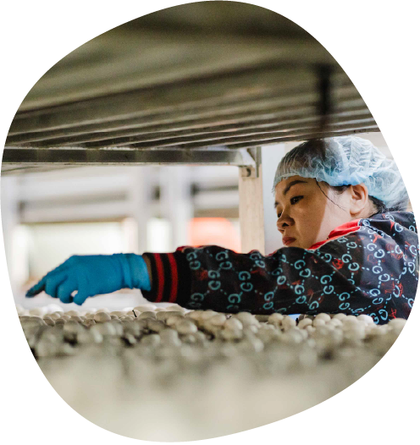
The steps to mushroom farming
5. Mycelium forms
The mycelium then begins to grow and spread. These are tiny, thread-like parts of a mushroom that grow underground or inside something else, like roots. Mycelium is the living organism, which forms into a mushroom.
6. Pinning
After about 2 weeks the mycelium in the casing layer begins to form tiny mushroom fruiting bodies, known as pins. The pins look like small, white blobs or ‘pinheads’ and will eventually grow into full-sized mushrooms.
7. Harvesting
After a few days, the pins form into mushrooms - baby buttons, then cups, then flats. The mushrooms are harvested every day. The mushrooms grow in cycles called a 'Flush'. There are three 'flushes' in one mushroom crop.
3. Indoor growing rooms
Farmers use indoor growing rooms with carefully controlled temperature and humidity, air flow and watering techniques to grow the mushrooms. They load the substrate onto long metal shelves, stacked up like bunk beds.
2. Spawning
Once the compost process is finished, mushroom spawn is added. Spawn is a cereal grain which is coated with mycelium, to allow the mycelium to grow through the substrate.
1. Substrate
The farmer prepares the compost called substrate to grow the mushrooms. They mix things like straw and chicken litter together and load it into special tunnels for it to start composting.
4. Casing
The substrate is then covered with a layer of casing soil. Casing soil is very important. Without this, the mushrooms will not grow.

Slide 21
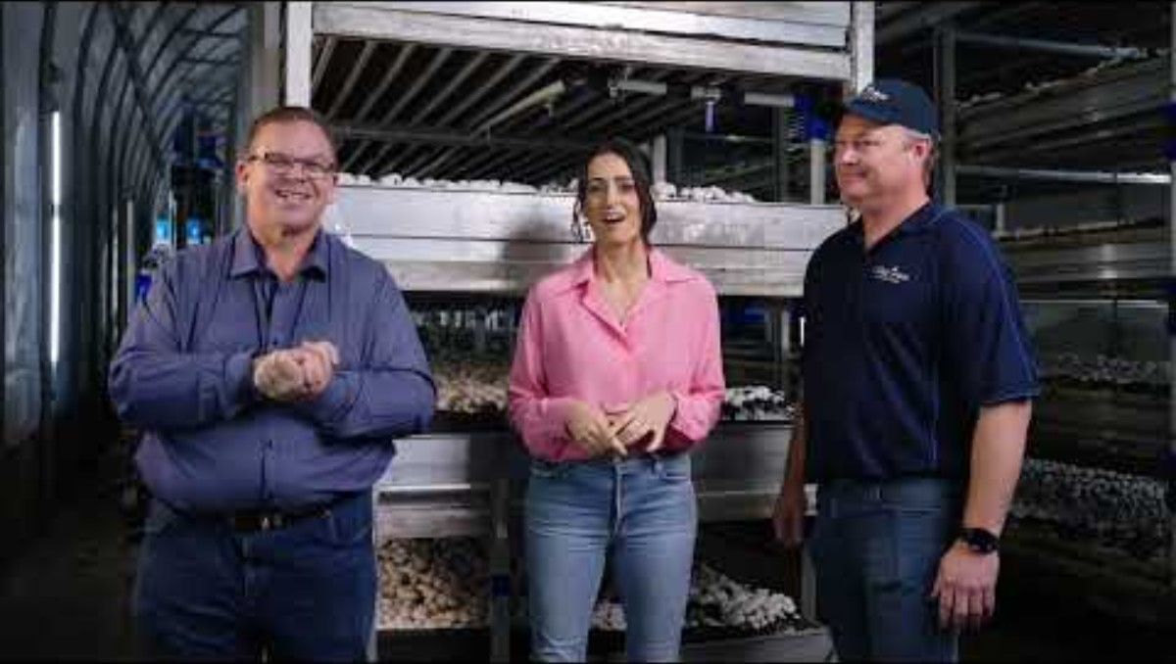
Let’s visit a mushroom farm
Australian mushroom growers monitor a range of environmental factors to create a perfect indoor climate. This is important because mushrooms are fungi, not plants, and they have very specific needs.
21

Slide 22

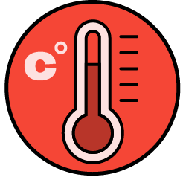
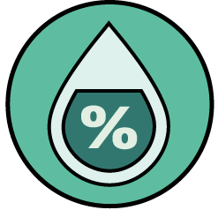
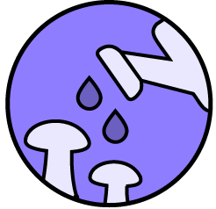
Let’s visit a mushroom farm
How and why do mushroom growers monitor:
Airflow
The mushroom growing rooms have special air conditioners, ventilation systems and fans that blow fresh air around the room. Mushrooms breathe in oxygen and breathe out carbon dioxide, just like humans. Proper airflow ensures the mushrooms have the air they need to grow.
Temperature
That Farmers use digital temperature sensors connected to the heating and cooling systems to control the temperature in the growing rooms. This is very important because different stages of the mushroom life cycle require different temperatures. The mycelium need a specific warm temperature to grow properly. Once the mycelium is ready, the growers drop the temperature to a cooler, more stable range. This temperature change tells the mushroom to begin the fruiting stage.
By controlling and monitoring these key factors, mushroom growers can manage the mushroom's entire life cycle and ensure a consistent, reliable supply of fresh mushrooms all year round.
Humidity
A special tool called a hygrometer measures how much water is in the air. Mushrooms are mostly made of water, so they need the air around them to be moist. If the air is too dry, the mushrooms can shrivel up. If it's too wet, they can get slimy.
Evaporation
The farmer must watch and control how temperature, humidity, and airflow work together. A very slight amount of evaporation from the surface of the growing material is a key trigger for mushrooms to ‘pin’. Too much evaporation will dry out the mushrooms, but too little will stop them from growing in the first place.
22

Slide 23
Different growing systems used on a mushroom farm
Tray Farm
The trays are heavy, so they're moved around the farm using forklifts.
The trays are taken from one room to another for different stages of growth.
Timber trays need constant replacement.
Timber trays are not easy to clean.
This is an old farming method which is being replaced with modern shelf farms.
Mushrooms are grown in large, rectangular timber trays filled with substrate.

Slide 24
Different growing systems used on a mushroom farm
Shelf Farm
The substrate is brought into the room and winched into the shelves using large nets.
The mushrooms stay on these shelves for their entire life.
Workers walk along the aisles between the shelves to take care of the mushrooms and harvesters pick them when they're ready.
It saves a lot of space because you can stack the shelves high.
It makes it easy to water and pick the mushrooms since they're all in one place.
Substrate can be easily winched out at the end of the growing cycle.
Aluminium shelves are easy to keep clean.
Mushrooms are grown on long, permanent aluminium shelves that stretch along a room.

Slide 25
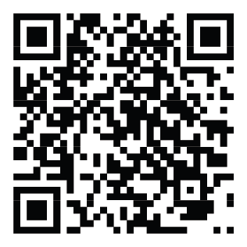
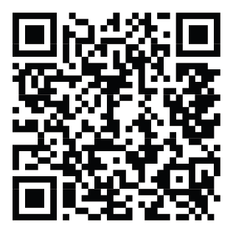
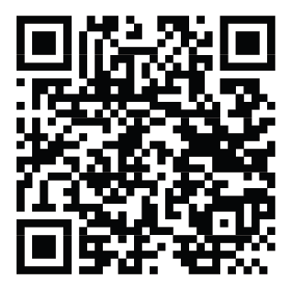
Mushroom production
In groups create an infographic flowchart to show the steps in the one of the stages of mushrooms production.
1
2
3
4
Choose one of the stages in mushroom production.
Making compost (substrate)
Growing and picking
Packing and transporting
Watch the video about your stage.
What information do you think was important?
Use dot points to write down the main steps of your stage of mushroom production.
Create a poster about your stage of mushroom production.
Include:
The steps in order.
Simple sentences to explain each step.
Pictures to show each of the steps.
Making compost
Growing and picking
Packing and transporting
25

Slide 26
Vocabulary
Something needs something else to live or happen. E.g. most living things are dependent on clean air, water, and sun to survive.
Dependent
The surroundings or conditions in which a person, animal, or plant lives.
Environment
How far food travels from where it is grown or made to where it is sold.
Food miles
Is a food that is good for us and the planet.
Future food
All the good things in food that help our bodies grow and be healthy, like vitamins and minerals.
Nutrients
Using resources in a way that is good for the planet now and for the future.
Sustainability
Click on the words to reveal the definition
26

Slide 27

Farm to plate
Listen to one of the farm to plate stories to discover the journey food takes.
How did that get in my Lunchbox?
Right This Very Minute
Use a Venn diagram to compare the farm to plate journey of a mushroom and another farm product.
27

Slide 28
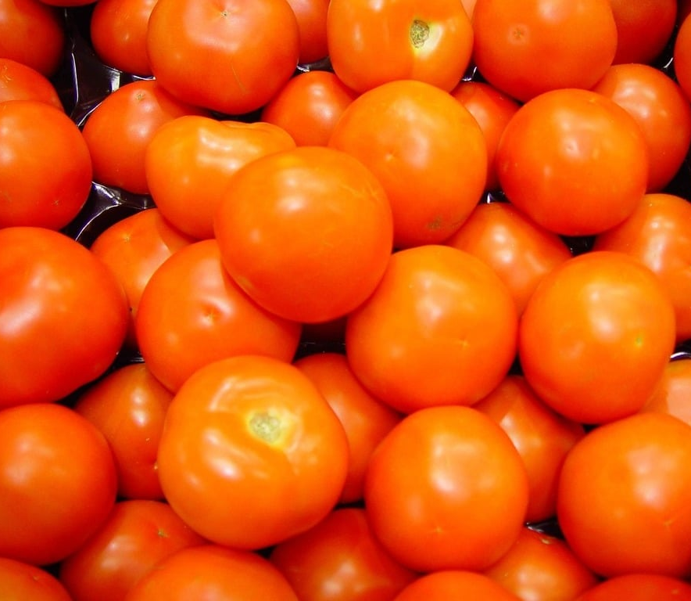
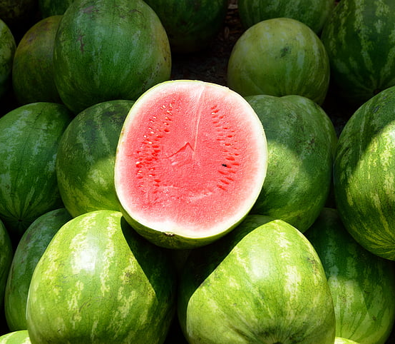
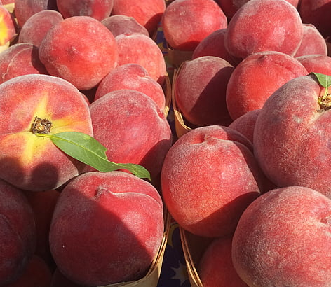
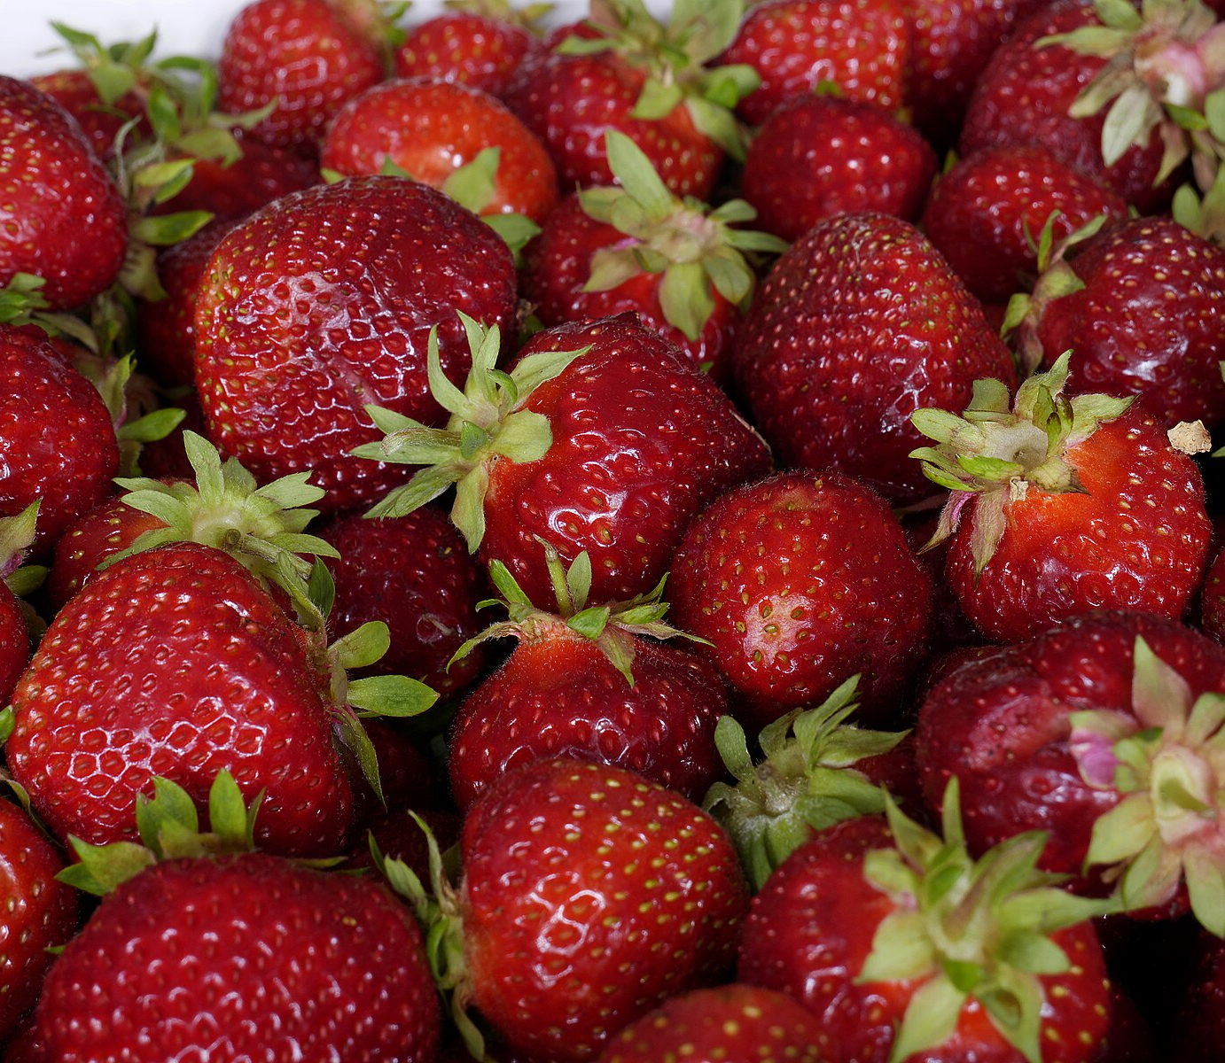
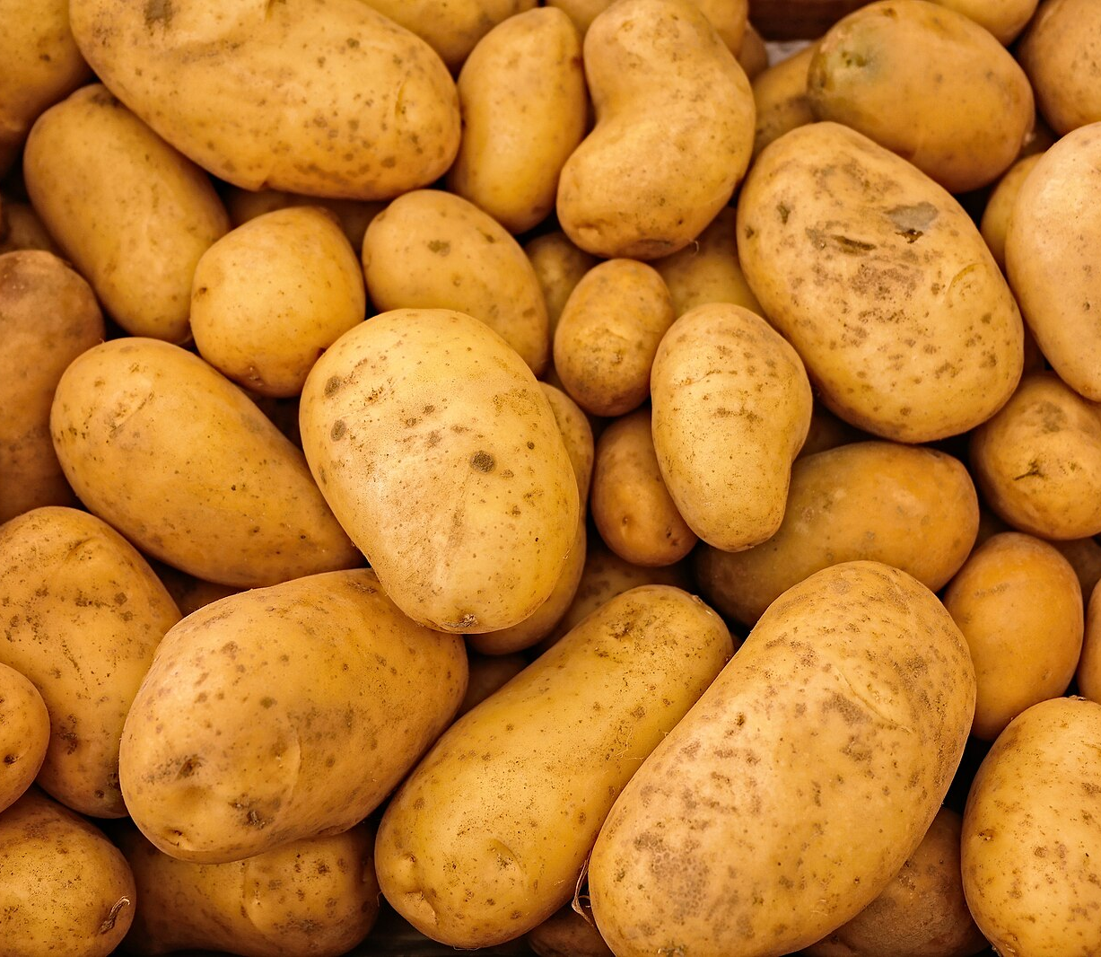
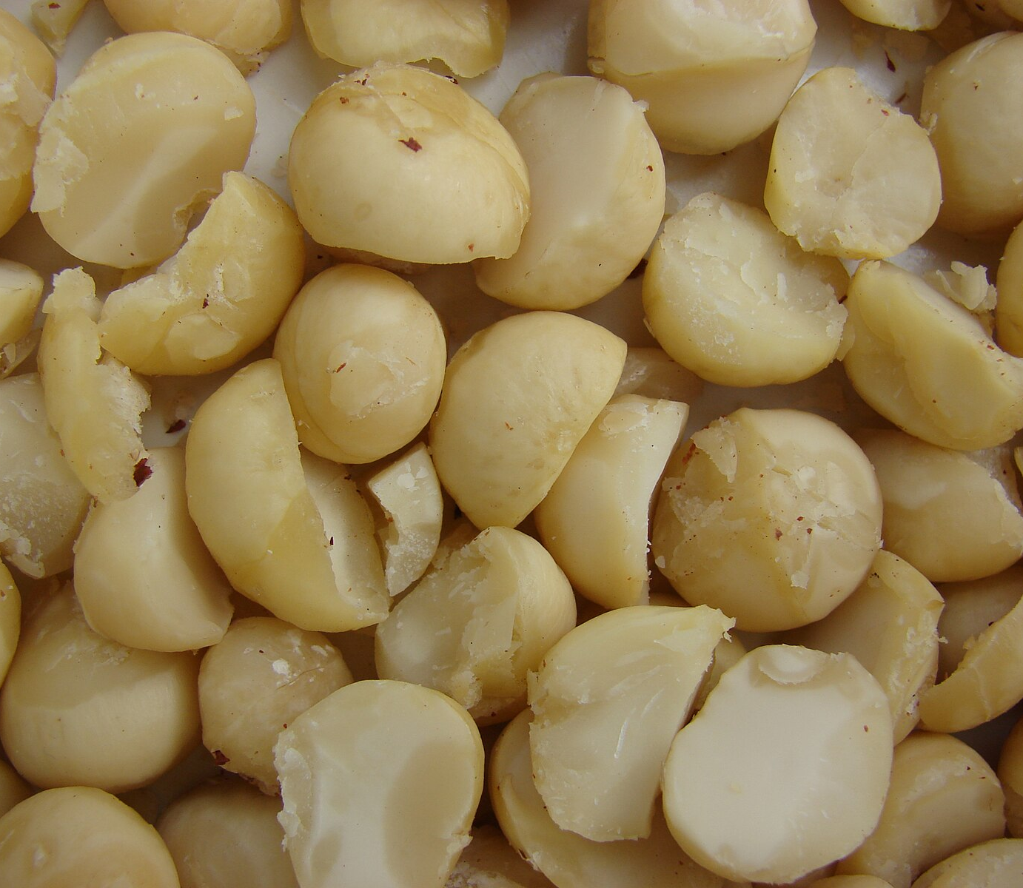
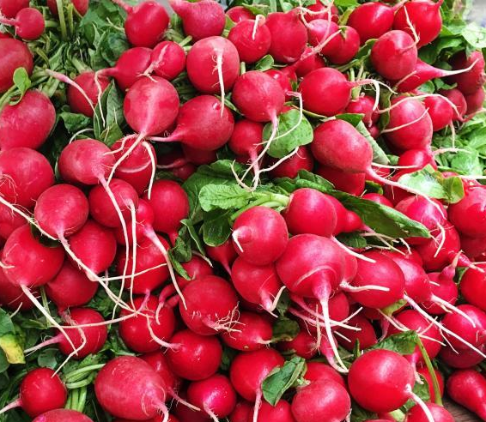

Where does it come from?
Can you guess which part of the world each of these originally comes from?
South America
North America
Tomatoes
Africa
China
Watermelon
Peaches
Strawberries
South America
Australia
Potatoes
Macadamia Nuts
Italy
England
Radish
Pears
28

Slide 29
Food miles and sustainability
Eating food grown close to home is important for our planet and our community.
Food Miles
Food miles are how far food travels from the farm to the shop. When food travels a long way, it uses vehicles that create pollution, which is bad for the Earth. Choosing food grown in Australia or locally means it doesn’t have to travel as far, so this creates less pollution.
Why is local food sustainable?
Sustainability means protecting the environment for the future. Eating local food helps us be more sustainable because:
It creates less pollution. Less travel means less air pollution from trucks and planes.
It's fresher and tastier. Local food can be picked at its best, so it's full of flavour and nutrients.
It creates jobs in the local community.
It helps local farmers. Buying from local farms helps support the people in your community.
Discuss: Why is it important to eat food that is grown locally?

Slide 30
Think-Pair-Share
Agaricus bisporus mushrooms are sourced and grown all year round in Australia, does this make them sustainable?
Mushrooms require less land than many other crops to grow. Farmers can grow up to 6 crops per year in the one growing room.
Mushroom substrate is made from recycled materials from other farms (e.g. straw and chicken litter) that might otherwise be waste.
They have lots of nutrients.
The water used in mushroom farms can often be collected and reused.
They are grown in controlled and monitored environments so they can grow all year round.
Most mushroom farms use solar power during the day
Mushrooms grow very quickly, they double in size every day, which means farmers can produce a lot of food very quickly.
Mushrooms are considered a sustainable food source because they are grown indoors where the temperature, water, and air can be controlled making it perfect for them to grow as they are not dependent on seasonal weather or external factors. They are considered a future food as they are good for us and the planet.
When the farmers have finished growing the mushroom crop, they sell the substrate to other farmers to use, to grow more food.
30

Slide 31

Worksheet
31

Slide 32
Vocabulary
Special helpers in food that keep our bodies healthy and strong.
Antioxidants
Is found inside the mushroom's cells and acts as a fibre when we eat mushrooms.
Chitin
How our bodies break down food so we can get energy and grow.
Digestion
Being in contact with something, like being in the sun.
Exposure
A part of plant food that helps our tummies work well.
Fibre
Having a happy and healthy tummy.
Gut health
Click on the words to reveal the definition
32

Slide 33
Vocabulary
The part of our body that fights off sickness and keeps us from getting ill.
Immune system
Being strong and not getting sick easily because your immune system is working well.
Immunity
Important tiny things in food that our bodies need to stay healthy, like calcium for strong bones.
Minerals
Food that is full of good things (nutrients) that are good for you.
Nutritious
Different kinds of helpers in food that do special jobs to keep our bodies healthy, like Vitamin D that helps make our teeth and bones strong.
Vitamins
Click on the words to reveal the definition
33

Slide 34

Vitamins and minerals
34

Slide 35

Vitamins and minerals
Our bodies need vitamins and minerals to be strong and healthy.
Your body which is made up of cells, tissues, organs, bones and many other parts needs vitamins and minerals to work.
What are vitamins and minerals?
Vitamins are made by plants and animals.
Minerals come from the soil and water they are absorbed by plants which are then eaten by animals.
Vitamins and minerals are found in the food we eat.
Different foods have different vitamins and minerals.
Our bodies need different amounts of different vitamins and minerals.
Vitamins and minerals support our body’s immune system so we don’t get sick. They also help us grow and develop.
It’s important to eat a variety of foods so we get the right balance of vitamins and minerals and other nutrients that our bodies need.
35

Slide 36

Healthy Eating
Grain foods: Foods like bread, pasta, and oats give you energy that lasts a long time. They're like the fuel for your body's engine.
Vegetables and legumes: These foods give you lots of vitamins and minerals. Think of them as your body's shield, helping to protect you from getting sick.
Eating a variety of foods is like having a team of superheroes to help your body! Each food group has special powers that help you grow big and strong.
Why is it important to eat from the different food groups
Eating from all five of these food groups every day makes sure your body gets all the different nutrients it needs.
A varied diet helps you:
Feel your best. When you eat well, you have more energy and feel ready to play and learn.
Grow and develop normally. All the different nutrients help your body and brain grow properly.
Stay healthy. Eating a variety of nutritious foods can help reduce your risk of getting sick and keep you feeling good for a long, long time.
Fruit: Fruits are full of natural sweetness and also have lots of vitamins. They give you energy to run, jump, and play.
Lean meats, chicken, fish, eggs, tofu, nuts, and seeds: These foods are your body's building blocks. They help your muscles and bones grow strong and healthy.
Click here to learn more
Milk, yoghurt, and cheese: These are great for building strong teeth and bones, which are super important for growing kids.
36

Slide 37


Mushrooms are a superfood
Are mushrooms a vegetable?
Mushrooms are fungi and have a special place in food groups.
Mushrooms are unique and, even though they are often white, they are full of special nutrients that our bodies need.
Mushrooms can provide our body with a unique combination of nutrients that other foods can’t – therefore a superfood!

Slide 38









Mushrooms are a superfood
Brain & mood
Energy & metabolism
Gut & digestion
Heart & cardiovascular
Immune system
Teeth & bones
Nervous system
Hair, skin & nails
Muscles & activity
A
B
C
D
Mushrooms contain antioxidants that keep our body and immune system healthy.
Mushrooms contain B vitamins that give us energy. They also help our brain to work well.
Mushrooms contain fibre that helps our gut health and keeps our tummies happy.
Mushrooms are the only non-animal food with vitamin D. They help make our teeth and bones strong.

Slide 39





Mushrooms supercharge in the sun!
Vitamin D
Is known as the sunshine vitamin because you can get it from being outside in the sunshine.
Our bodies are able to produce vitamin D when we expose ourselves to sunlight.
We can make vitamin D in our skin when we are in the sun.
Mushrooms can make vitamin D just like us, because they are biologically closer to humans and animals, than they are to plants.
Sun
Put mushrooms in direct sunlight – whole stem side up, or slided. 15 mins in bright peak sunlight (longer, e.g. one hour, in lower light.) Exposure to sunlight helps mushrooms make vitamin D.
Store
You can put the mushrooms in the fridge after they've been in the sun. The vitamin D they make will stay for about a week. You can also use them right away.
Use
Eat however you enjoy mushrooms – raw or cooked.
Buy
from your local shop or market.
39

Slide 40


Worksheet
40

Slide 41
Mushroom quiz
1. Mushrooms are a type of vegetable.
2. Mushrooms are the only plant-based food that naturally contains vitamin D.
3. Eating mushrooms can help keep your immune system strong.
4. Mushrooms contain B Vitamins that give you energy.
5. Mushrooms have no fibre, so they don’t help your digestion.
False - they are fungi!
True
False
True - they make vitamin D from sunlight!
True
False
True - they contain antioxidants
True
False
True - they make vitamin D from sunlight!
True
False
False - they contain fibre, which helps your gut
True
False

Slide 42
Mushroom quiz
6. Eating mushrooms can help give you energy.
7. Mushrooms contain vitamin D which helps make my bones strong.
8. Exposure to sunlight helps mushrooms make vitamin D.
9. You need to eat lots of coloured fruit and vegetables to stay healthy.
10. White foods like mushrooms are important for our health.
True - they contain B vitamins, which help your body use energy!
True
False
True
True
False
True
True
False
True
True
False
True
True
False

Slide 43
Vocabulary
A strong, sometimes sharp taste like coffee without sugar or very dark chocolate.
Bitter
The ways we explore the world (sight, smell, touch, taste, hearing).
Senses
This is a rich, full flavour that isn't sweet, sour, or bitter. Cooked meat, cheese and mushrooms are savoury.
Savoury
How something feels when we touch or eat it (smooth, bumpy, crunchy, soft).
Texture
A special savoury taste, like the taste of mushrooms or soy sauce.
Umami
Click on the words to reveal the definition
43

Slide 44

Mushroom tasting
Before the mushroom tasting station discuss:
Have you ever eaten a mushroom before?
What do you imagine it tastes like?
Do you think all mushrooms taste the same?
After the mushroom tasting station discuss:
How does the flavour change between button, flat, swiss, and portobello mushrooms?
44

Slide 45

Worksheet
45

Slide 46





What is Umami?
Did you know there are five different tastes?
Can you guess what they are?
Sweet
Sour
Bitter
S
S
B
lollies, cake, ripe bananas
plain yoghurt, lemon, kimchi
dark chocolate, coffee, kale
Umami is a yummy savoury taste - like cheese, vegemite or mushrooms.
Umami
Salty
U
S
mushrooms, parmesan cheese, seaweed
potato chips, bacon, pretzels

Slide 47

Mushroom Cooking
Watch this video to learn how to cook mushrooms!

Slide 48






Classroom cook up
Teriyaki Mushroom Sushi Rolls
Cheesy Mushroom Quesadillas
Mushroom Omelette Wrap
Here are some simple mushroom recipes you might want to try.
Recipes
48

Slide 49
Congratulations!
You are now a Mini Mushroom Grower
Download certificate
Teacher feedback
Click on the link to complete the teacher and student post-survey with your class.
Student survey
49

