Slide 1





Supporting Resource Pack
Use this Years 5 - 6 supporting resource pack in conjunction with the teacher guide to seamlessly explore and access all lesson materials.
Proudly brought to you by:
This project has been funded by Hort Innovation using the mushroom research and development levy and funds from the Australian Government.

Slide 2
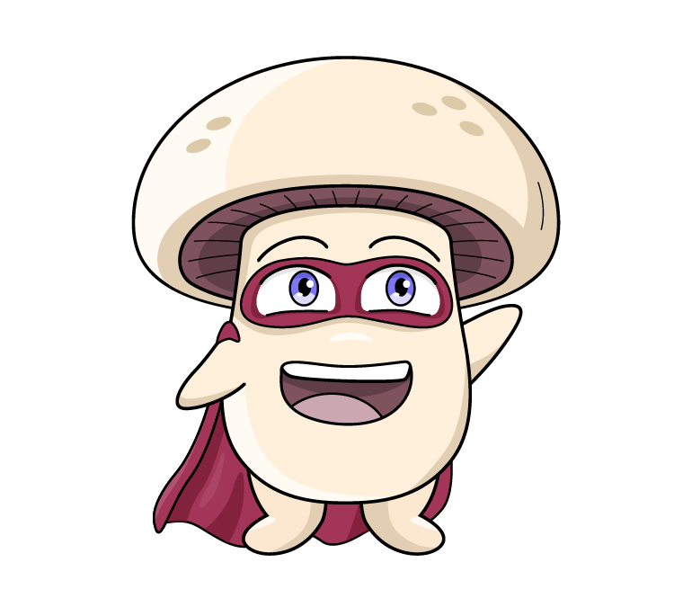

Contents
Lesson 1: Mushrooms are Fun-guys
Lesson 2: Let’s Visit a Mushroom Farm
Lesson 3: There’s Mush-room for Sustainability
Lesson 4: Mushrooms are a Superfood
Lesson 5: Mini Mushroom Chefs
Click on the link to complete the pre student survey with your class.
Student survey
2

Slide 3

Click on the words to reveal the definition
Vocabulary
The top of the mushroom.
Cap
An ecosystem is made up of all the living and nonliving things in an area.
Ecosystem
Something that is safe to eat.
Edible
To look for food, especially in the wild.
Forage
To look for mushrooms, but not eat or touch them.
Foraying
A special group of living things that includes mushrooms. They are not plants or animals.
Fungi
The thin layers under the cap where spores are made.
Gills
Hyphae are the feathery, hair-like threads that branch out, and form the large network called a mycelium. Each hyphae help the mushroom get food by releasing enzymes to break it down and absorb the nutrients.
Hyphae
3

Slide 4
Click on the words to reveal the definition
Vocabulary
The part of a fungus that we can see above the ground, usually with a stem and a cap.
Mushroom
The tiny, thread-like parts of a mushroom that grow underground or inside something else, like roots. Mycelium is the living organism, which forms into a mushroom.
Mycelium
When very tiny mushrooms, called ‘pins’, first start to grow and look like little bumps.
Pinning
A cereal grain which is coated with mycelium, to allow the mycelium to grow through the substrate.
Spawn
Very tiny, dust-like particles that mushrooms use to make new mushrooms. Think of these like tiny seeds of a plant.
Spore
The stalk part of the mushroom, that joins the mycelium to the cap. Like a tree trunk joins roots and branches. Mushroom growers call the stem a ‘stipe’.
Stem
The special material or food that mushrooms grow on, like wood or compost.
Substrate
A ring of tissue that joins the cap to the stem of the mushroom.
Veil
Is a layer of tissue that protects the mushroom as it grows out of the ground.
Volva
4

Slide 5
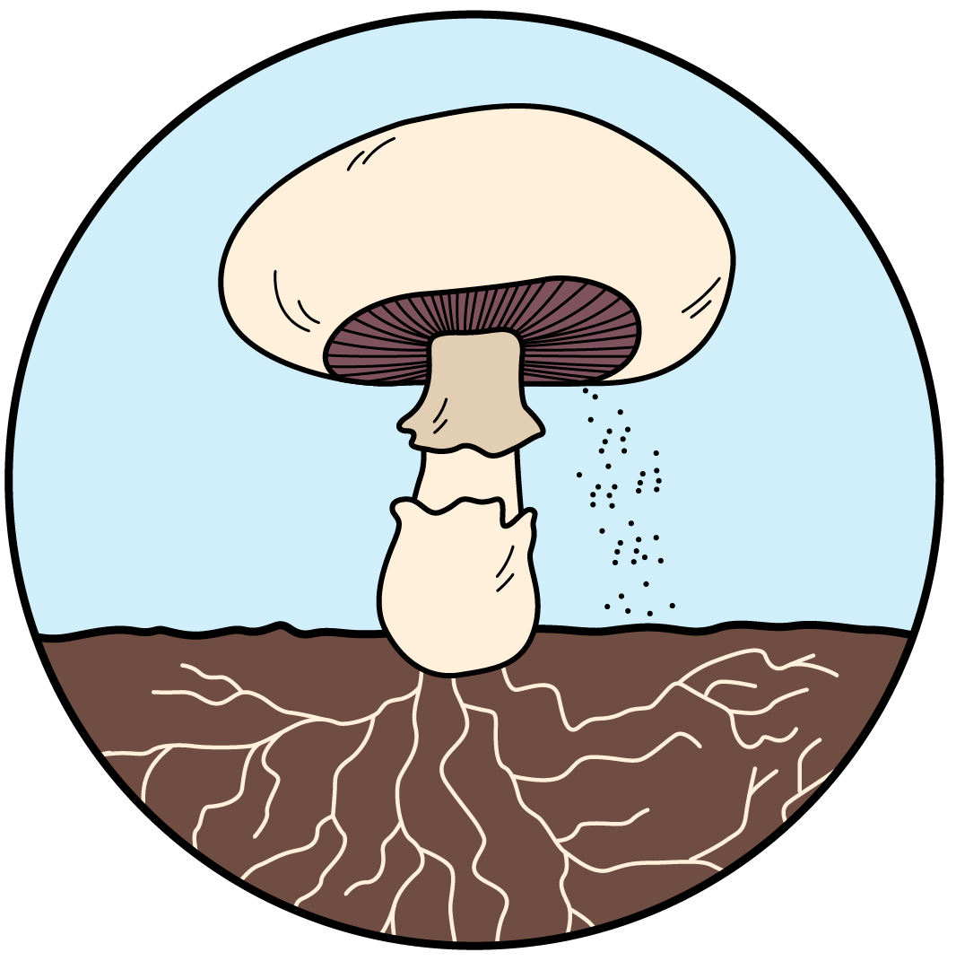


Parts of a Mushroom
Gills
are the thin layers under the cap. This is where spores are made.
Cap
is the top of the mushroom. It protects the spores.
Stem
holds up the cap.
Veil
this is a ring of tissue that connects the mushroom stem and the cap.
Volva
is a layer of tissue that protects the mushroom as it grows out of the ground.
Spores
are similar to a seed.
Mycelium
are the underground part of the fungus, like roots.
5

Slide 6
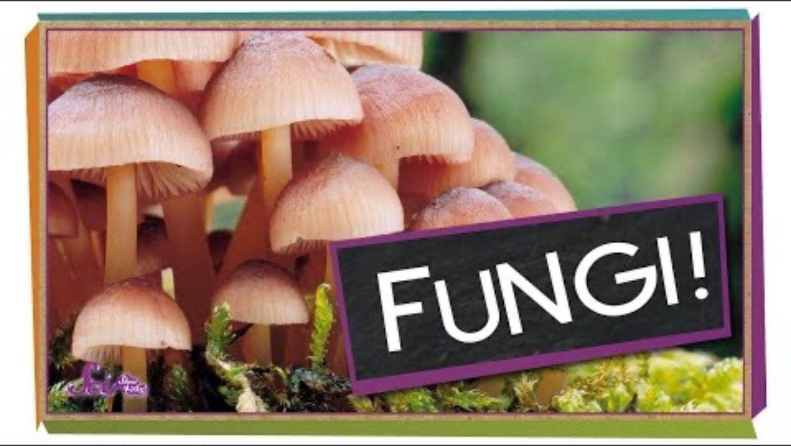

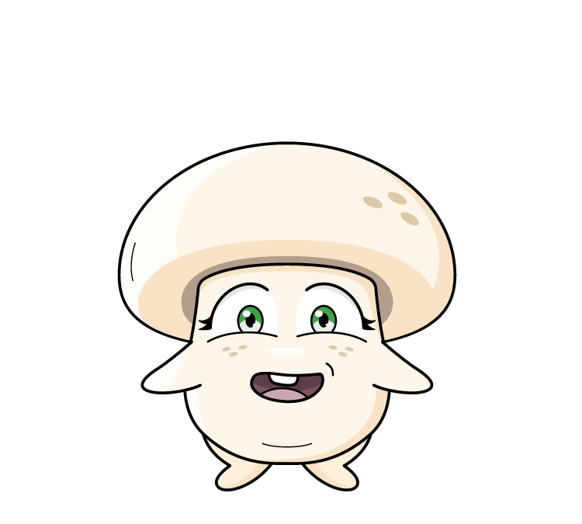
Are Mushrooms Plants?
Are mushrooms plants?
What do you know about mushrooms?
6

Slide 7
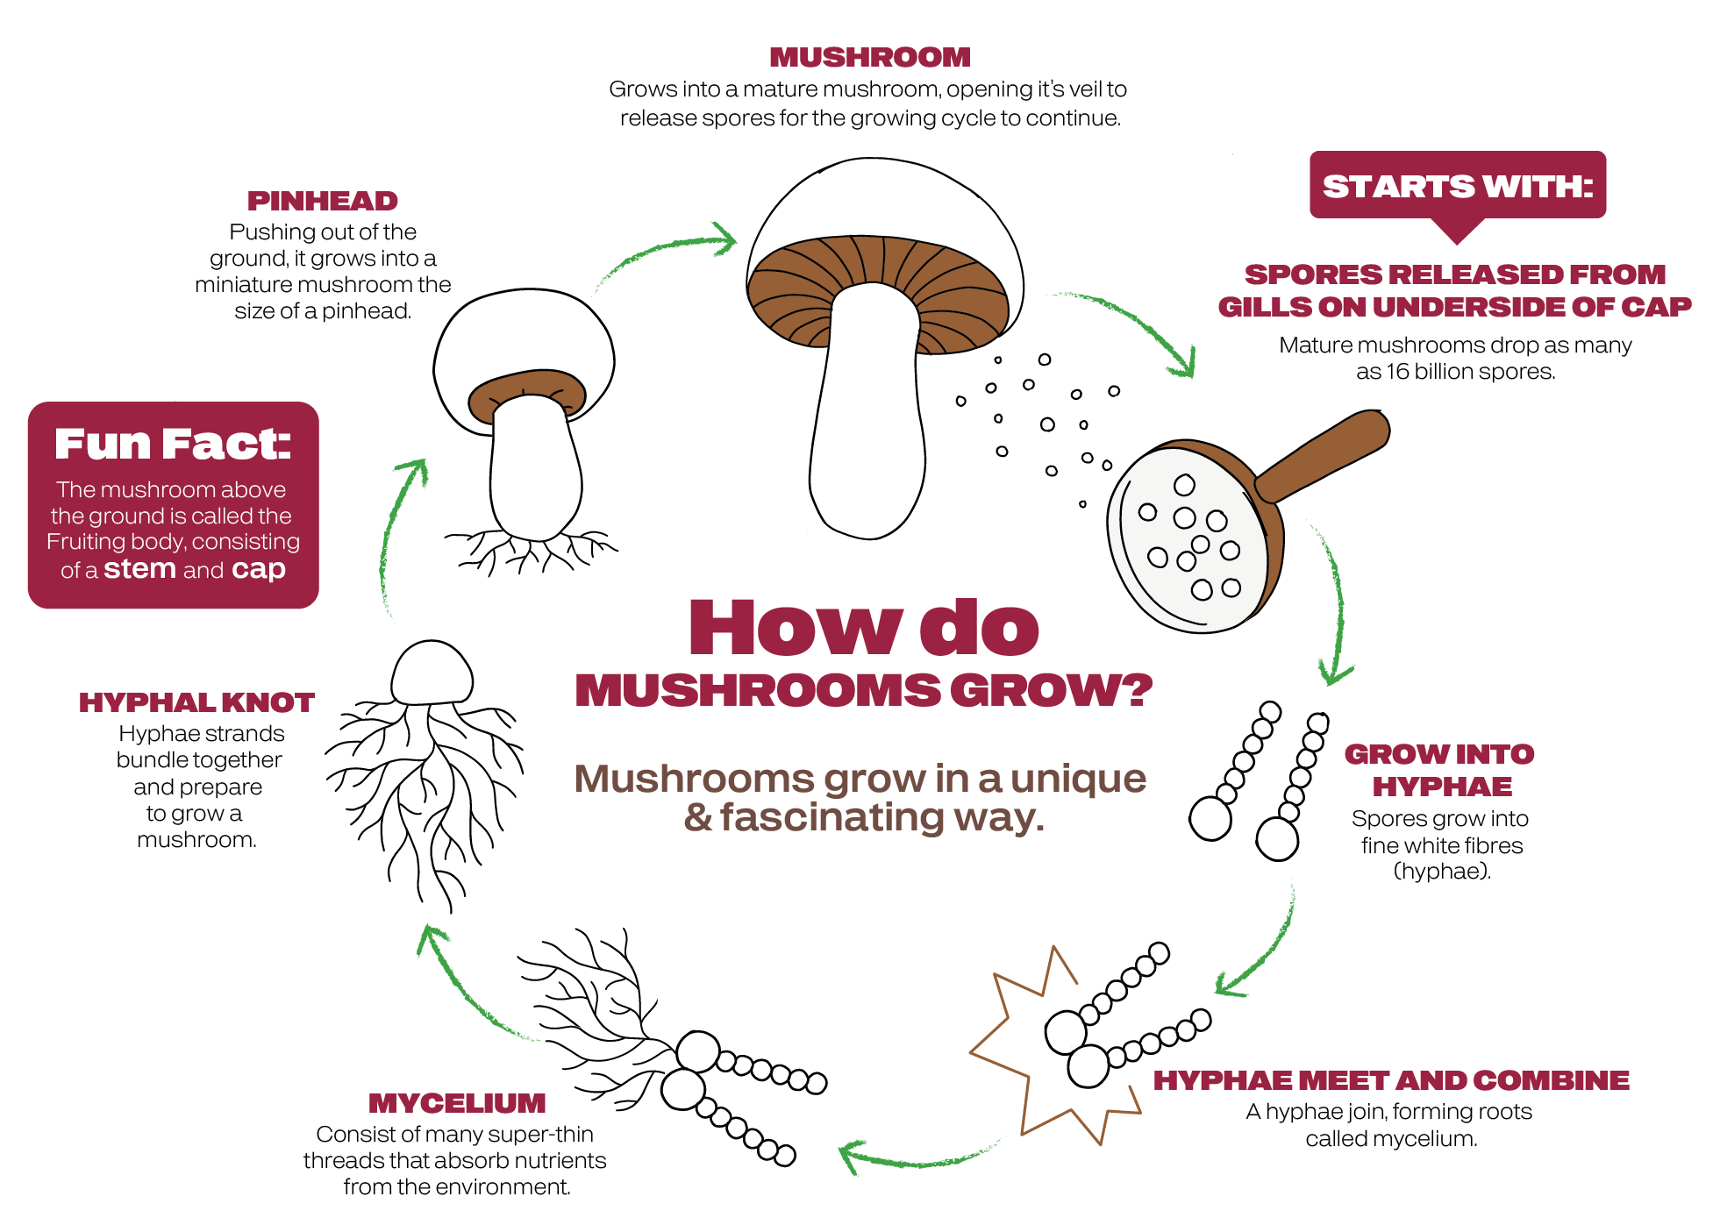
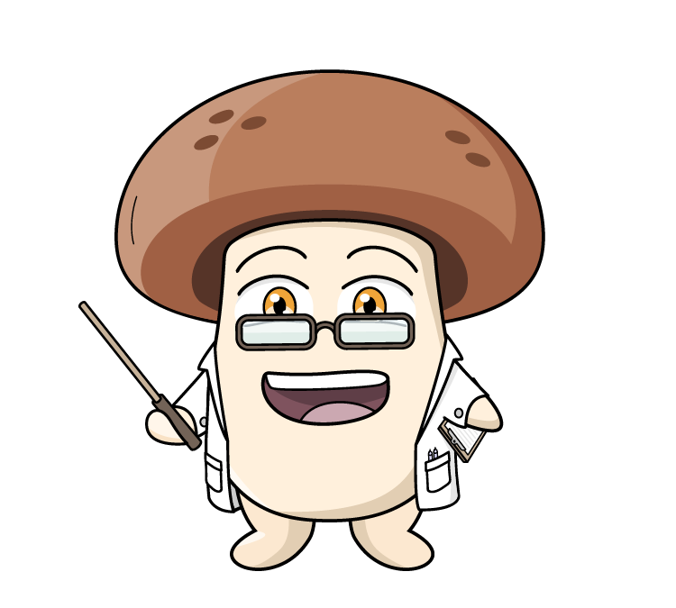
The Mushroom Lifecycle
7

Slide 8
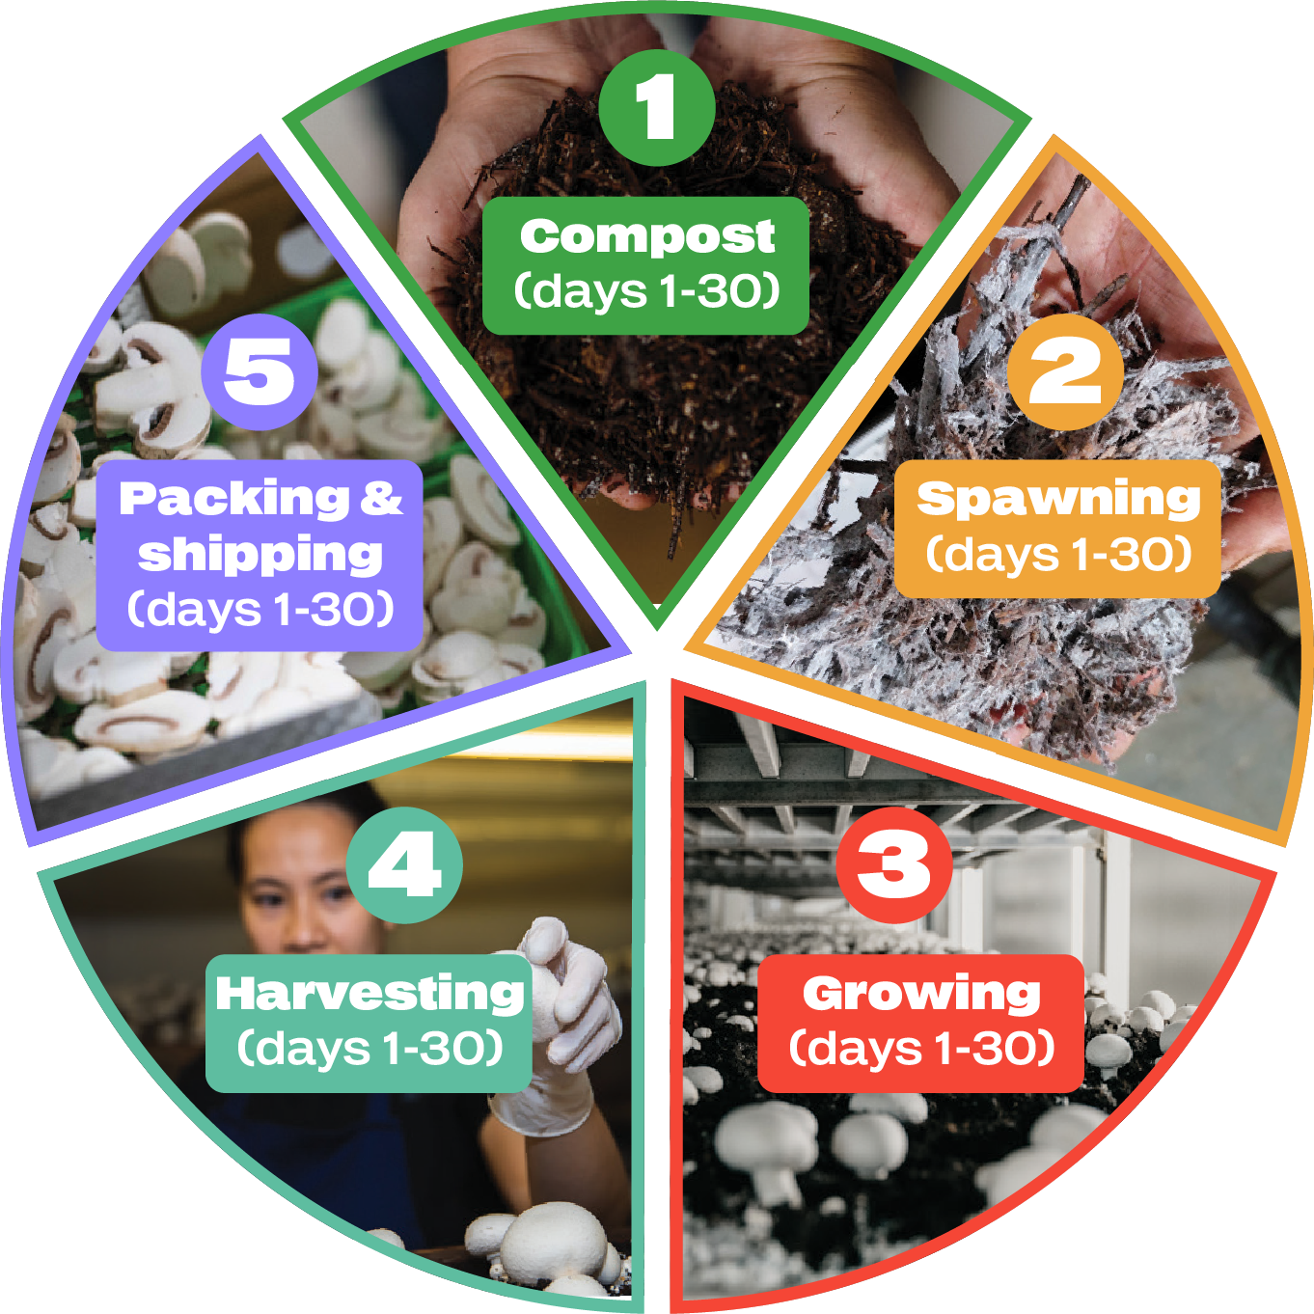



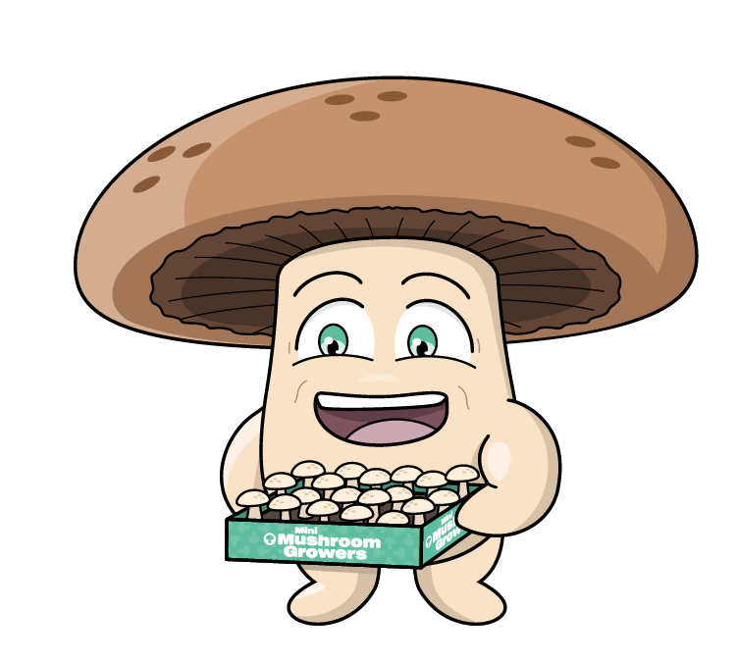


The Mushroom Life Cycle
Recycled waste from other farms (straw and poultry manure) is made into compost (which growers refer to as substrate) which is pasteurised before use for mushroom growing. At the end of mushroom production, compost is sold to other farms or nurseries for use as a growing medium for other crops.
Commercial mushroom growers use spawn that is propagated from mycelium onto a sterilised cereal grain, which are produced under controlled conditions.
The spawn is mixed through the compost. Mycelium then colonises the compost, after which, the mushrooms form.
Click the + buttons to learn more
Mushrooms are packed and immediately refrigerated. Shipped within 24 hours of being harvested.
Substrate removed and on sold as a growing medium for other crops.
At harvest end, growing rooms are steamed at 65°C to eliminate pest contamination.
Carefully harvested by hand.
Mushrooms double in size daily.
Growing rooms have long shelves called growing beds, stacked 4 to 8 beds high.
Colonised compost is extruded into the beds. A casing layer is applied on top, to promote the mushroom fruit body.
8

Slide 9

What is Mycelium?
Fruiting Body
Mycelium is the key stage in the mushroom life cycle. It consists of an intricate web of tiny, thread-like parts. As it develops mycelium supports the growth of the fruiting body that produces spores.
Mushrooms belong to the fungi kingdom.
Mycelium is the living organism, which forms into a mushroom.
Mycelium also supports the health of the surrounding ecosystem by recycling nutrients into the food chain.
It is the main part of the mushroom and supports the health, vitality and immune response of the mushroom.
Mycelium
9

Slide 10
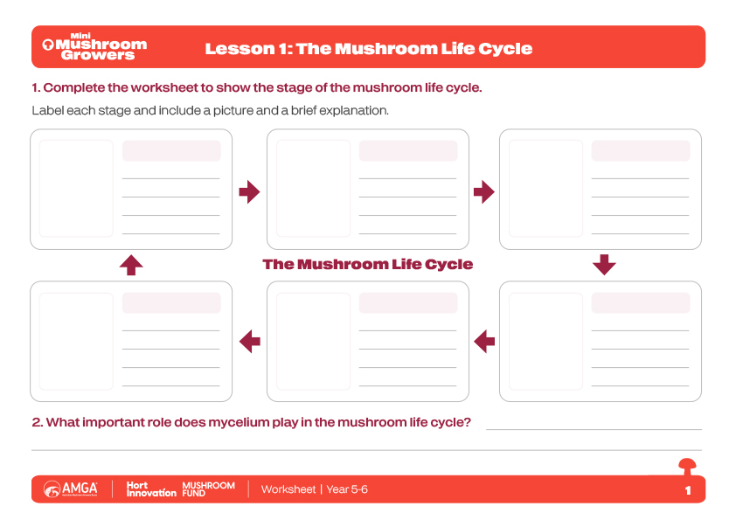
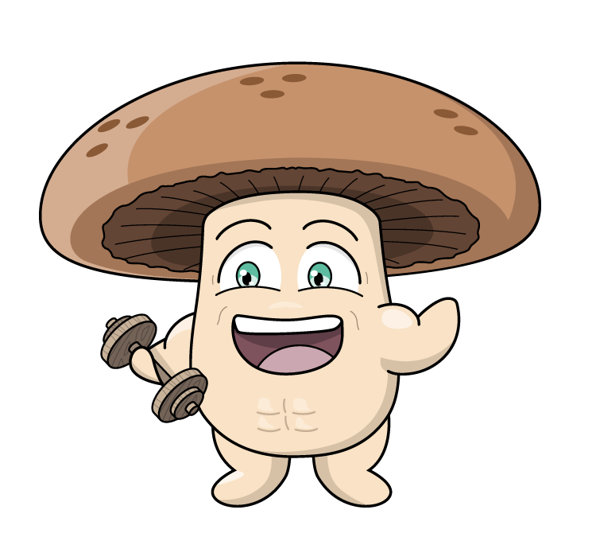
Worksheet
10

Slide 11
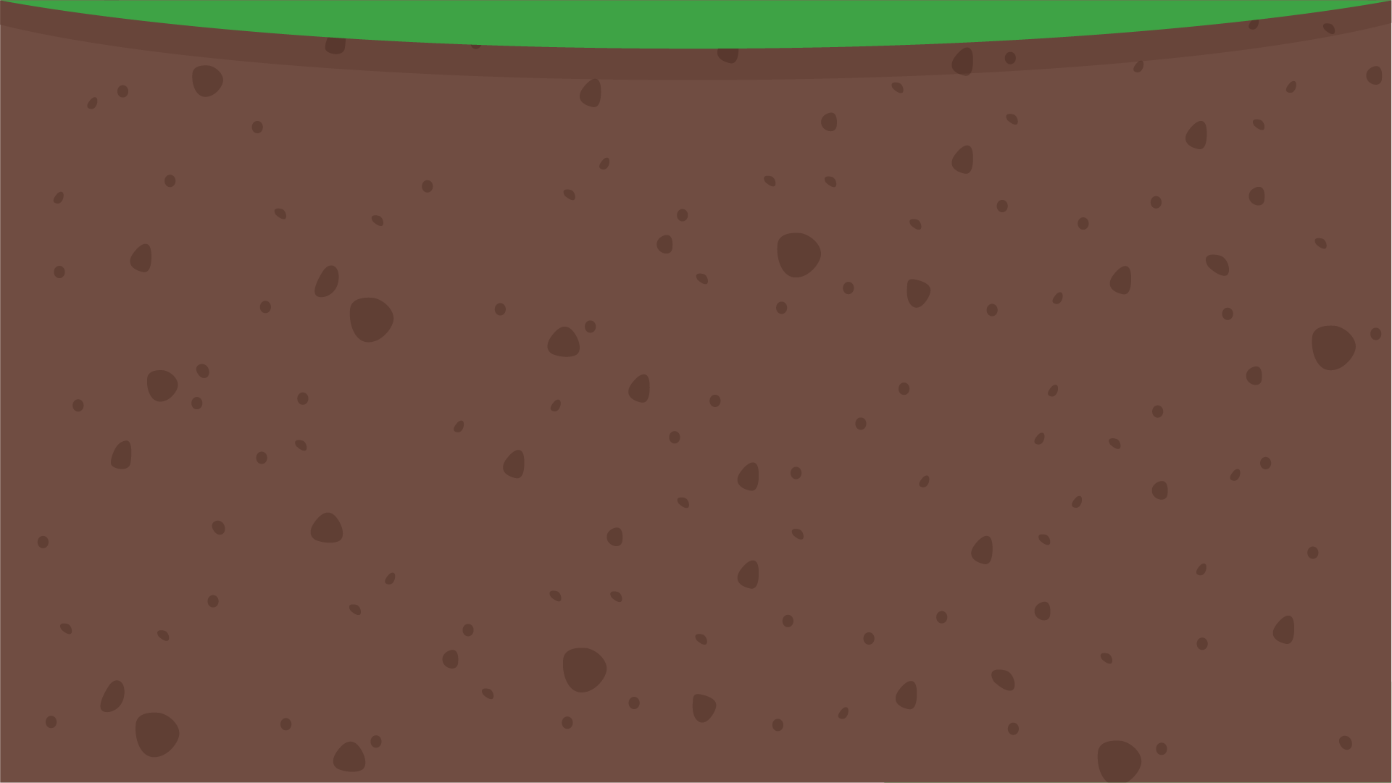



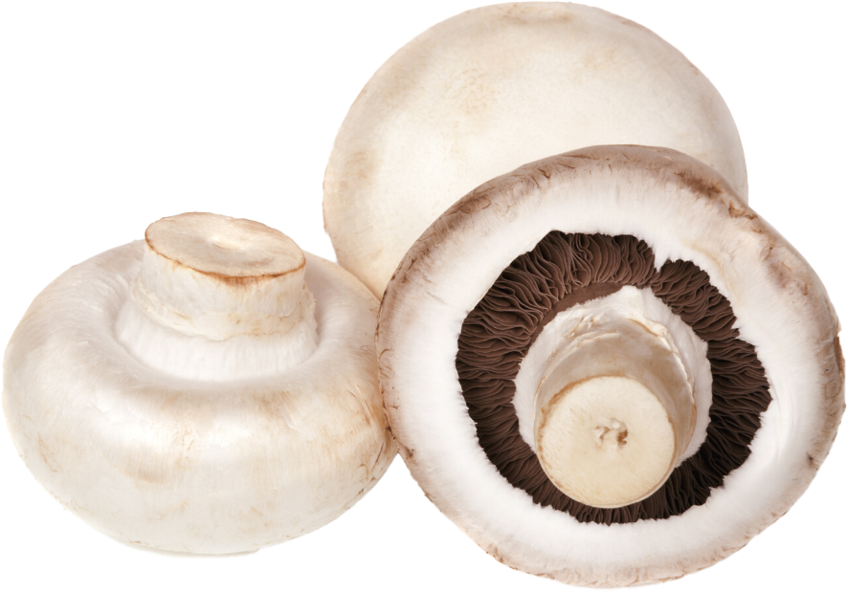
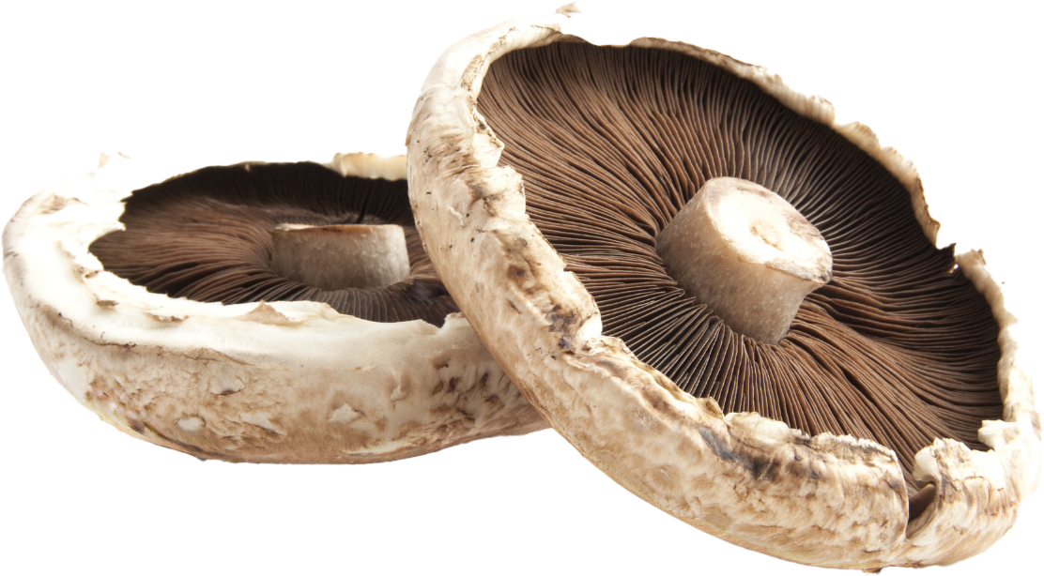
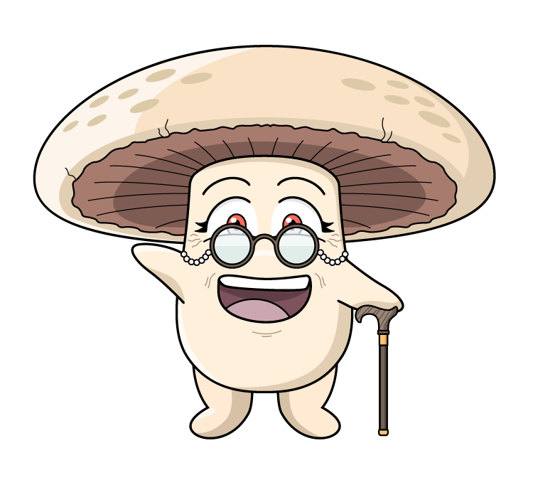
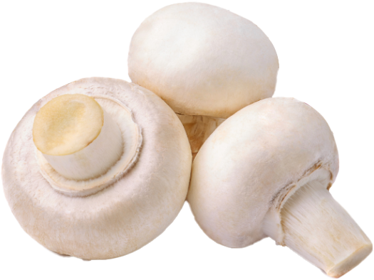
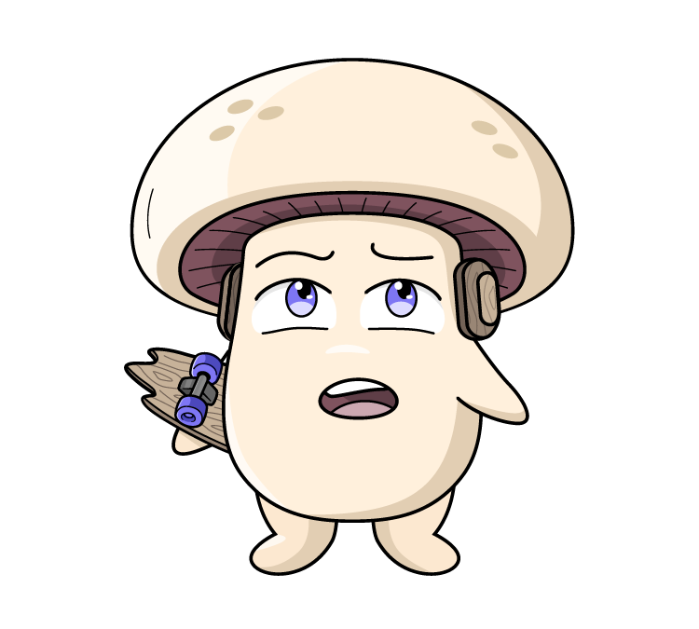
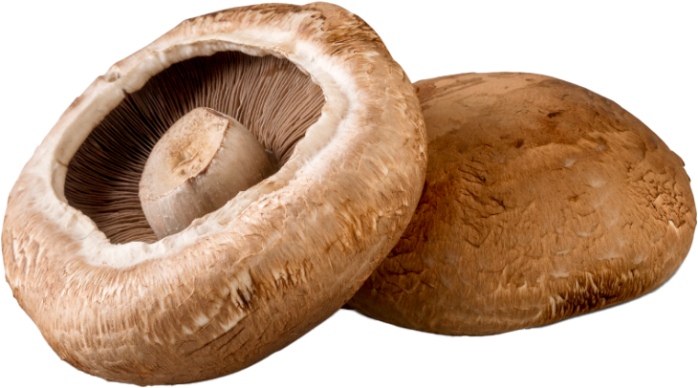
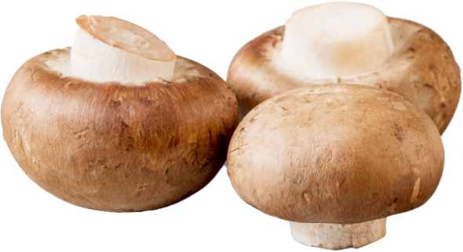

What do you know about mushrooms?
What am I?
Can you name these mushrooms?
These are Agaricus bisporus mushrooms.
Agaricus bisporus - pronounced - Ahh-gar-ikus bye-spore-us
Australian grown mushroom varieties (white, Swiss brown and portobello) are the same species Agaricus bisporus! The difference is simply their
stage of harvesting. Mushrooms double in size everyday.
Button
Cap
Flat
The white Agaricus bisporus starts off as a little white button mushroom and grows to become a cup, and then grows to become a large flat mushroom.
The Swiss brown mushroom, grows to become a portobello. The only difference is one is brown in colour, the other is white.
Swiss brown
Portobello
11

Slide 12

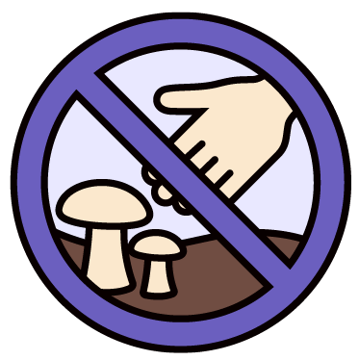
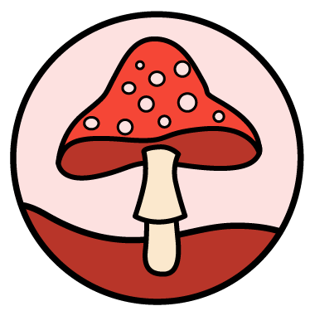


Don’t touch! Don’t eat!
What are the dangers of foraging for mushrooms in the wild?
Not all mushrooms are safe to eat:
Just because a mushroom looks pretty or looks like one from a shop doesn't mean it's safe.
Never touch or pick wild mushrooms:
Never touch or pick any mushrooms you see growing outside, even in your own garden.
If you see a wild mushroom, tell a grown-up:
That way the adult can make sure everyone stays safe.
Only eat mushrooms from the shop:
These mushrooms have been grown by experts and are safe to eat.
Mushrooms are special living things:
While some wild mushrooms are dangerous for humans to eat, they are still important parts of nature for other animals and plants.
Don’t forage - enjoy foraying – look but don’t touch!
12

Slide 13

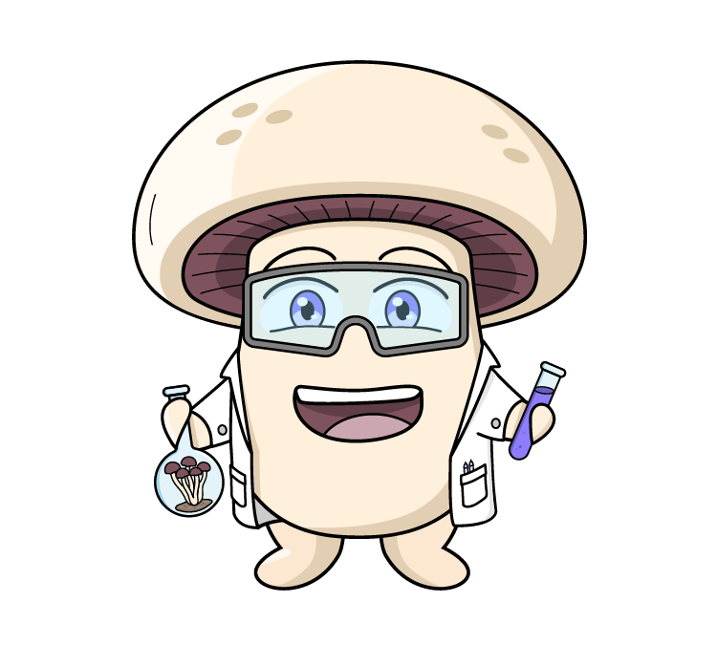
Fascinating Fungi Facts
The living organism is the mycelium. When the mycelium reaches a point of maturity or if it thinks it is going to die (like a change in temperature, moisture or Co2), the mycelium goes through its fruiting stage - it shoots up a mushroom - so it can grow to release the spores. It’s a survival mechanism, and the reproductive cycle of the fungus.
Mycelium are the tiny, thread-like parts of a mushroom that grow underground or inside something else, like roots. Mycelium is the living organism, which forms into a mushroom.
Mushroom mycelium is the immune system of the Earth! It supports the health of the surrounding ecosystem by providing nutrients to its surrounding environment.
Fungi grow by breaking down their food, like leaves, compost and other substrates. Mushrooms are the fruiting bodies of fungi.
Fungi are not plants or animals. They belong to a separate biological kingdom to plants and animals.
They can grow in the dark because they don’t need sunlight.
13

Slide 14
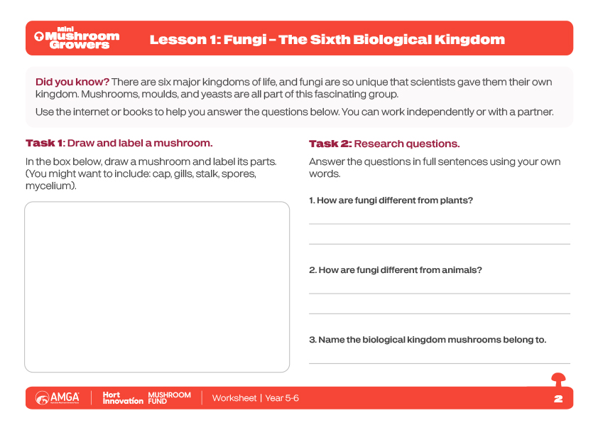
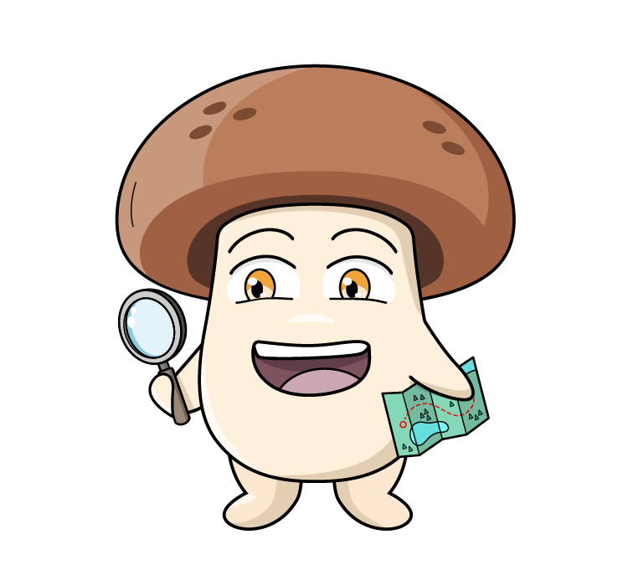
Worksheet
14

Slide 15
Vocabulary
Growing plants and raising animals for food, clothing or other products.
Agriculture
Technology used to help farmers grow food more easily or efficiently.
Agricultural technology (Ag tech)
Big changes in the world’s weather over time, like warmer temperatures or stronger storms.
Climate change
A person who buys or uses goods and services.
Consumer
A business or project that people work on to make or sell something.
Enterprise
The steps food goes through from being grown or made to reaching your plate.
Food supply chain
Click on the words to reveal the definition
15

Slide 16
Vocabulary
Using technology to make, improve or cook food.
Food tech
A new idea, method or invention that makes something better.
Innovation
Making products in large numbers, usually in a factory.
Manufacturing
To change something completely in a way that makes it much better or different.
Revolutionise
Using resources in a way that is good for the planet now and for the future.
Sustainability
Click on the words to reveal the definition
16

Slide 17
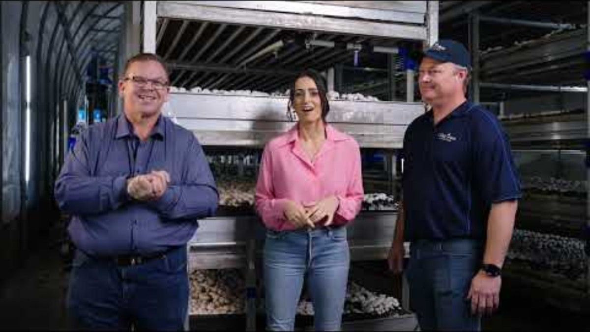
Farm to Plate
What have we learned about farm to plate?

Slide 18

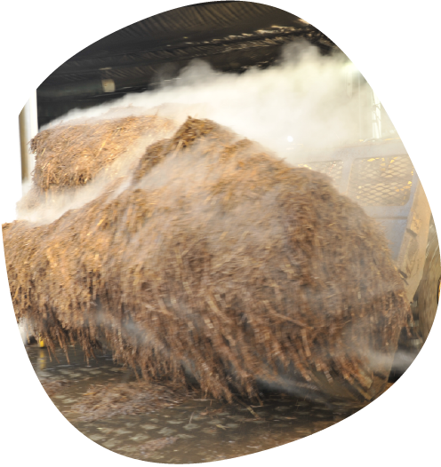
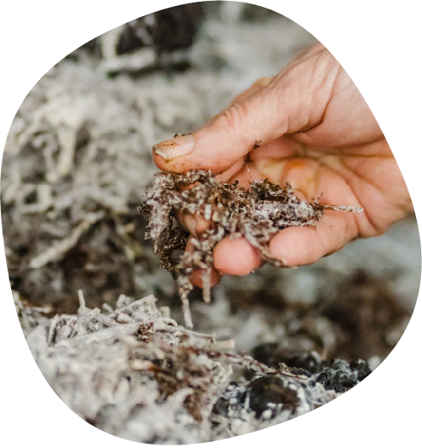
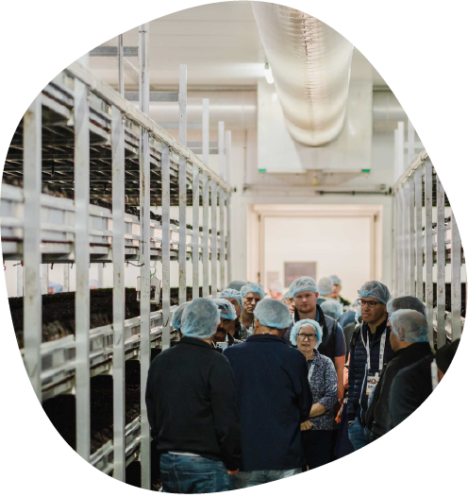
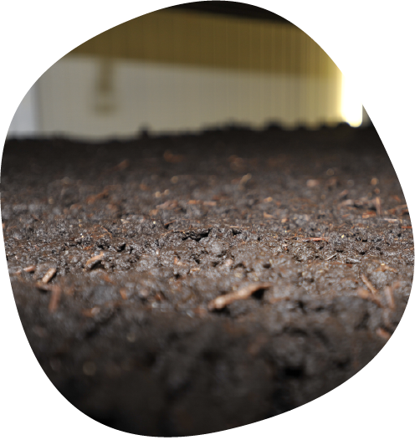
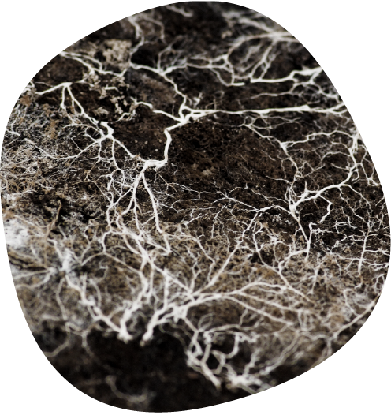
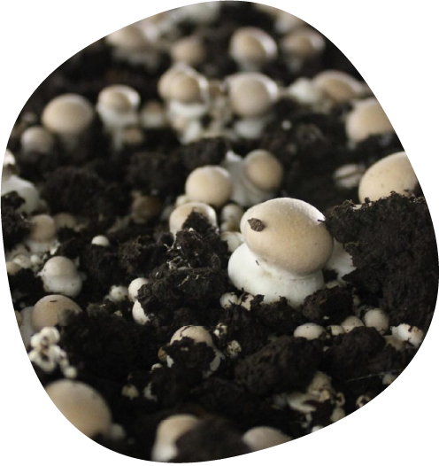
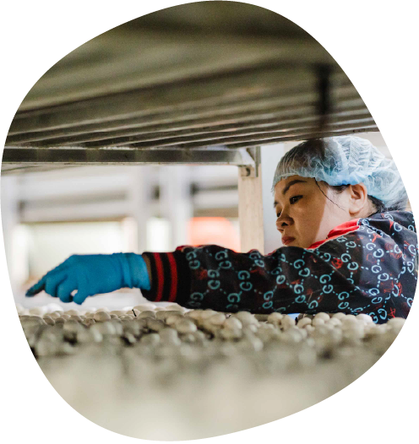
The Steps to Mushroom Farming
1. Substrate
The farmer prepares the compost called substrate to grow the mushrooms. They mix things like straw and chicken litter together and load it into special tunnels for it to start composting. Substrate is the food source for the Agaricus bisporus mushroom
5. Mycelium forms
The mycelium then begins to grow and spread. These are tiny, thread-like parts of a mushroom that grow underground or inside something else, like roots. Mycelium is the living organism, which forms into a mushroom.
6. Pinning
After about 2 weeks the mycelium in the casing layer begins to form tiny mushroom fruiting bodies, known as pins. The pins look like small, white blobs or ‘pinheads’ and will eventually grow into full-sized mushrooms.
2. Spawning
Once the compost process is finished, mushroom spawn is added. Spawn is a cereal grain which is coated with mycelium, to allow the mycelium to grow through the substrate. Agaricus bisporus spawn is produced commercially.
7. Harvesting
After a few days, the pins form into mushrooms - baby buttons, then cups, then flats. The mushrooms are harvested every day. The mushrooms grow in cycles called a 'Flush'. There are three 'flushes' in one mushroom crop.
3. Indoor growing rooms
Farmers use indoor growing rooms with carefully controlled temperature and humidity, air flow and watering techniques to grow the mushrooms. They load the substrate onto long metal shelves, stacked up like bunk beds.
4. Casing
The substrate is then covered with a layer of casing soil. Casing soil is very important. Without this, the mushrooms will not grow.

Slide 19



Mushroom Production
What are the three key elements managed in mushroom farming?
How and why do growers monitor this?
1
2
3
Watch your group’s video about one of the key procedures managed in mushroom farming.
Take notes and write down at least 2 - 3 important facts or ideas about:
This stage of mushroom production
How and why growers monitor this.
Report back to the class about your findings.
Group 1 | Group 2 | Group 3
Making compost (substrate) | Growing and picking | Packing and transporting
19

Slide 20
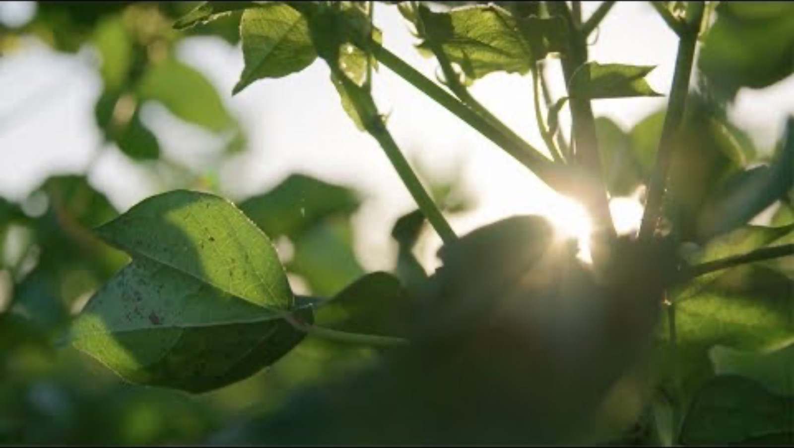
Farm to Plate
What are the messages around technology in agriculture?

Slide 21
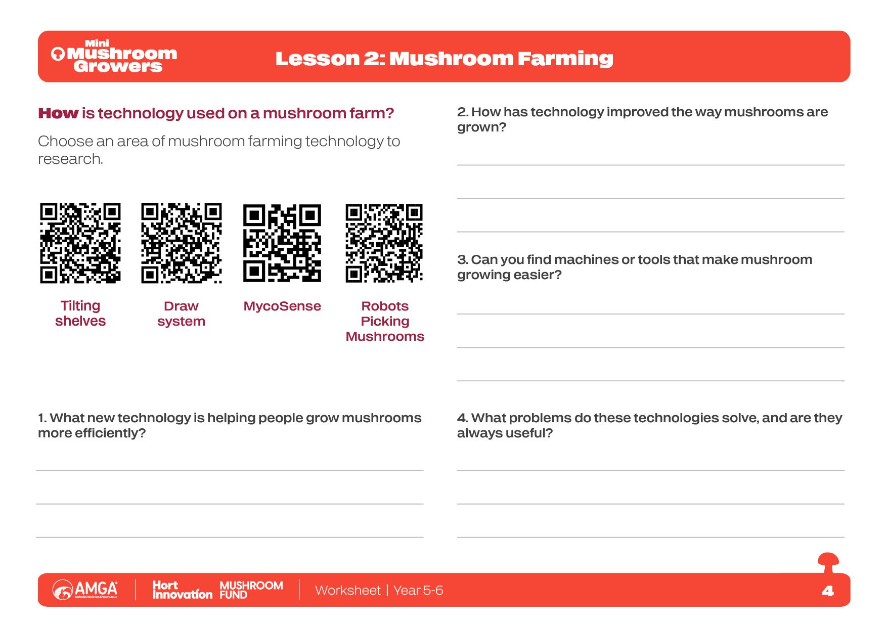
Worksheet
21

Slide 22
Vocabulary
Is a food that is good for us and the planet.
Future food
Turn waste into new materials.
Recycle
To use fewer resources in the first place.
Reduce
Return resources back to nature e.g. composting food scraps to grow new plants.
Regenerate
To use products again instead of throwing them away.
Reuse
Click on the words to reveal the definition
22

Slide 23
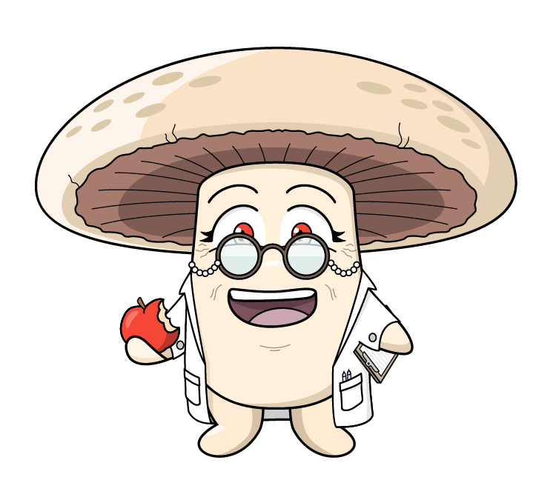
Food Security
What do you think the term ‘Food security’ means?
Food security exists when all people at all times have physical and economic access to sufficient, safe and nutritious food to met their dietary needs and food preferences for an active and healthy life
(reference: The United Nations)
23

Slide 24

Farm to Plate
What challenges do we face around food security?
24

Slide 25
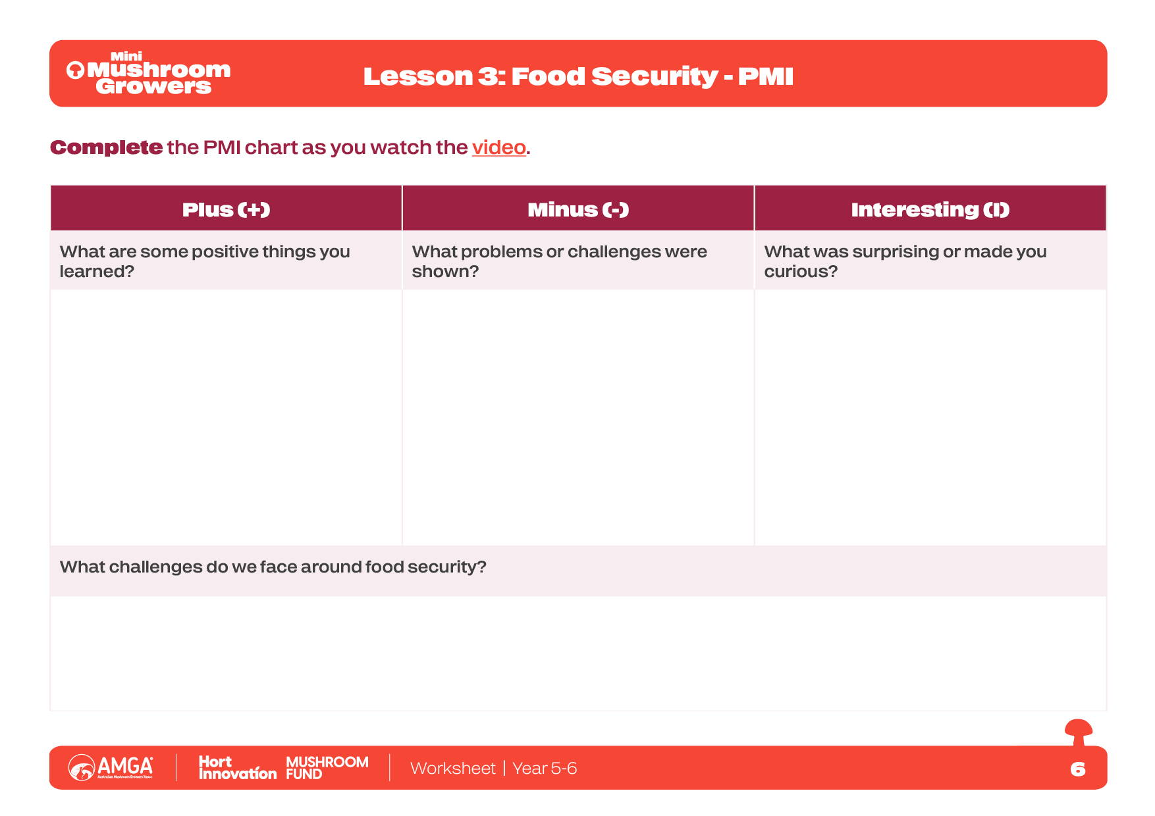
Worksheet
25

Slide 26
Sustainable Food Production
Why do we need sustainable food production?
Sustainable food production means caring for the Earth while still growing all the food we need. We need it to protect our planet for the future!
What can you do to help? What sustainable practices do you follow at home, or would like to follow?
Protecting our Planet:
Sustainable farming helps protect the Earth
Saving our soil: Sustainable farmers keep the soil healthy and full of nutrients. This means the soil can keep growing food for many generations, not just a few years.
Helping the climate: Farming uses a lot of energy. Sustainable methods use less energy and cut down on gases that cause the planet to get too hot. They also help save important forests!
Wasting less water: Sustainable farms are smart about using less water and making sure they don't pollute our rivers and oceans.
What can you do to help? What sustainable practices do you follow at home, or would like to follow?
Enough Food for Everyone:
We need to make sure every person has healthy food, even as the world's population grows.
Food for the future: Sustainable farming is all about long-term thinking. It makes sure we don't use up all the Earth's natural resources today, so there will still be plenty for your children and their children.
Healthier food: These methods often produce a bigger variety of crops and help keep our food more nutritious and healthy.
Helping farmers and animals:
Sustainable food production is also about fairness:
Happier animals: It includes practices that ensure farm animals are raised in better, more natural conditions.

Slide 27
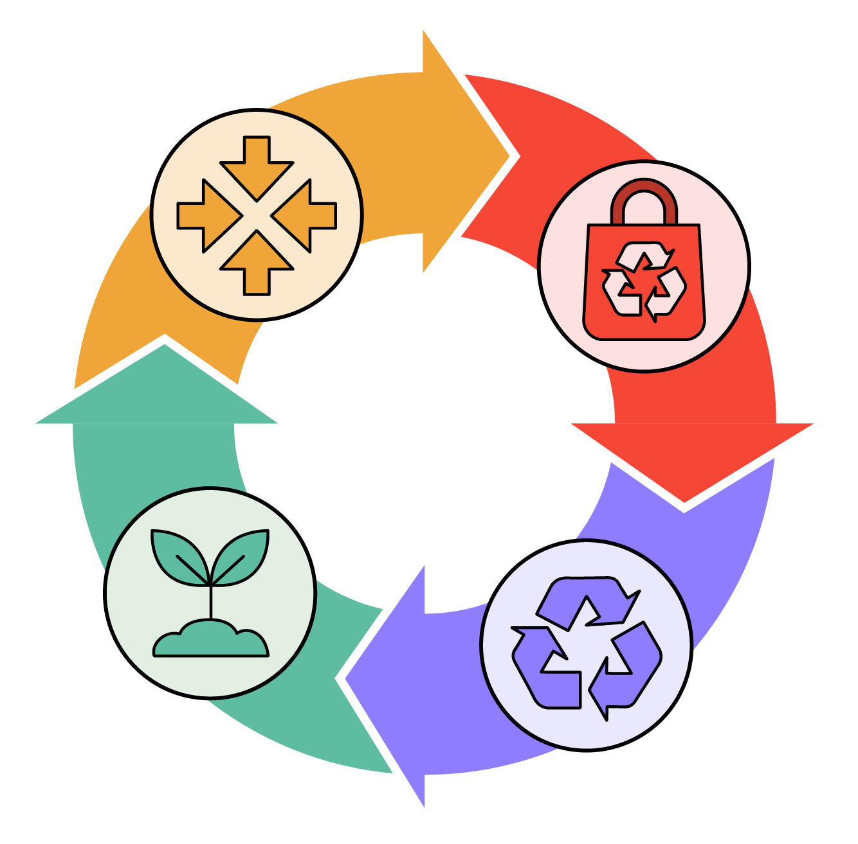
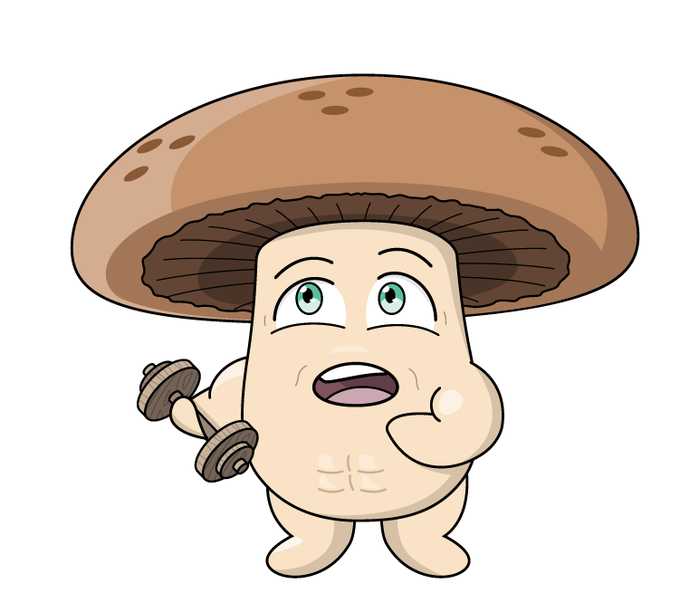
Circular Economy
Reduce
Reuse
A circular economy is a system where we try not to waste things. Instead, we reduce what we use, reuse items again, recycle materials, and return resources to nature so they can grow back.
How does a circular economy benefit our planet?
Regenerate
Recycle

Slide 28
Circular Economy
Reduce: Farmers try to use less of everything. Mushroom farms use solar power and vertical farming to reduce energy and space. This includes less land use for growing food.
Reuse: Things that might normally be thrown away are used again. For example, old straw or poultry litter from other farms can be used to make compost (substrate) to help grow mushrooms.
Circular agriculture, also known as a circular farming, is a way of farming that focuses on reducing waste, reusing resources, recycling materials and regenerating the environment.
Regenerate: This means making the environment healthier. For example, returning nutrients to the soil to keep it healthy for plants to grow. Mushroom farmers send nutrient-rich used compost to other farms, to grow more food.
Recycle: Materials are turned into something new. On a mushroom farm, the used compost can be collected and recycled to grow even more food. Wastewater is recycled and used in compost.
Circular agriculture helps to keep the farm healthy and uses resources wisely.
Video coming soon - Contact: schools@amga.asn.au

Slide 29
Vocabulary
Special helpers in food that keep our bodies healthy and strong.
Antioxidants
Is found inside the mushroom's cells and acts as a fibre when we eat mushrooms.
Chitin
How our bodies break down food so we can get energy and grow.
Digestion
A special antioxidant found mostly in mushrooms that helps protect our cells from damage. It can also keep our brain healthy, helping us think clearly and stay focused.
Ergothioneine
A part of plant food that helps our tummies work well.
Fibre
Having a happy and healthy tummy.
Gut health
Click on the words to reveal the definition
29

Slide 30
Vocabulary
Being strong and not getting sick easily because your immune system is working well.
Immunity
Important tiny things in food that our bodies need to stay healthy, like calcium for strong bones.
Minerals
Special substances found in the food we eat. They are essential for our bodies to grow, repair themselves, stay healthy and have energy.
Nutrients
Different kinds of helpers in food that do special jobs to keep our bodies healthy, like Vitamin D that helps make our teeth and bones strong.
Vitamins
Click on the words to reveal the definition
30

Slide 31
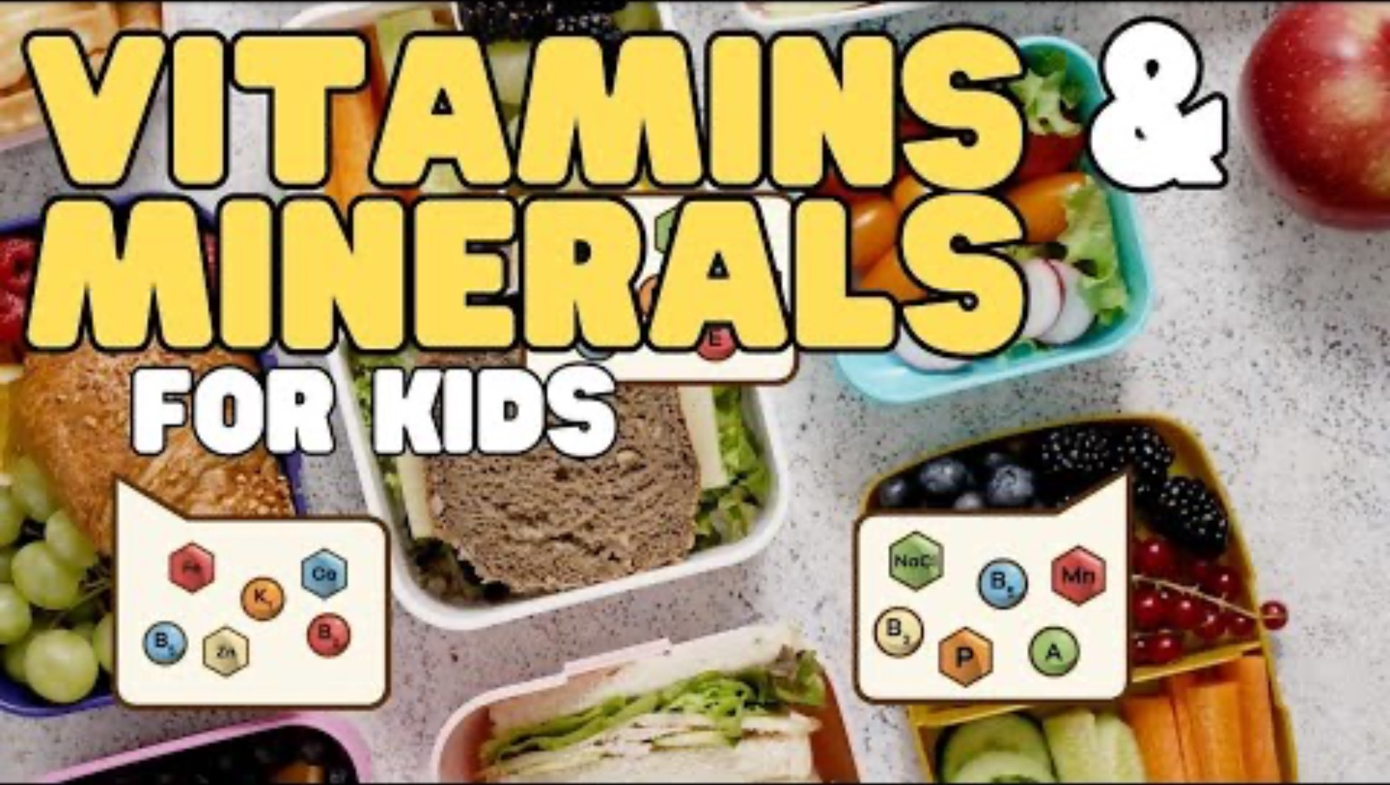
Vitamins and Minerals
What are vitamins and minerals?
Vitamins are made by plants and animals.
Minerals come from the soil and water they are absorbed by plants which are then eaten by animals.
Vitamins and minerals are found in the food we eat.
31

Slide 32
13 Essential Vitamins and Minerals
Our bodies need many vitamins and minerals, but these 13 are the most important ones. They help us grow, move, heal, and stay healthy every day!
Vitamins
Vitamin A – Helps you see in the dark and keeps your skin and eyes healthy.
Vitamin B1 (Thiamine) – Helps your body turn food into energy.
Vitamin B2 (Riboflavin) – Keeps your skin, eyes, and nerves healthy.
Vitamin B3 (Niacin) – Gives you energy and helps keep your skin healthy.
Vitamin B6 – Helps your body use protein and keeps your brain working well.
Vitamin B12 – Helps keep the body’s nerve and blood cells healthy.
Vitamin C – Keeps your immune system strong and helps your body heal cuts and wounds.
Vitamin D – Helps build and maintain strong bones by helping the body absorb calcium.
Vitamin E – Protects your body’s cells and keeps your skin healthy.
Vitamin K – Helps your blood to clot when you get a cut so it can heal properly.
Minerals
Calcium – for strong bones and teeth.
Selenium – helps your body make antioxidants to prevent cell damage.
Zinc – helps the immune system fight off bacteria and viruses.
32

Slide 33
Your Immune System
The immune system is like your body's defence system, working to keep you healthy and prevent illness.
Mushrooms are a unique superfood that offers many health benefits.
Mushrooms help our immune system:
Antioxidants: Mushrooms have antioxidants that protect your body's cells from getting hurt, helping you stay healthy and strong.
Vitamin D: Mushrooms are amazing because they are the only food from plants that gives us Vitamin D! This vitamin helps your body grow and makes your immune system work even better.
Fibre: The fibre in mushrooms is like food for the good bugs in your tummy. When these good bugs are happy, your immune system works well.
Selenium: Mushrooms have a mineral called selenium. It helps your body make antioxidants to protect your cells.
Vitamin B6: Mushrooms also have Vitamin B6, which is important for making healthy blood and other things that help your body fight off sickness.
33

Slide 34
Vitamin D
What is vitamin D?
Vitamin D is a nutrient your body needs to stay healthy.
It is sometimes called the ‘sunshine vitamin’ because your skin makes it when sunlight hits it.
The sun is the most common producer of vitamin D as the ultraviolet (UV) rays from sunlight strike the skin and trigger vitamin D synthesis.
You can also get vitamin D from foods like fish, eggs and milk.
Why is Vitamin D important?
Builds strong bones and teeth - Vitamin D helps your body use calcium from food.
Keeps muscles healthy - It helps you move, run and play without problems.
Supports your immune system - Helps your body fight off sickness.
Interesting facts:
Without enough vitamin D, bones can become weak.
Spending 10-15 minutes in the sun each day can help your body make enough vitamin D.
Vitamin D works like a helper - it carries calcium to your bones so they grow strong.
34

Slide 35
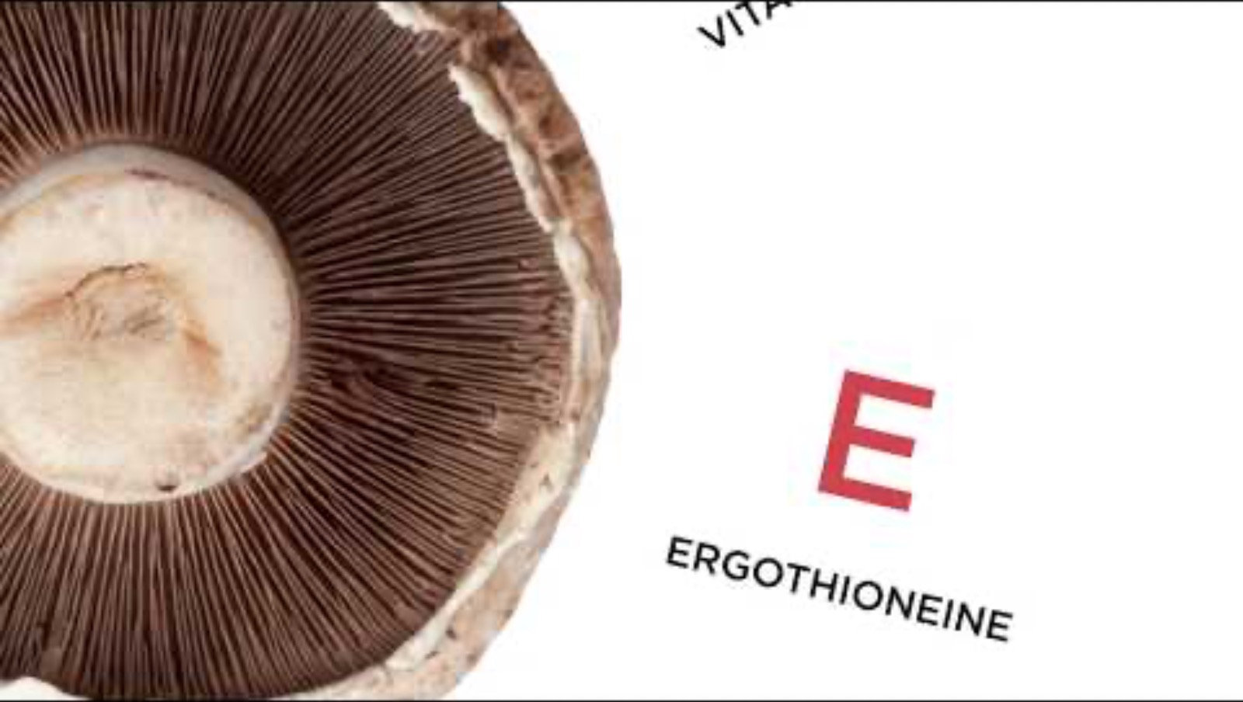
Mushrooms and Vitamin D
35

Slide 36
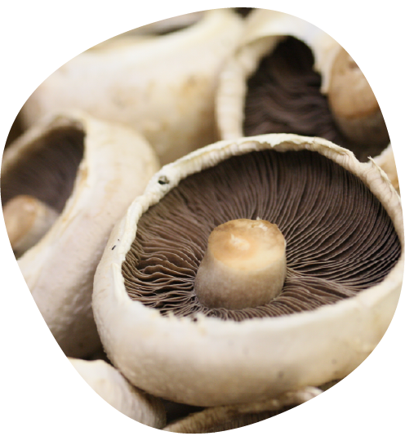
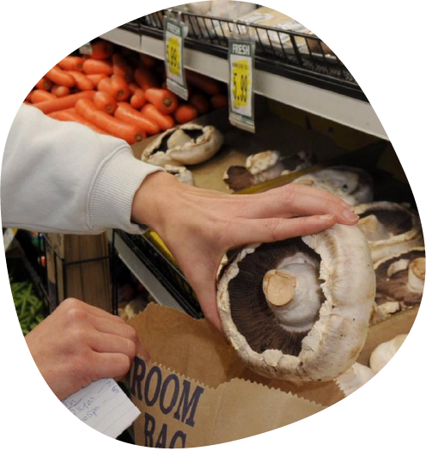
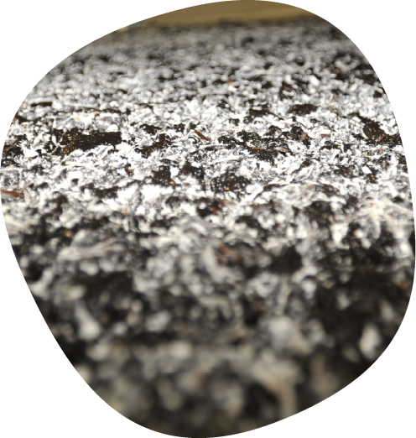
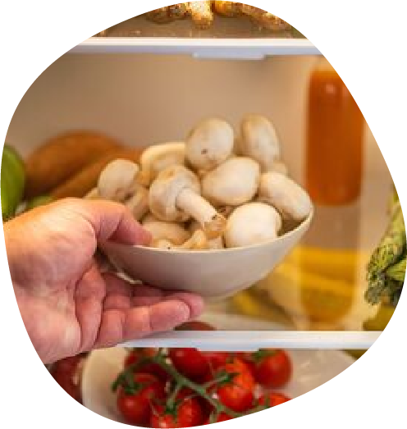
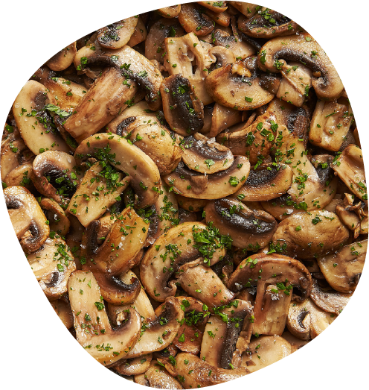
Mushrooms and Vitamin D
Make any mushroom a vitamin D Mushroom
Mushrooms can make vitamin D just like us, because they are biologically closer to humans and animals, than they are to plants.
Mushrooms are fungi and have a special place in food groups.
Mushrooms can provide our body with a unique combination of nutrients that other foods can’t - therefore they are sometimes referred to as a superfood!
Sun
Put mushrooms in direct sunlight – whole stem side up, or slided. 15 mins in bright peak sunlight (longer, e.g. one hour, in lower light.) Exposure to sunlight helps mushrooms make vitamin D.
Store
You can put the mushrooms in the fridge after they've been in the sun. The vitamin D they make will stay for about a week. You can also use them right away.
Use
Eat however you enjoy mushrooms – raw or cooked.
Buy
from your local shop or market.
36

Slide 37









The ABCDE Health Benefits of Mushrooms
Brain & mood
Energy & metabolism
Gut & digestion
Heart & cardiovascular
Immune system
Teeth & bones
Nervous system
Hair, skin & nails
Muscles & activity
A
B
C
D
E
Mushrooms contain antioxidants that keep our body and immune system healthy. This helps us not get sick and reduces our risk of disease.
Mushrooms contain B vitamins that give us energy. They help the release of energy from macronutrients - carbohydrates, protein and fats in the foods we eat. They are important for keeping our blood healthy and our nerves working properly.
Mushrooms contain chitin, a prebiotic fibre that helps our gut health and keeps our tummies happy and working properly. They also have beta-glucan fibre, which feeds the good bacteria in our gut and keeps our heart healthy.
Mushrooms are the only non-animal food with vitamin D. Vitamin D helps our body absorb calcium from foods which helps our teeth and bones become strong.
Mushrooms contain a special antioxidant called ergothioneine. This helps protect our cells and may keep our brain healthy, helping us think clearly and stay focused.

Slide 38
Mushroom Quiz
Mushrooms contain antioxidants, which help protect your cells from damage.
Vitamin D is only found in animal products, so mushrooms don’t have it.
The fibre in mushrooms can help support a healthy gut microbiome.
Mushrooms are a rich source of calcium, which helps strengthen bones.
True - they are rich in antioxidants like ergothioneine!
True
False
False - mushrooms absorb sunlight to produce vitamin D!
True
False
True - fibre feeds good gut bacteria!
True
False
False - they don’t contain much calcium, but they do have vitamin D to help absorb calcium!
True
False
38

Slide 39
Mushroom Quiz
5. Mushrooms are a good source of iron, which helps carry oxygen in the blood.
6. You can replace meat with mushrooms in some meals because they have a similar texture and some protein.
7. All mushrooms sold in supermarkets are safe to eat.
8. Mushrooms can help regulate blood sugar levels.
True - they contain a small amount of plant-based iron!
True
False
True - they are often used as a meat alternative!
True
False
True - but wild mushrooms can be toxic!
True
False
True - they have fibre and compounds that may help balance blood sugar!
True
False
39

Slide 40
Vocabulary
A strong, sometimes sharp taste like coffee without sugar or very dark chocolate.
Bitter
The ways we explore the world (sight, smell, touch, taste, hearing).
Senses
This is a rich, full flavour that isn't sweet, sour, or bitter. Cooked meat, cheese and mushrooms are savoury.
Savoury
A special savoury taste, like the taste of mushrooms or soy sauce.
Umami
Click on the words to reveal the definition
40

Slide 41
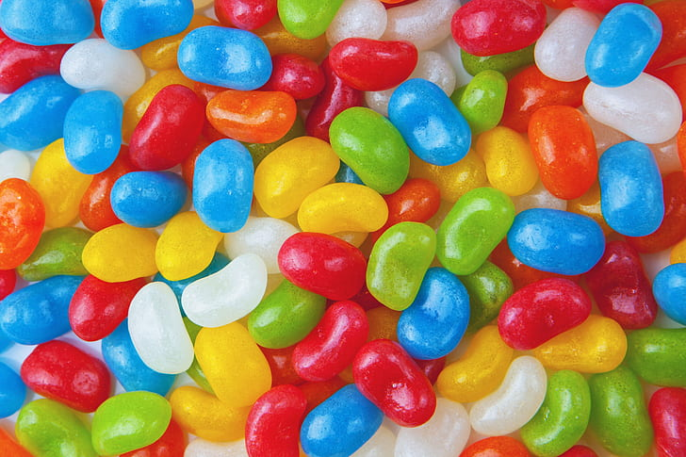
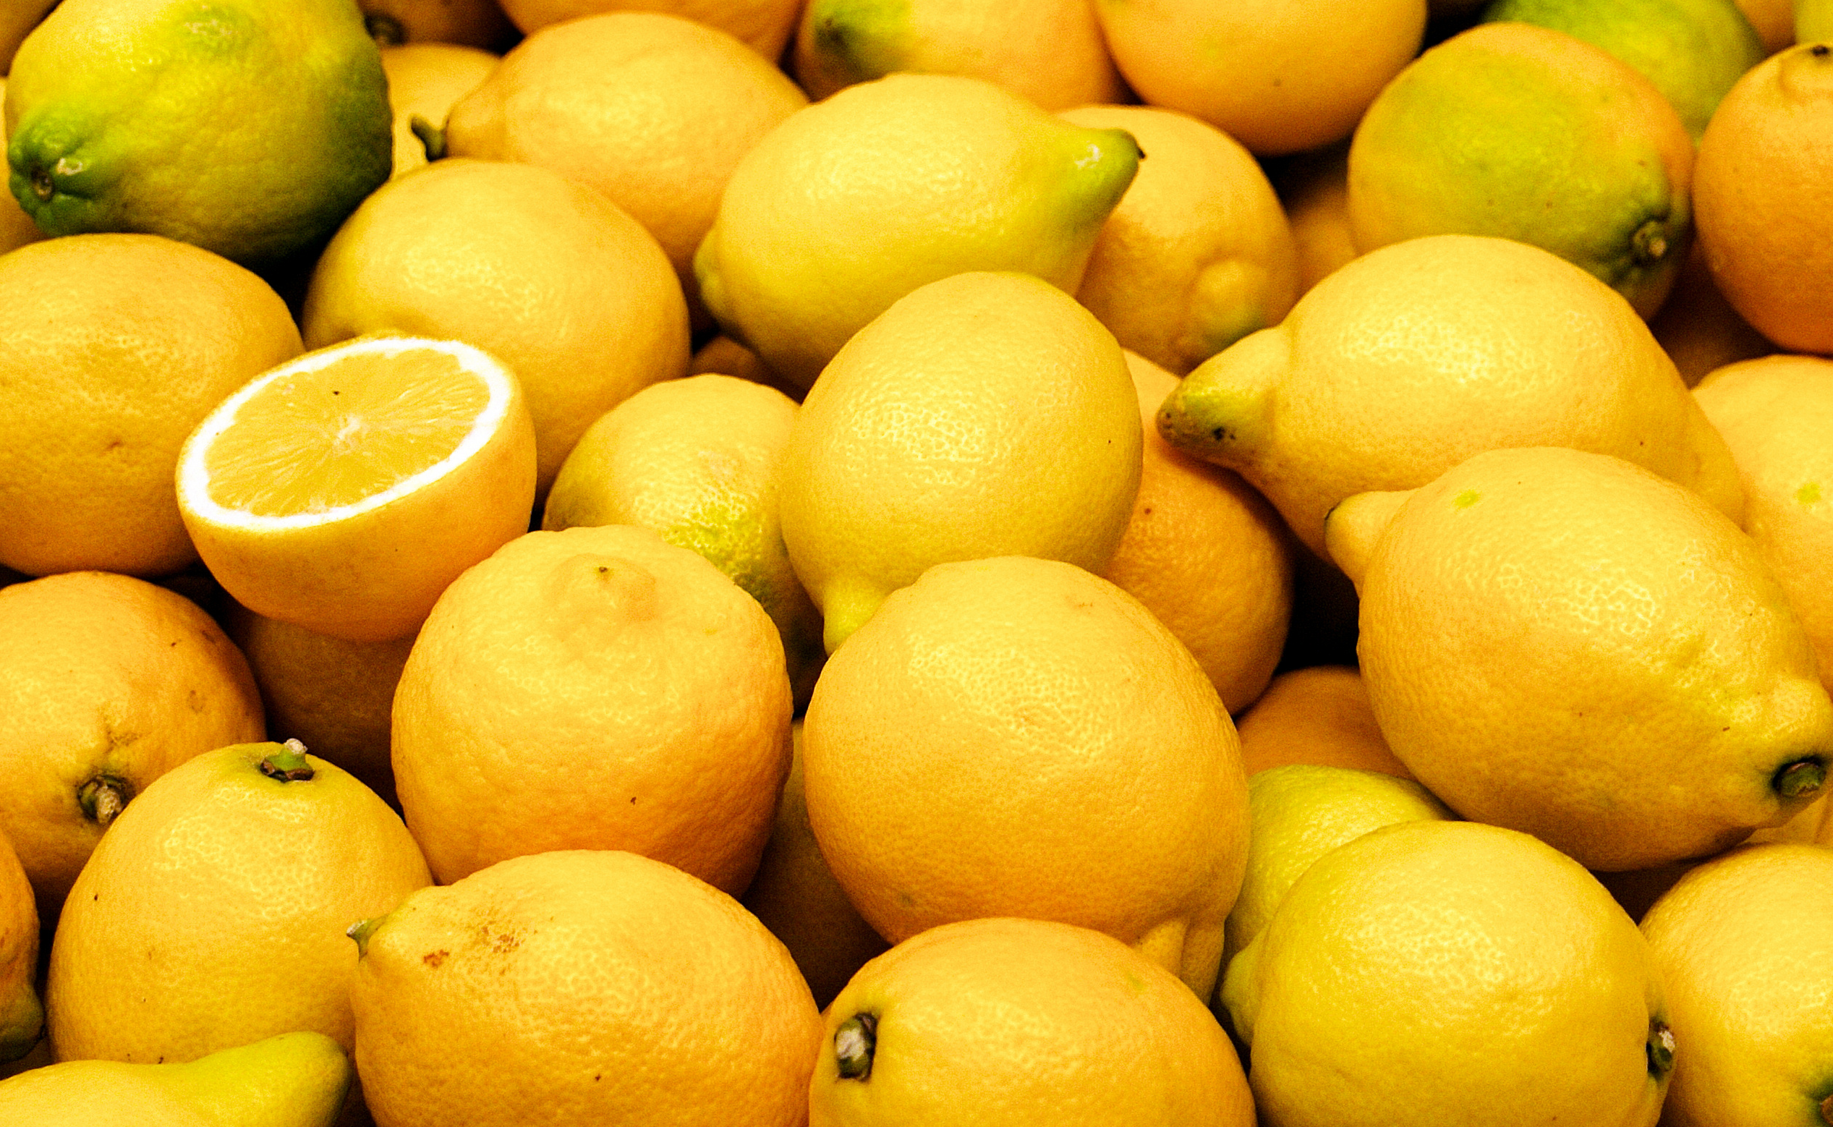
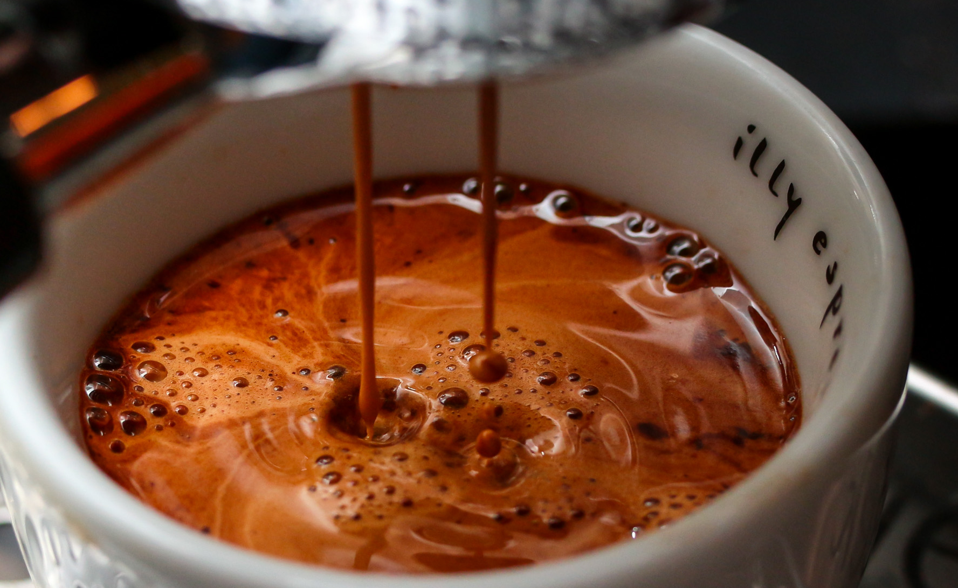
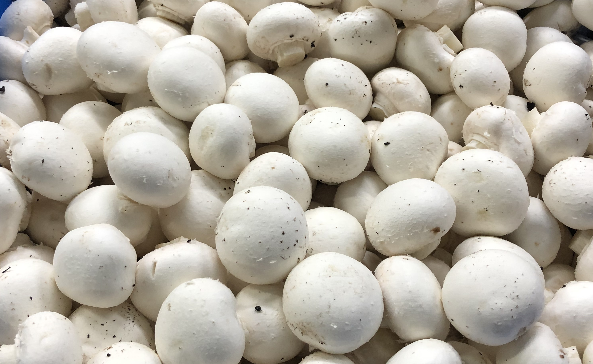
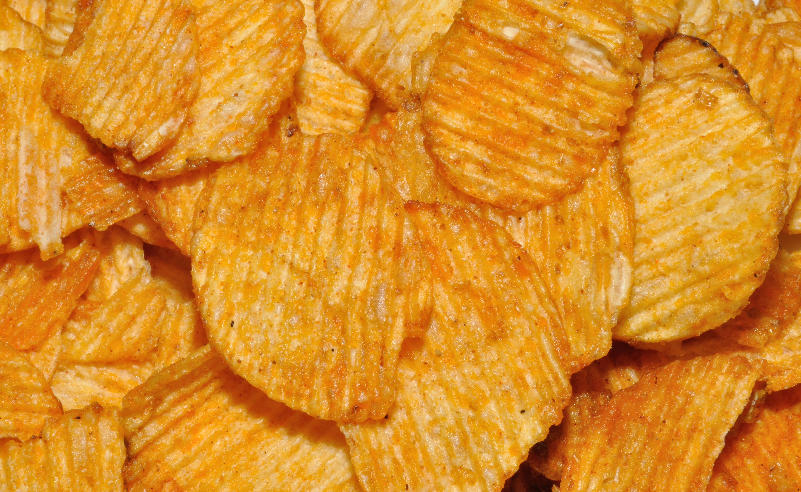
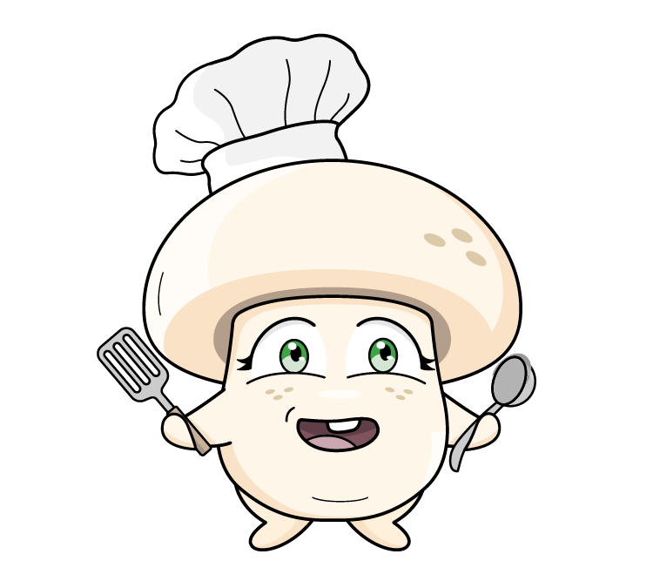
What is Umami?
There are five different tastes.
Sweet, sour, bitter, umami and salty.
Sweet
Sour
Bitter
S
S
B
lollies, cake, ripe bananas
plain yoghurt, lemon, kimchi
dark chocolate, coffee, kale
Umami
Salty
Umami is a yummy savoury taste - like cheese, vegemite or mushrooms.
U
S
mushrooms, parmesan cheese, seaweed
potato chips, bacon, pretzels

Slide 42

Worksheet
42

Slide 43




Mushroom Pairings
Did you know that when you pair mushrooms up with other tasty ingredients not only do you get a whole new level of flavour, it also adds extra key nutrients to your plate?
Try these combinations:
Mushrooms and chicken
Mushrooms and eggs
Mushrooms and beans
S
S
B
Vitamins D and B6
Selenium and Vitamin B12
Vitamin D and Folate
Umami is a yummy savoury taste - like cheese, vegemite or mushrooms.
What other combinations can you find? (Based on health advice from America)
Click here
43

Slide 44

Worksheet
44

Slide 45






Classroom Cook Up
Teriyaki Mushroom Sushi Rolls
Cheesy Mushroom Quesadillas
Mushroom Omelette Wrap
Here are some simple mushroom recipes you might want to try.
Recipes
45

Slide 46
Congratulations!
You are now a Mini Mushroom Grower
Download certificate
Teacher feedback
Click on the link to complete the teacher and student post-survey with your class.
Student survey
46

