Slide 1

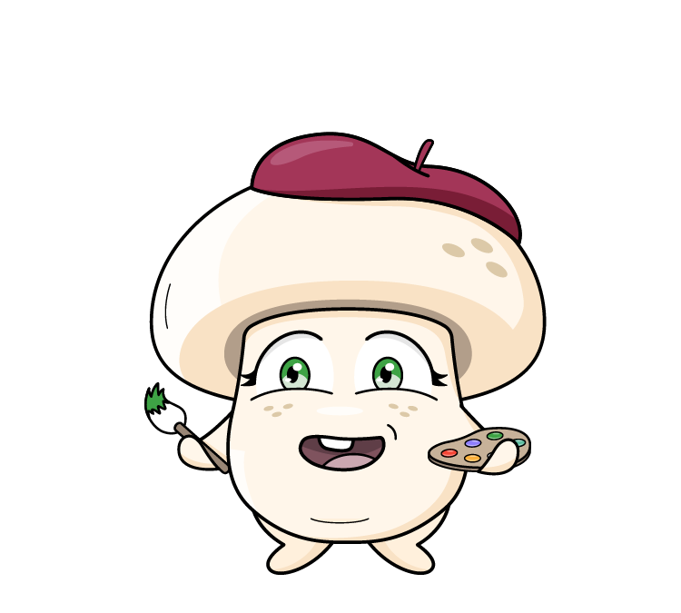



Supporting resource pack
Use this Foundation to Year 2 supporting resource pack in conjunction with the teacher guide to seamlessly explore and access all lesson materials.
Proudly brought to you by:
This project has been funded by Hort Innovation using the mushroom research and development levy and funds from the Australian Government.

Slide 2
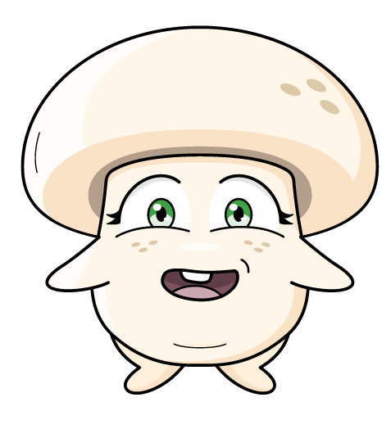

Contents
Lesson 1: Mushrooms are fun-guys
Lesson 2: Let’s visit a mushroom farm
Lesson 3: There’s mush-room for sustainability
Lesson 4: Mushrooms are a superfood
Lesson 5: Mini Mushroom Chefs
Click on the link to complete the pre student survey with your class.
Student survey
2

Slide 3

Vocabulary
The top of the mushroom.
Cap
To look for food, especially in the wild.
Forage
To look for mushrooms, but not eat or touch them.
Foraying
A special group of living things that includes mushrooms. They are not plants or animals.
Fungi
The thin layers under the cap where spores are made.
Gills
The part of a fungus that we can see above the ground, usually with a stem and a cap.
Mushroom
The tiny, thread-like parts of a mushroom that grow underground or inside something else, like roots. Mycelium is the living organism, which forms into a mushroom.
Mycelium
Click on the words to reveal the definition
3

Slide 4
Vocabulary
A living thing that grows in the ground, usually has green leaves, and makes its own food using sunlight, like flowers, trees, and grass.
Plant
Very tiny, dust-like particles that mushrooms use to make new mushrooms. They are like the seed of a plant.
Spore
The stalk part of the mushroom, that joins the mycelium to the cap. Like a tree trunk joins roots and branches. Mushroom growers call the stem a stipe.
Stem
A part of a plant that we can eat, like carrots (which are roots) or broccoli (which are flowers).
Vegetable
A ring of tissue that joins the cap to the stem of the mushroom.
Veil
Growing or living in nature, without people taking care of it.
Wild
Click on the words to reveal the definition
4

Slide 5
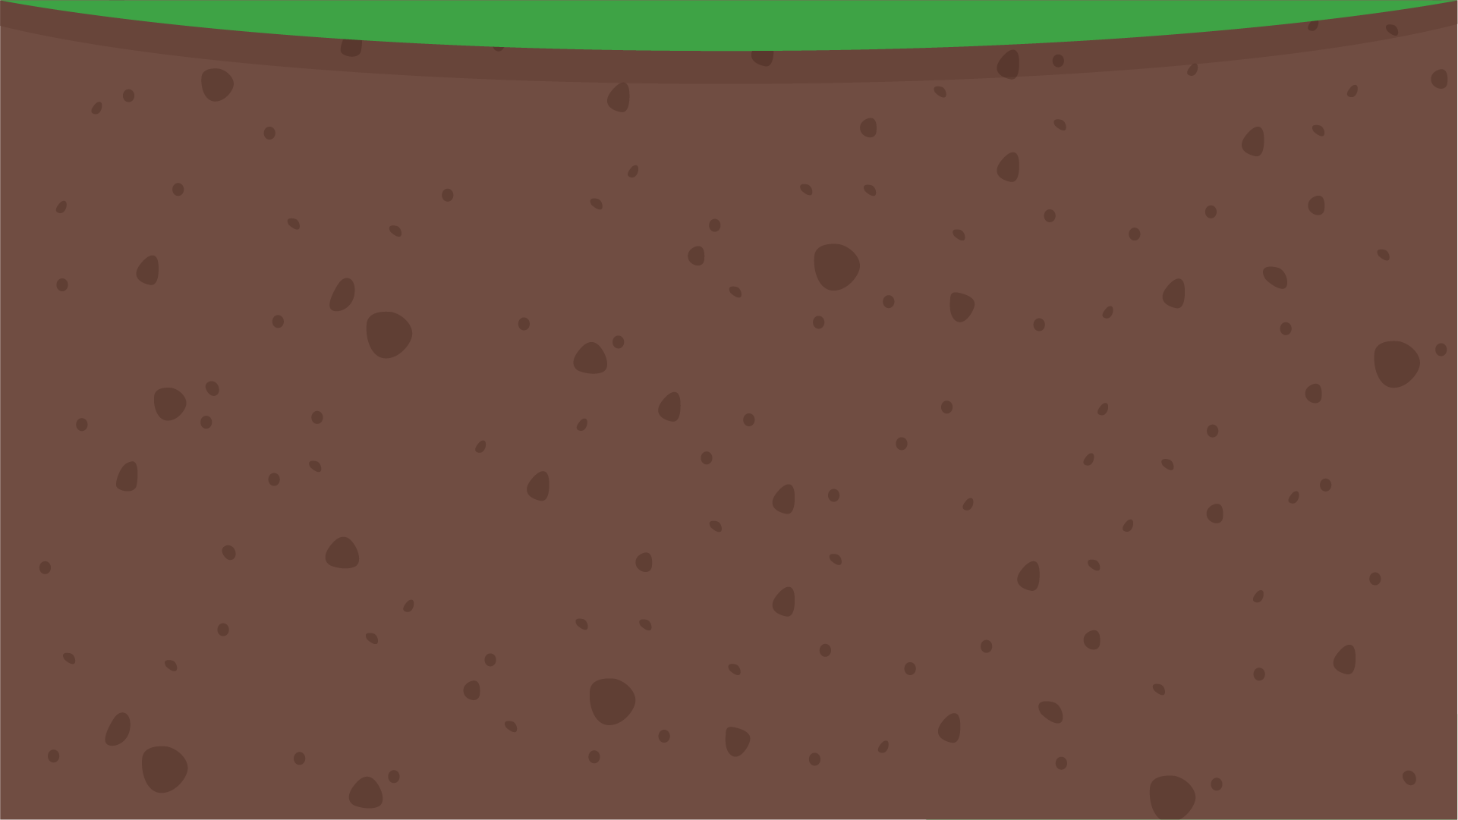




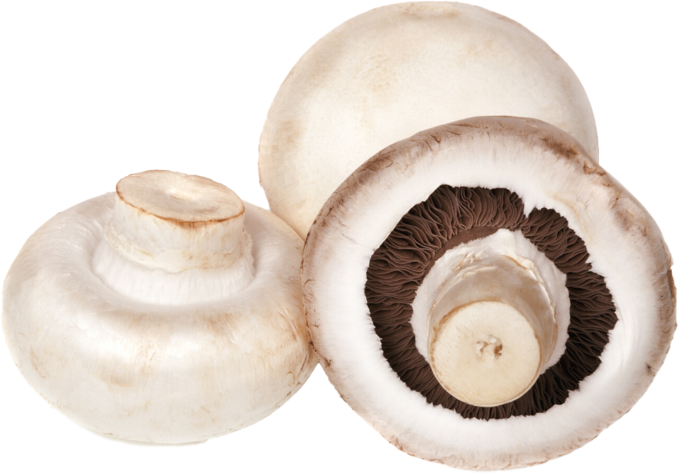
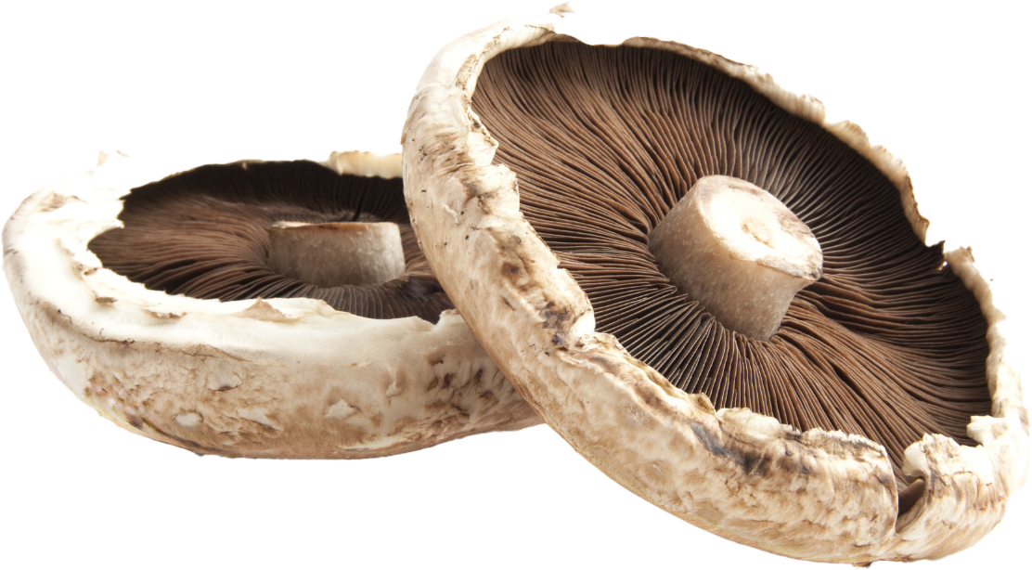
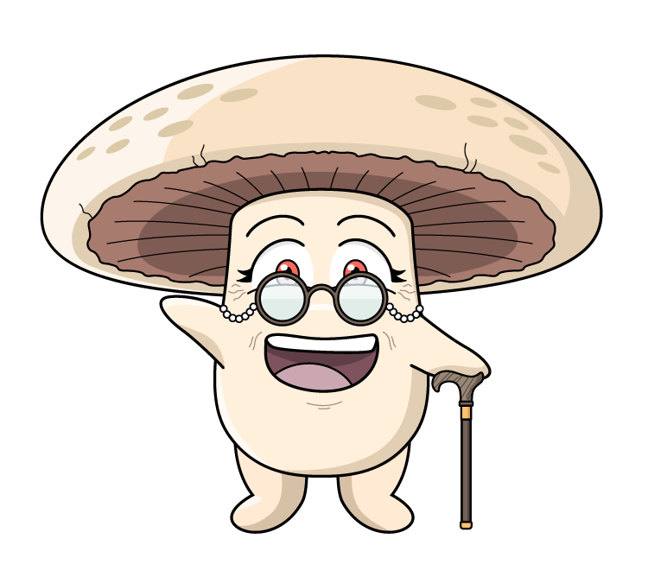
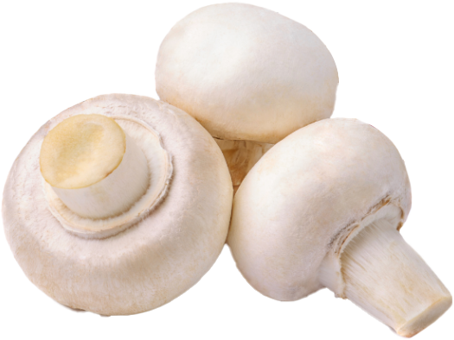
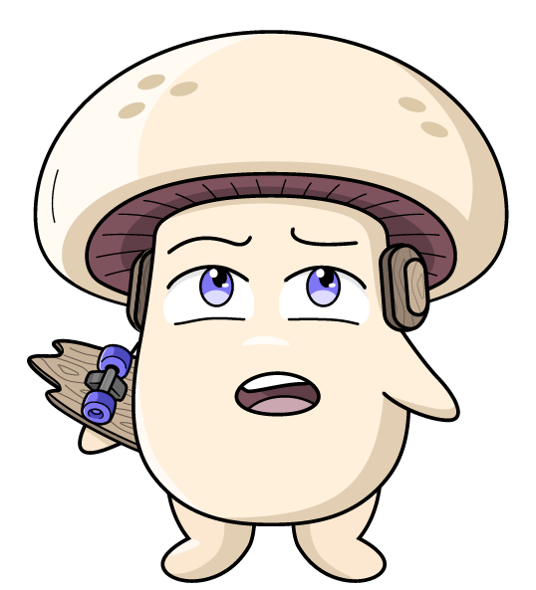
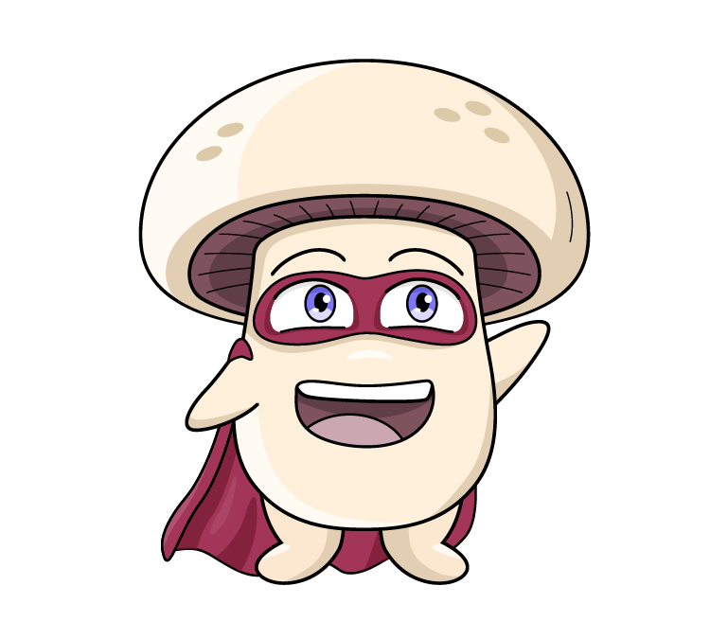
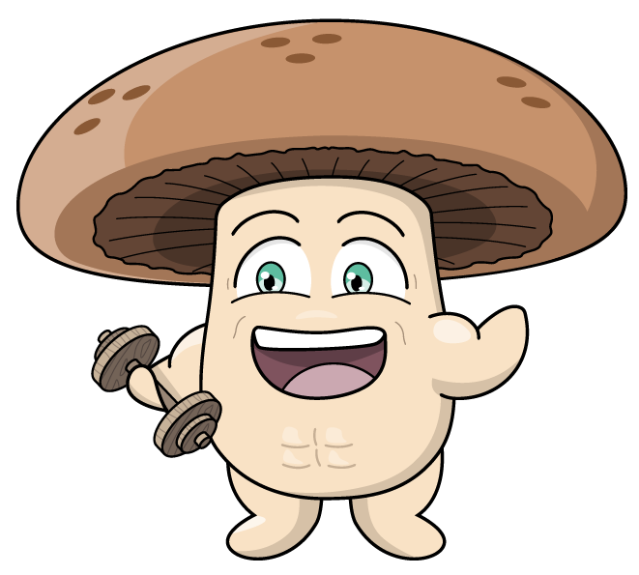
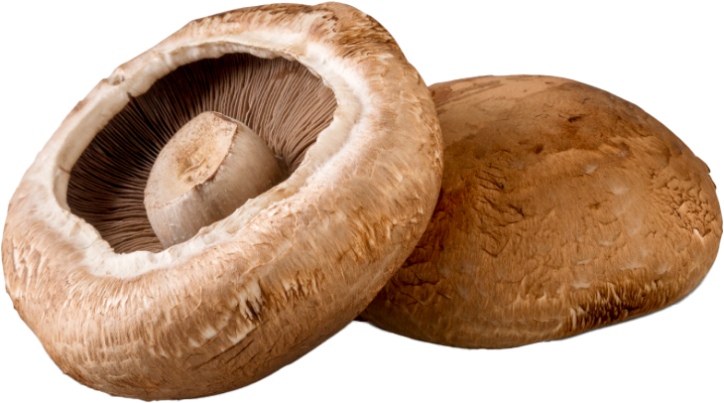
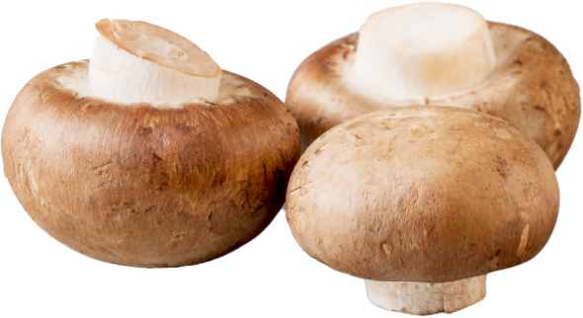
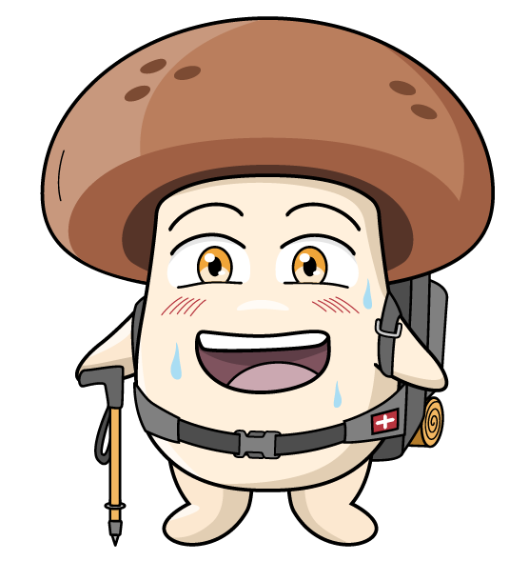
What do you know about mushrooms?
What am I?
Can you name these mushrooms?
These are Agaricus bisporus mushrooms.
Agaricus bisporus - pronounced - Ahh-gar-ikus bye-spore-us
The white Agaricus bisporus starts off as a little white button mushroom and grows to become a cup, and then grows to become a large flat mushroom.
The Swiss brown mushroom, grows to become a portobello. The only difference is one is brown in colour, the other is white.
Button
Cap
Flat
Swiss brown
Portobello
5

Slide 6

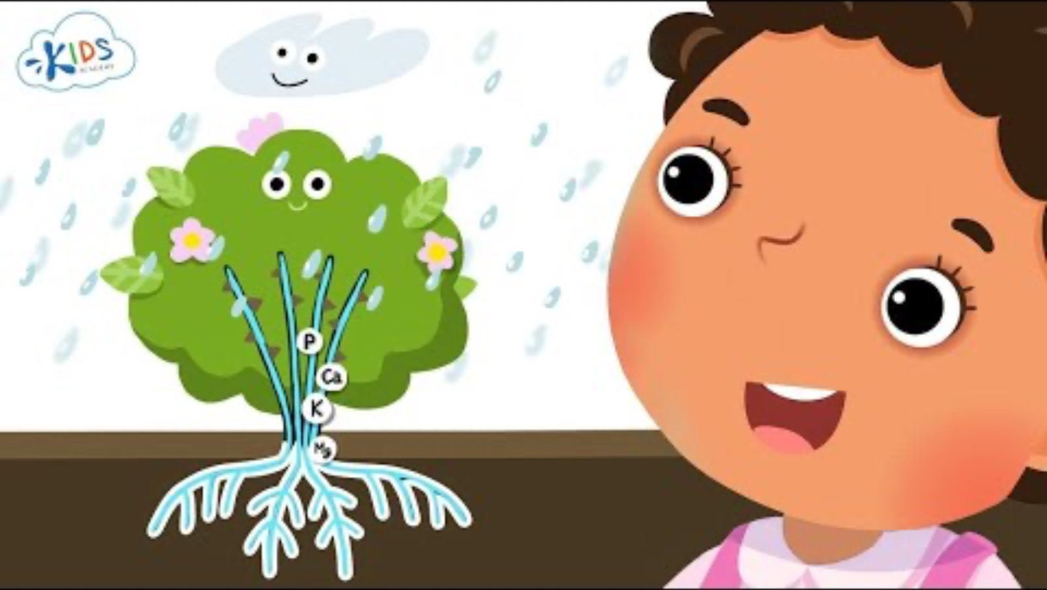


How do plants grow?
Lesson 1
What new information have we learnt about how plants grow?

Slide 7
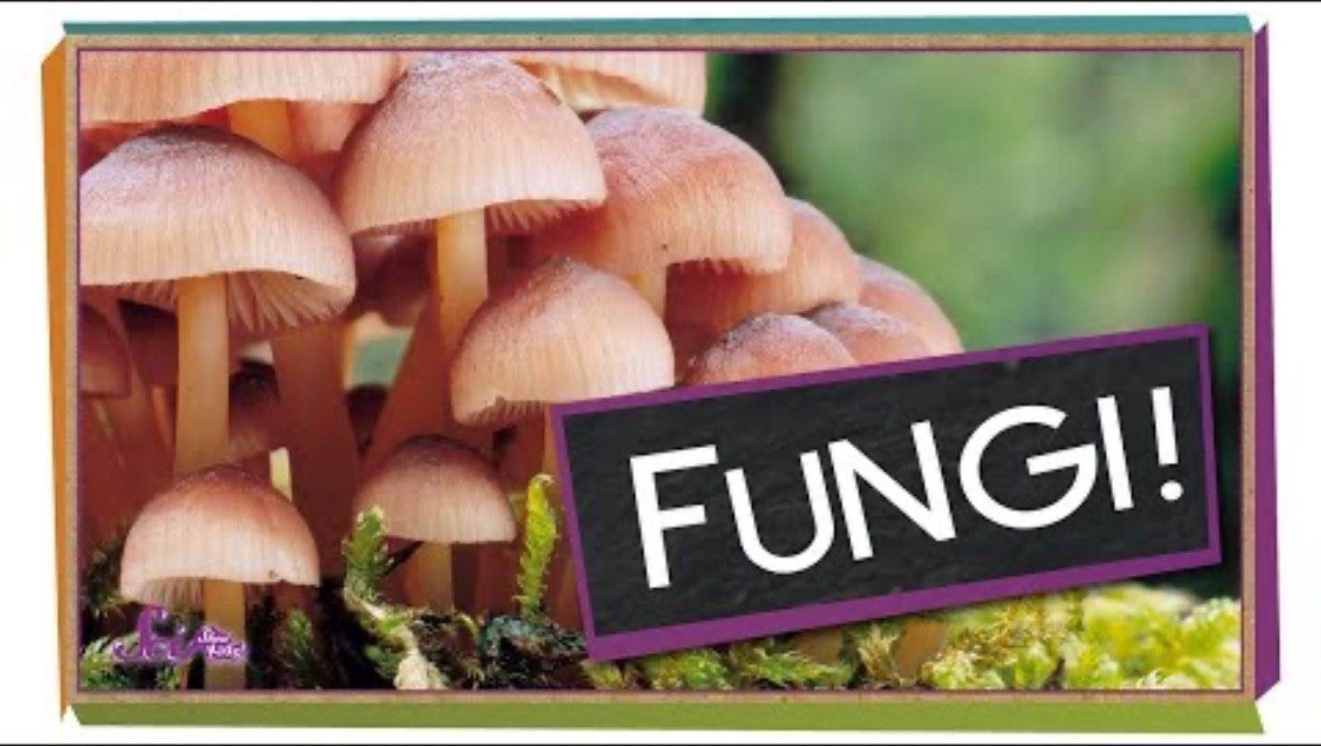
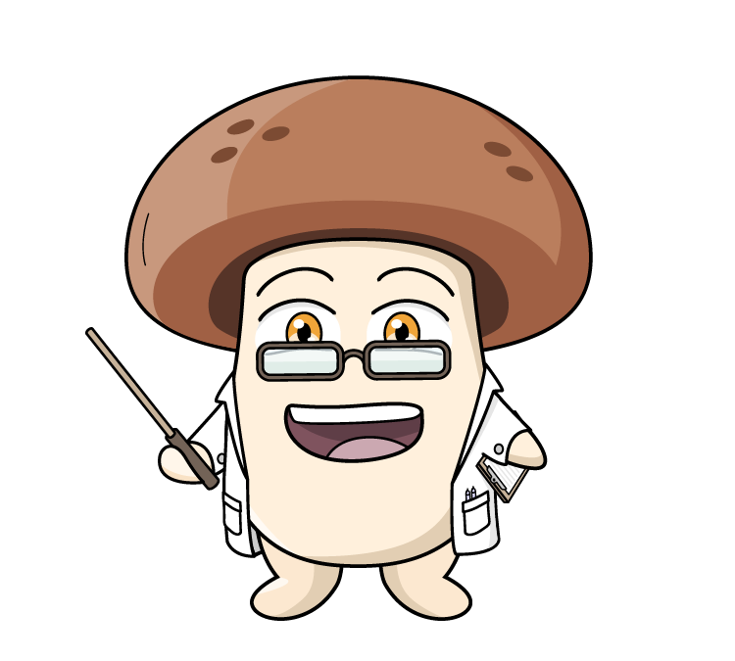
What are mushrooms?
Fungi facts
They have lots of minerals and vitamins.
Mushrooms are fungi - they are not a fruit or vegetable.
They are not plants or animals.
7

Slide 8
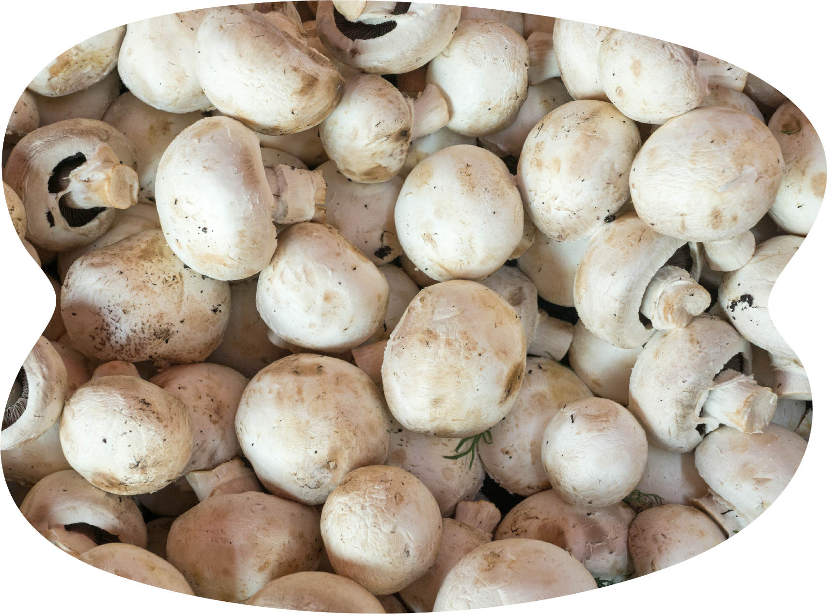
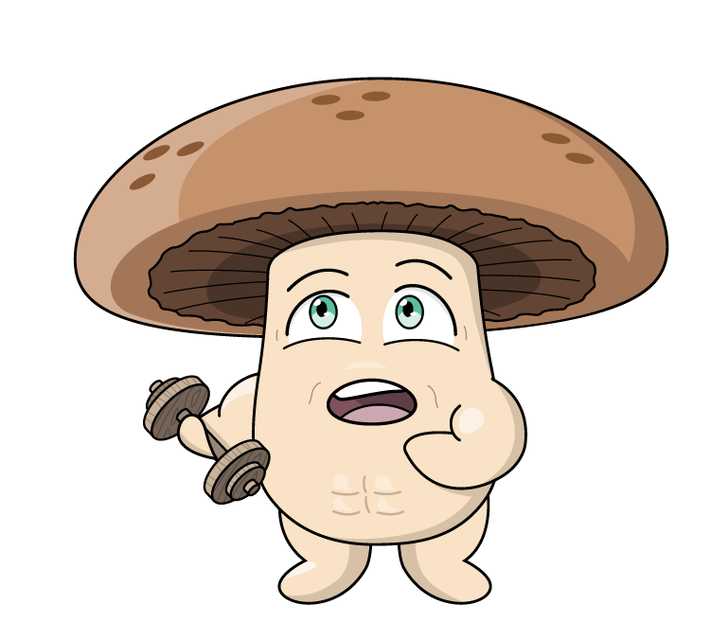
What are mushrooms?
Did you know:
Mushrooms can grow upside down.
They belong to a separate biological kingdom to plants and animals.
They can get their food differently to plants.
Unlike plants they do not need sunlight to grow - they can grow in the dark.
Mushrooms like to grow in places like compost, wood, or sometimes even dirt.
You should NEVER pick wild mushrooms- there are so many different varieties and some will make you very sick.
Mushrooms that ARE safe to eat, are very healthy and delicious.
8

Slide 9
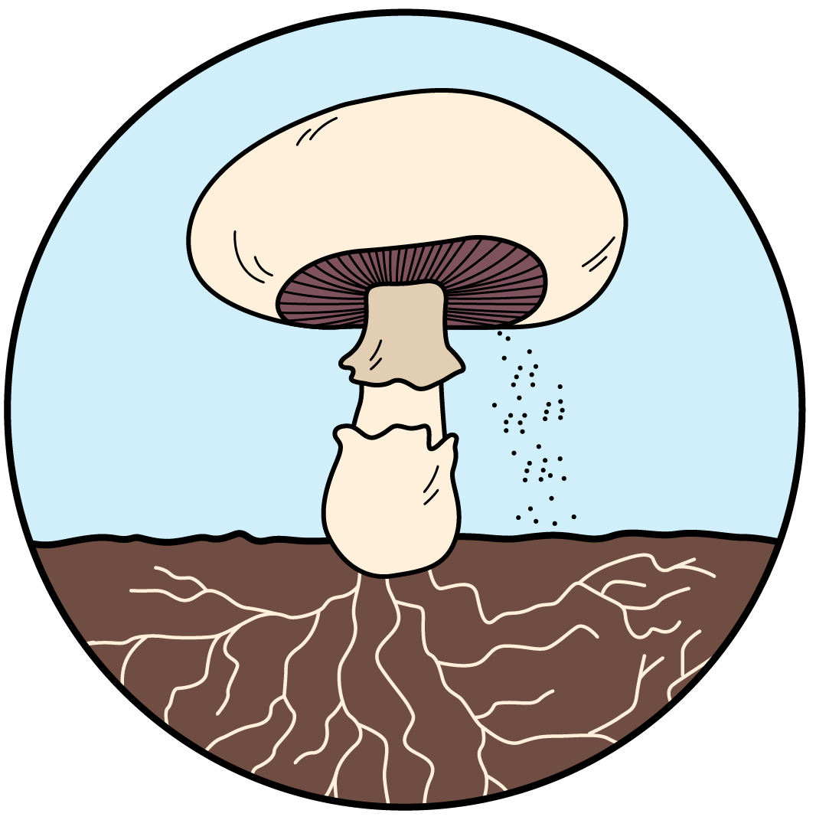
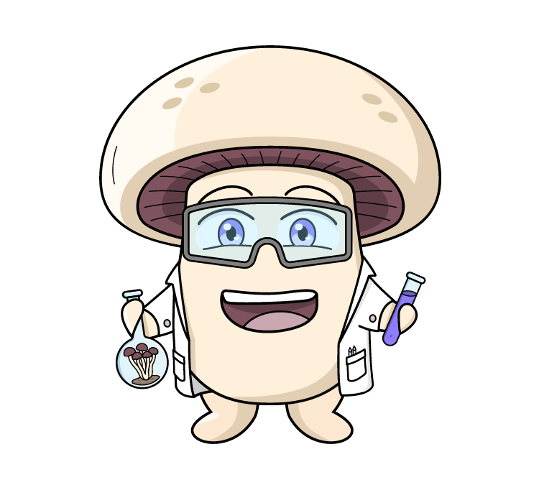
What are mushrooms?
Gills
are the thin layers under the cap. This is where spores are made.
Cap
is the top of the mushroom. It protects the spores.
Not all mushrooms have gills. Lion’s mane has teeth!
Stem
holds up the cap.
Veil
this is a ring of tissue that connects the mushroom stem and the cap.
Volva
is a layer of tissue that protects the mushroom as it grows out of the ground.
Did you know: The veil is broken as the mushroom matures, and opens to show the gills - ready to release the spores.
A button mushroom has a closed veil, and a cup mushroom has an open veil.
Spores
are similar to a seed.
Mycelium
are the underground part of the fungus, like roots.
9

Slide 10
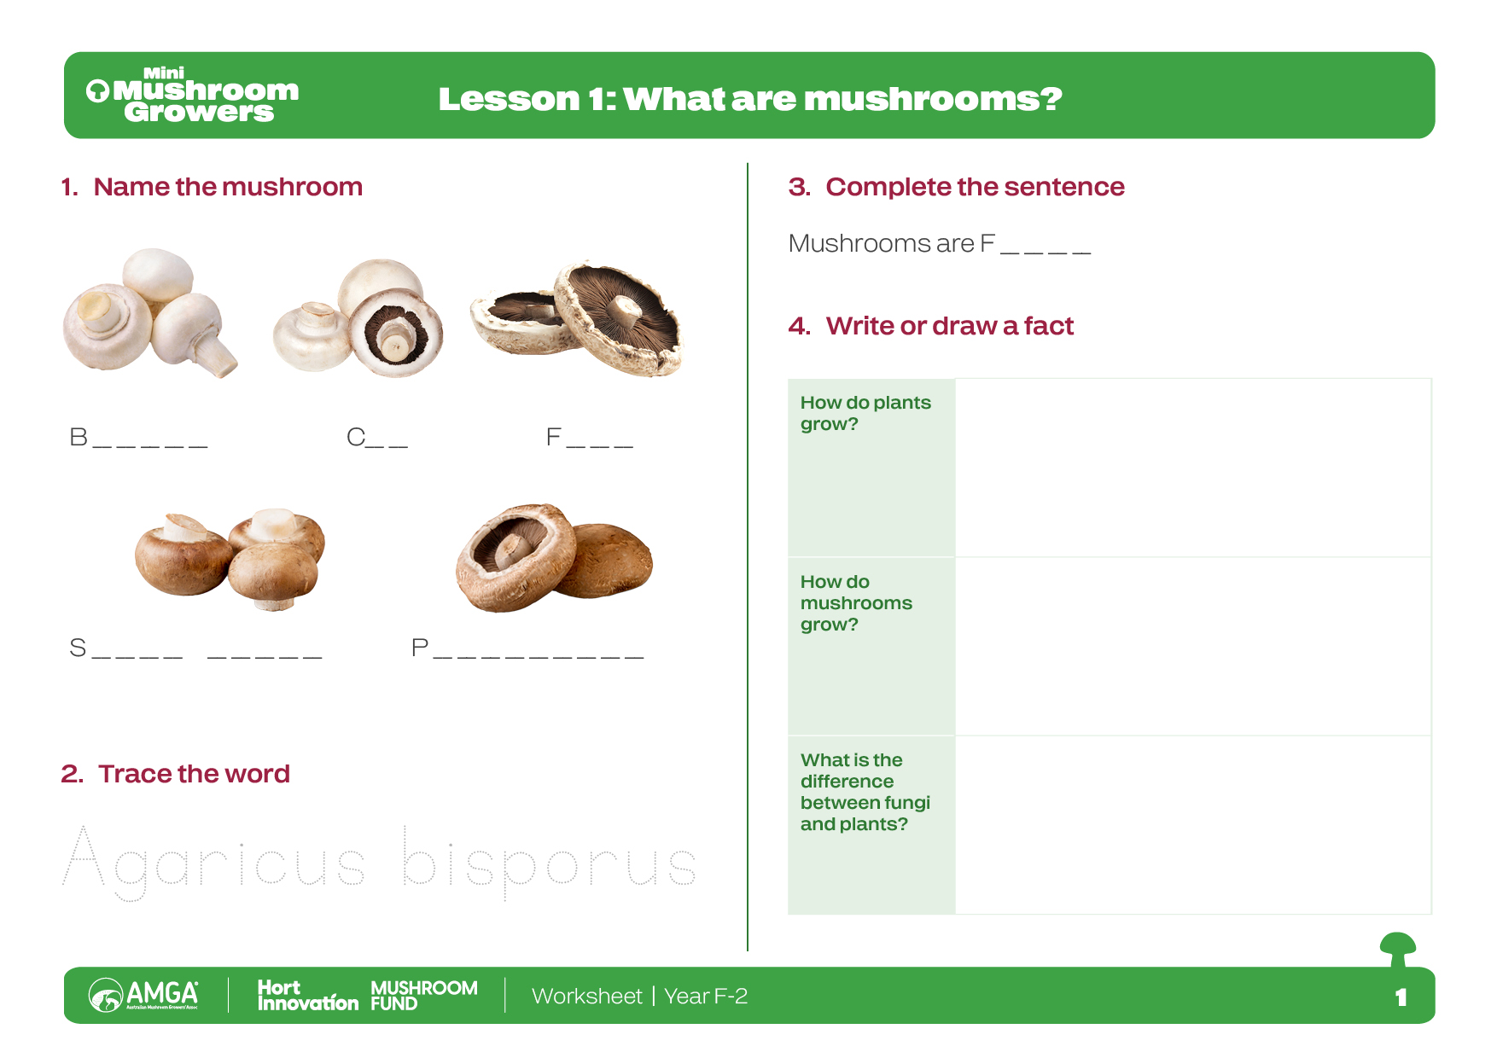
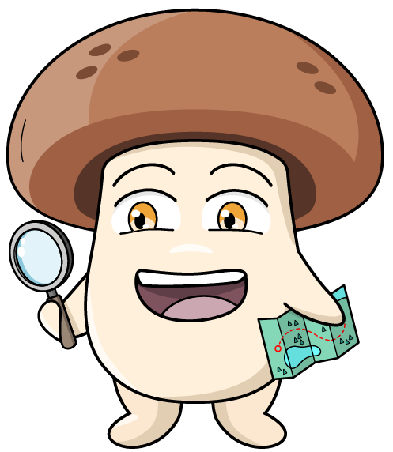
Worksheet
10

Slide 11

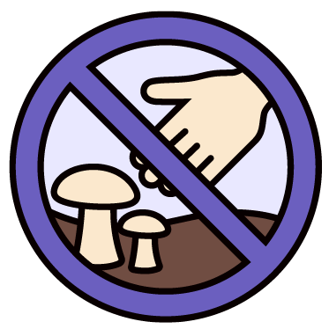
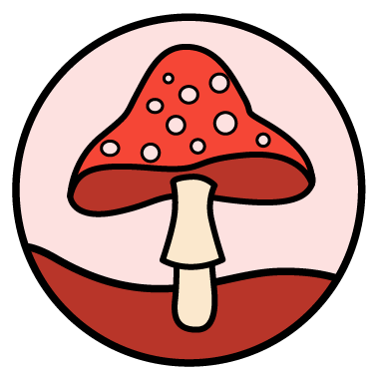


Don’t touch! Don’t eat!
What are the dangers of foraging for mushrooms in the wild?
Not all mushrooms are safe to eat:
Just because a mushroom looks pretty or looks like one from a shop doesn't mean it's safe.
Never touch or pick wild mushrooms:
Never touch or pick any mushrooms you see growing outside, even in your own garden.
If you see a wild mushroom, tell a grown-up:
That way the adult can make sure everyone stays safe.
Only eat mushrooms from the shop:
These mushrooms have been grown by experts and are safe to eat.
Mushrooms are special living things:
While some wild mushrooms are dangerous for humans to eat, they are still important parts of nature for other animals and plants.
Don’t forage - enjoy foraying – look but don’t touch!
11

Slide 12
Vocabulary
To pick or collect something that has grown, like mushrooms or vegetables, when it's ready to eat.
Harvest
The special food or good things that living things, like mushrooms and people, need to grow strong and healthy.
Nutrients
When things are put into containers or wrapping, like a box or bag, so they can be kept safe and carried easily.
Packaged
When very tiny mushrooms, called ‘pins,’ first start to grow and look like little bumps.
Pinning
This is almost like a seed. It contains mycelium, and is added to the substrate to make the mushrooms grow
Spawn
The special material or food that mushrooms grow on, like wood or compost.
Substrate
When something is moved from one place to another, like mushrooms being moved from the farm to the shop.
Transported
Click on the words to reveal the definition
12

Slide 13
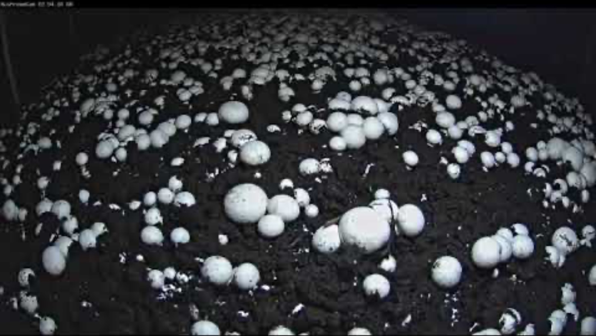
The life cycle of the mushroom
Lesson 2
What have we learned so far about how mushrooms grow?

Slide 14
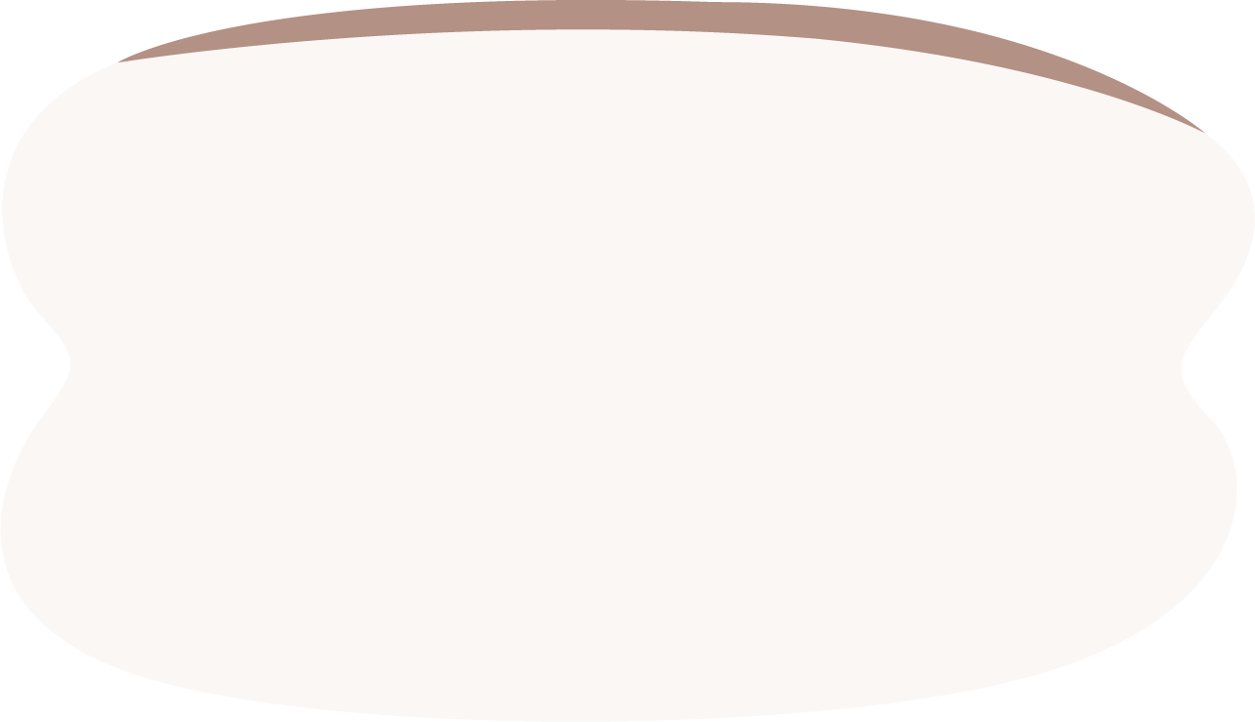
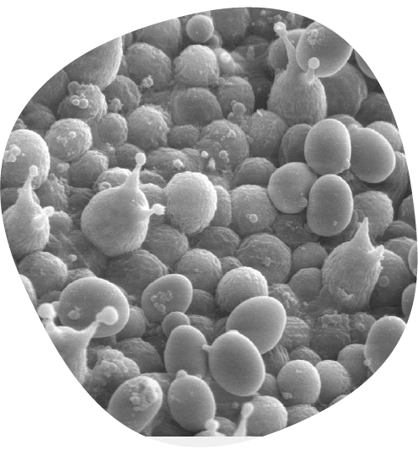
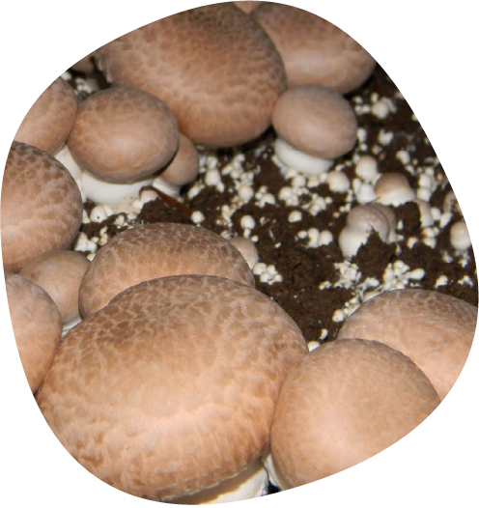
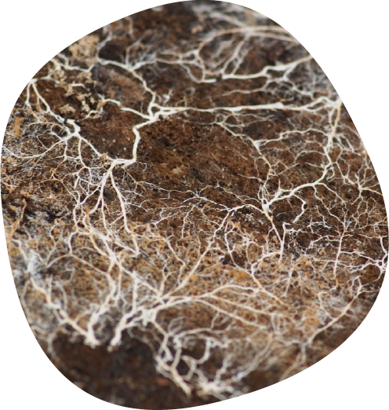
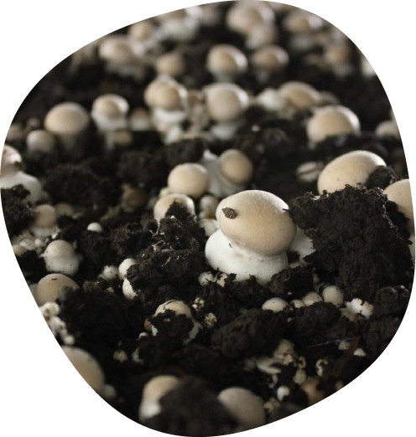
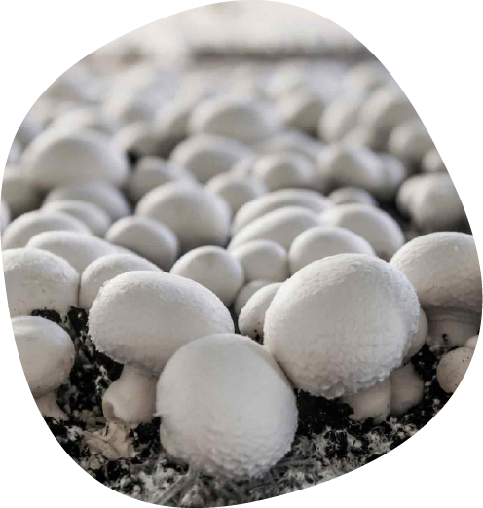
Mushroom life cycle
Drops spores
Mushrooms grow from spores, not seeds.
Spores are very hard to see unless you have a microscope. The spores germinate - this means they start to grow into a new mushroom.
Mycelium
The mushroom’s mycelium (roots) grows.
The mycelium helps the mushroom absorb nutrients from its environment.
Pin head
At first they look like small fluffy cotton wool, the size of tiny dots. They then grow to the size of a pin head.
Button mushrooms
Next they become baby button mushrooms.
Mushrooms
Did you know: Mushrooms double in size every 24 hours.
14

Slide 15
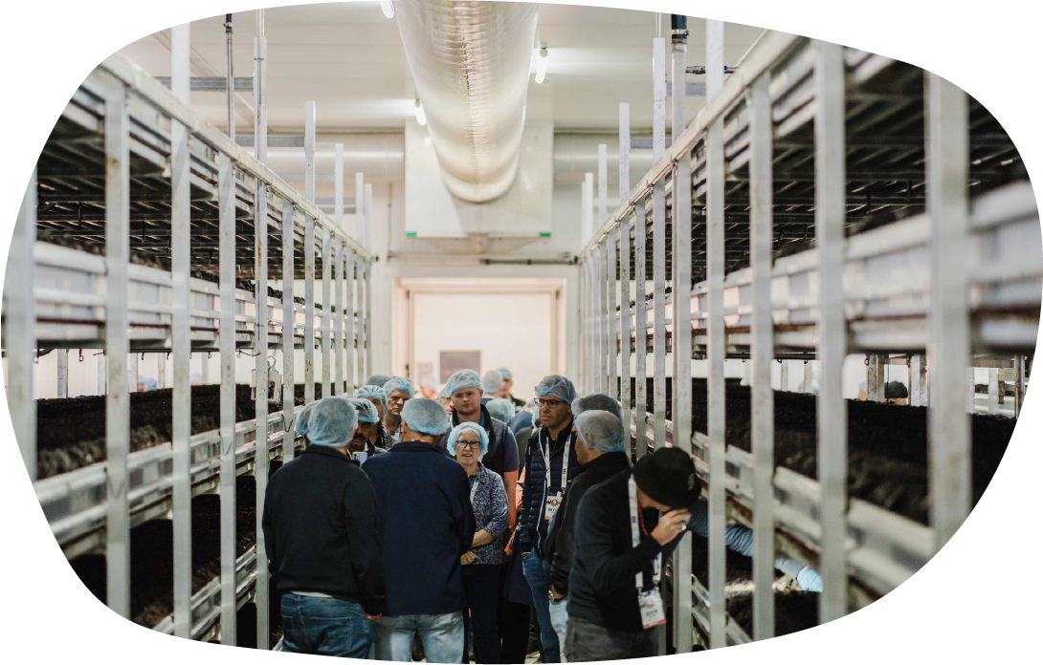
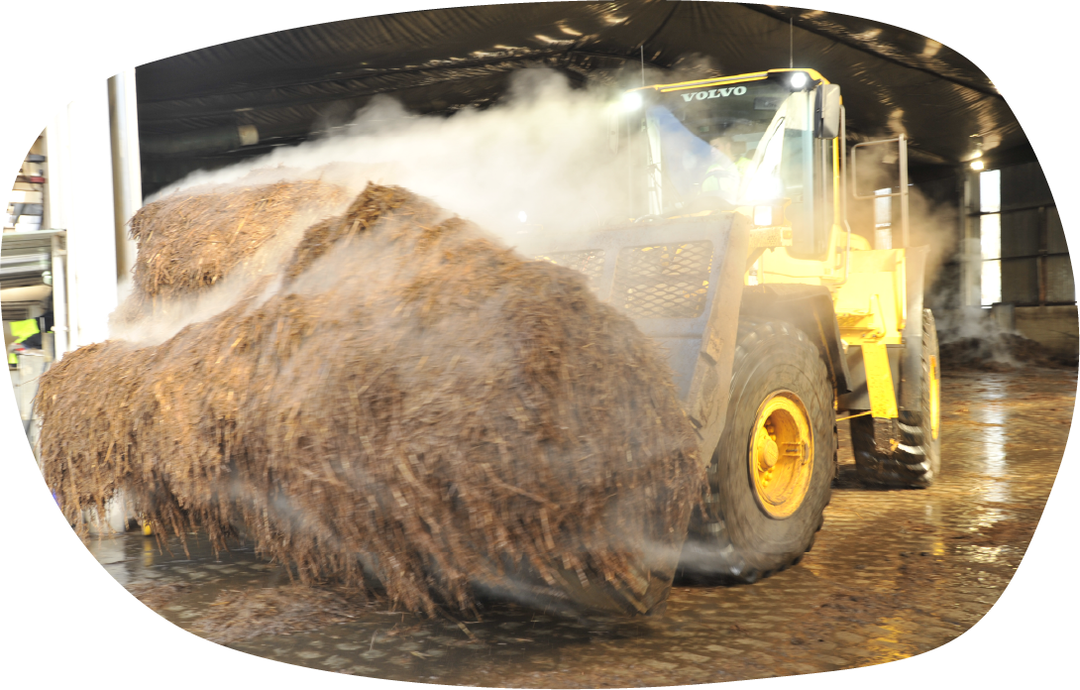
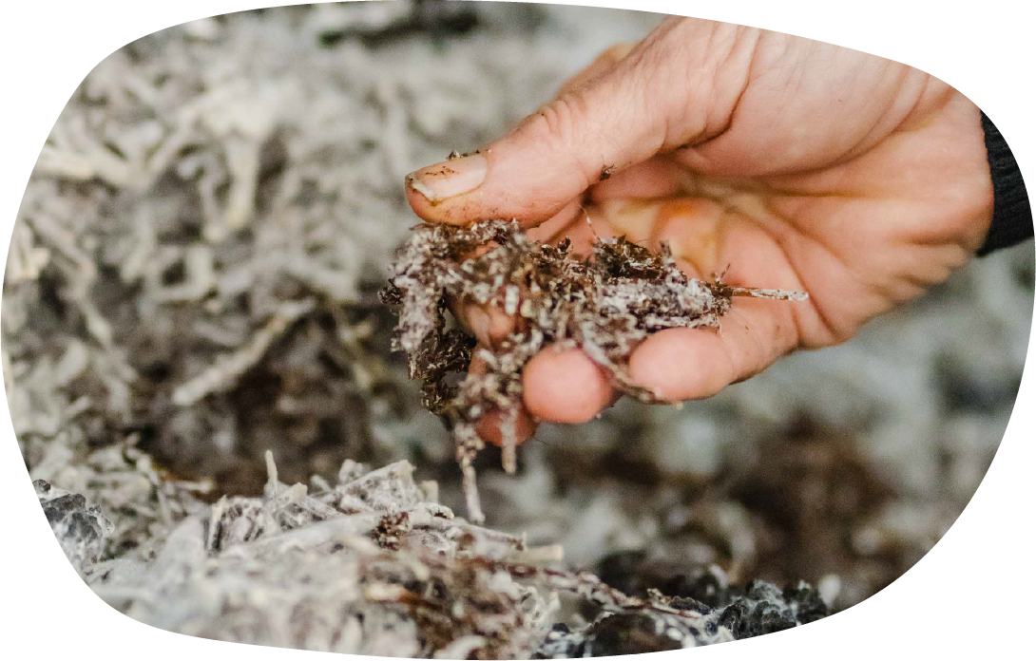
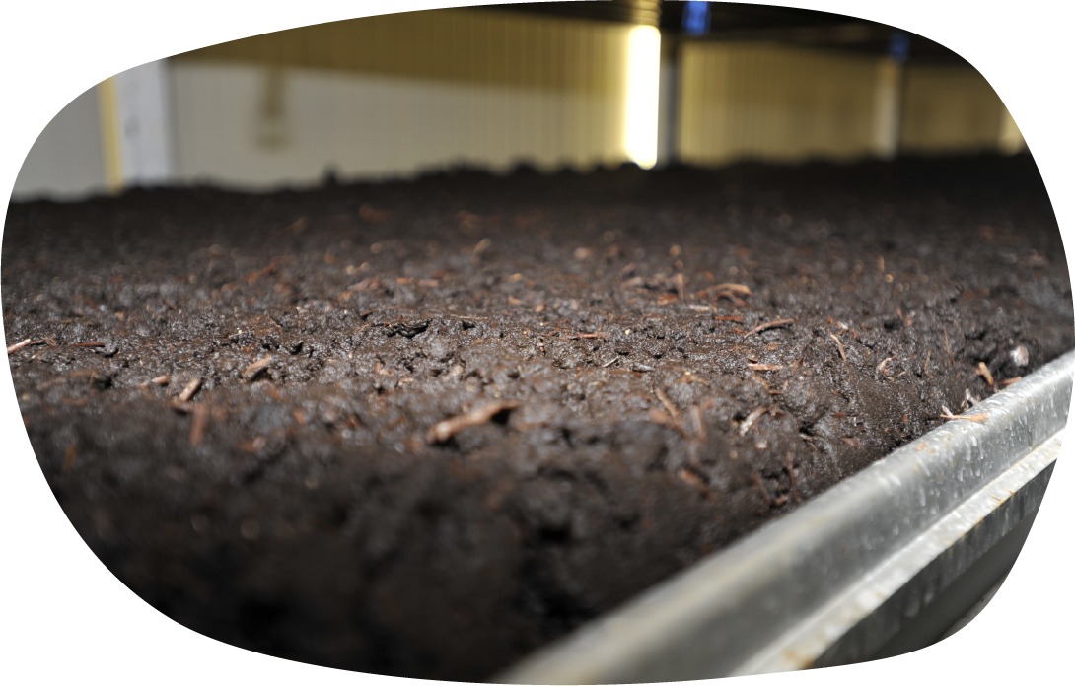
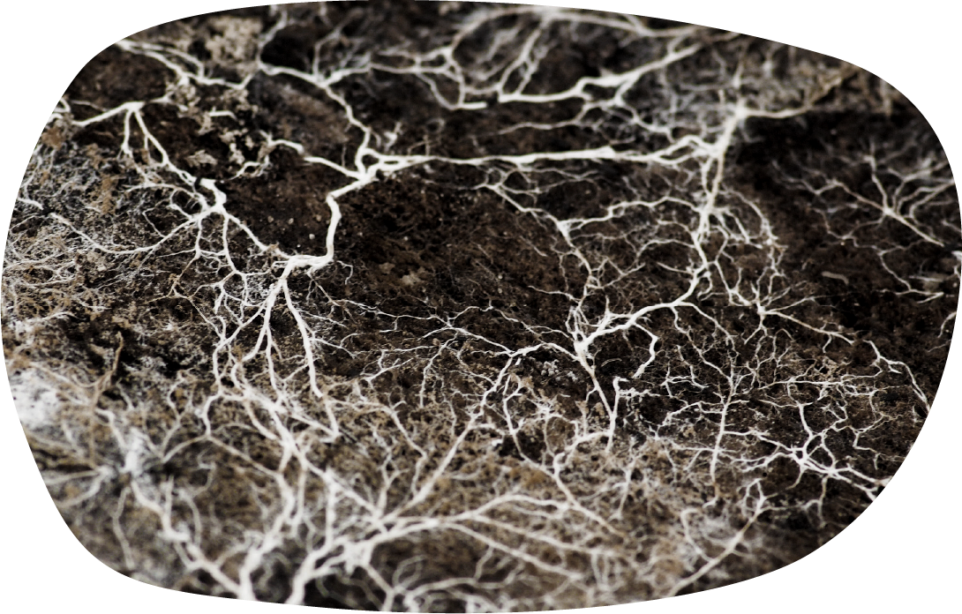
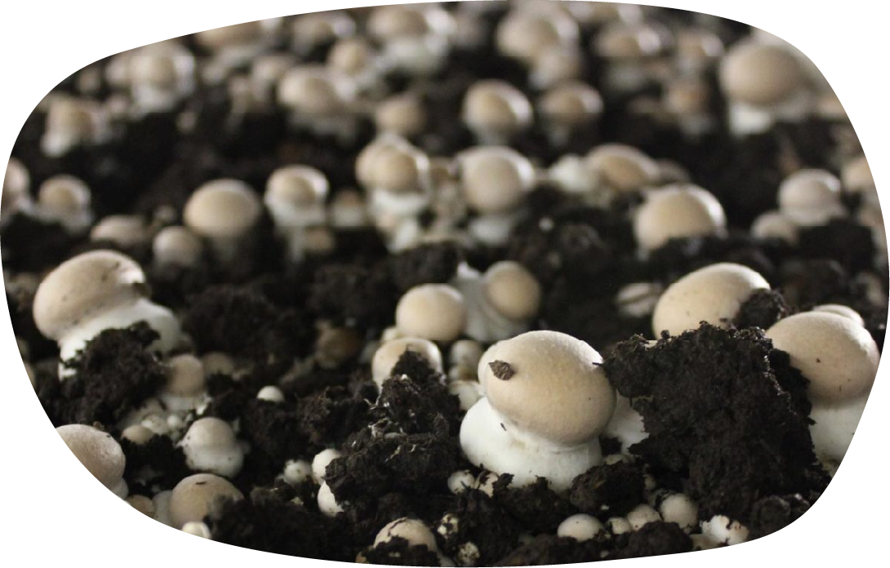
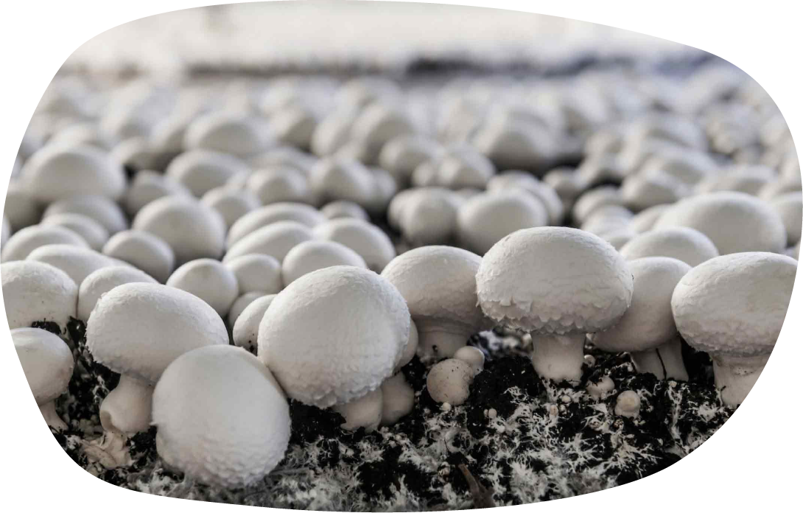
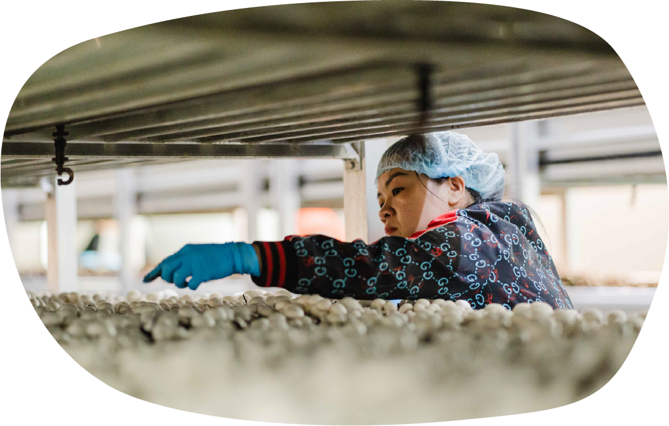
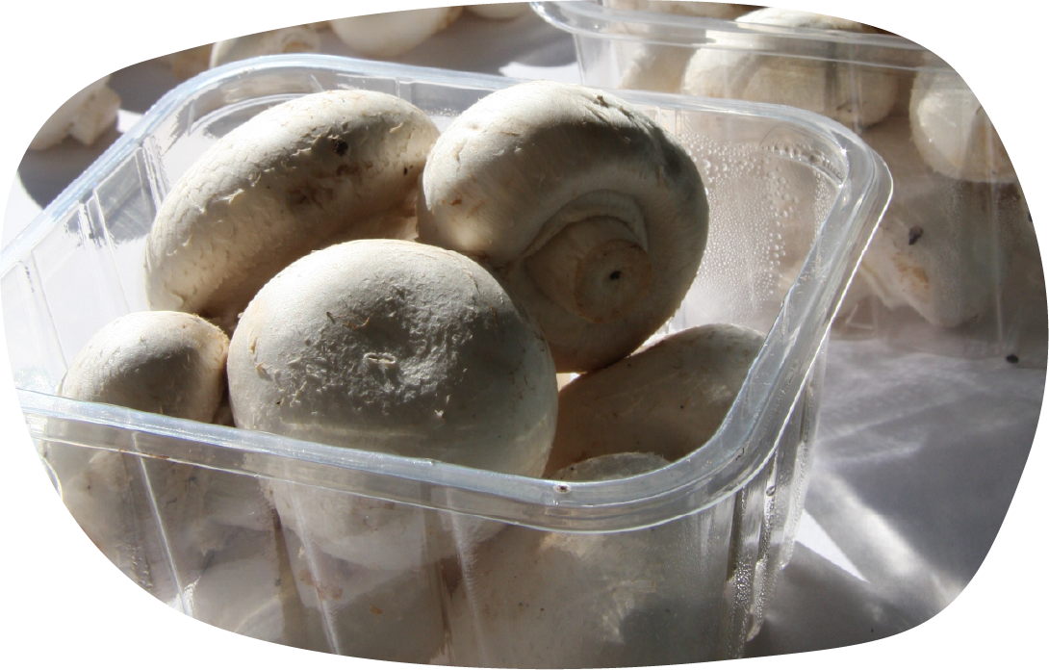
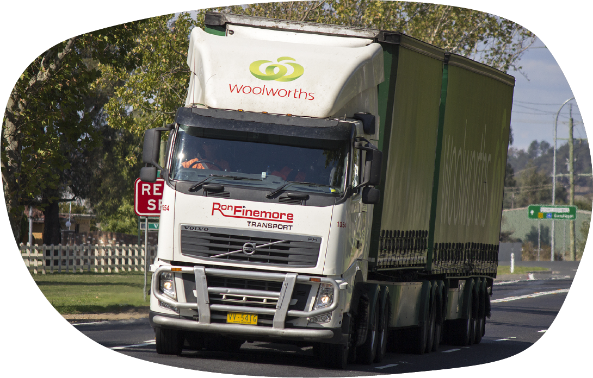
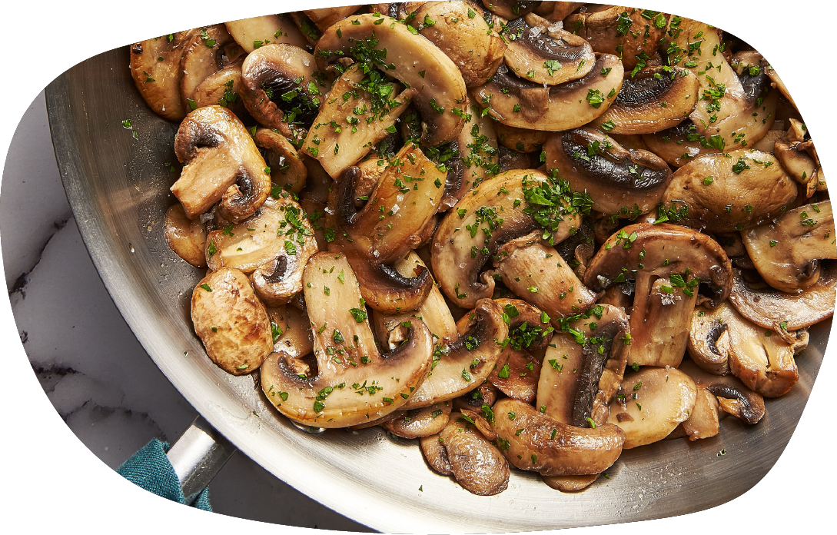
Farm to plate
Step 1
Mushroom farms use indoor growing rooms with carefully controlled temperature and humidity, air flow and watering techniques.
Step 7
After a few days, the pins form into mushrooms - baby buttons, then cups, then flats.
Step 2
The farmer prepares the compost called substrate to grow the mushrooms.
Step 6
After about 3 weeks the small mushrooms appear - this is called pinning.
Step 4
The substrate is covered with a layer of casing soil.
Step 10
Then transported to shops, markets and restaurants.
Step 11
They are now ready to be bought, cooked and enjoyed.
Step 3
Spawn is mixed into trays full of the substrate.
Step 8
The mushrooms are harvested by hand.
Step 9
They are carefully packaged.
Step 5
The mycelium grows.
Notes:
Step 2 - mushrooms.

Slide 16
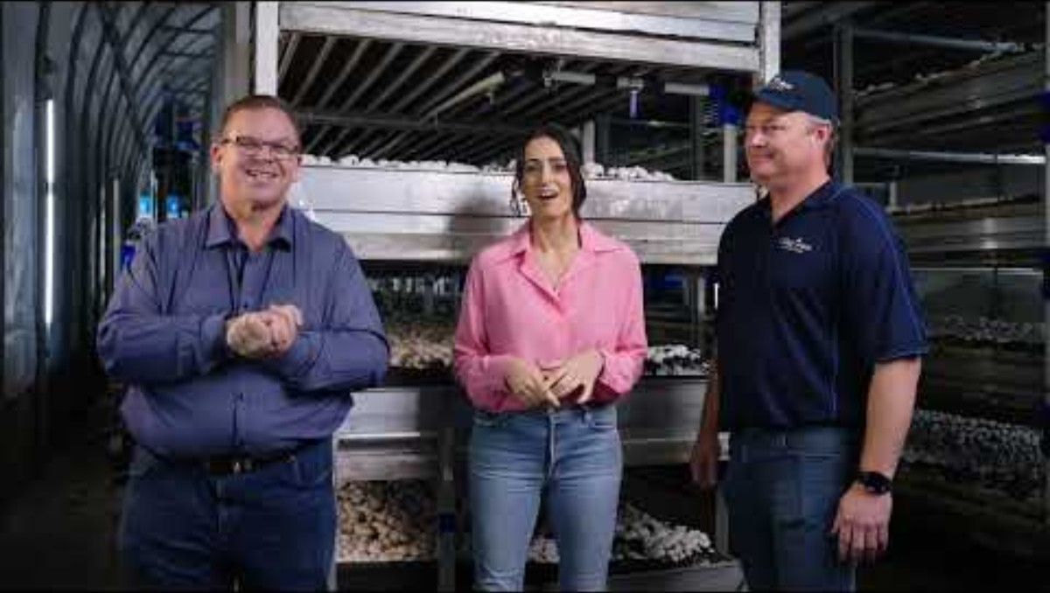
Farm to plate
16

Slide 17
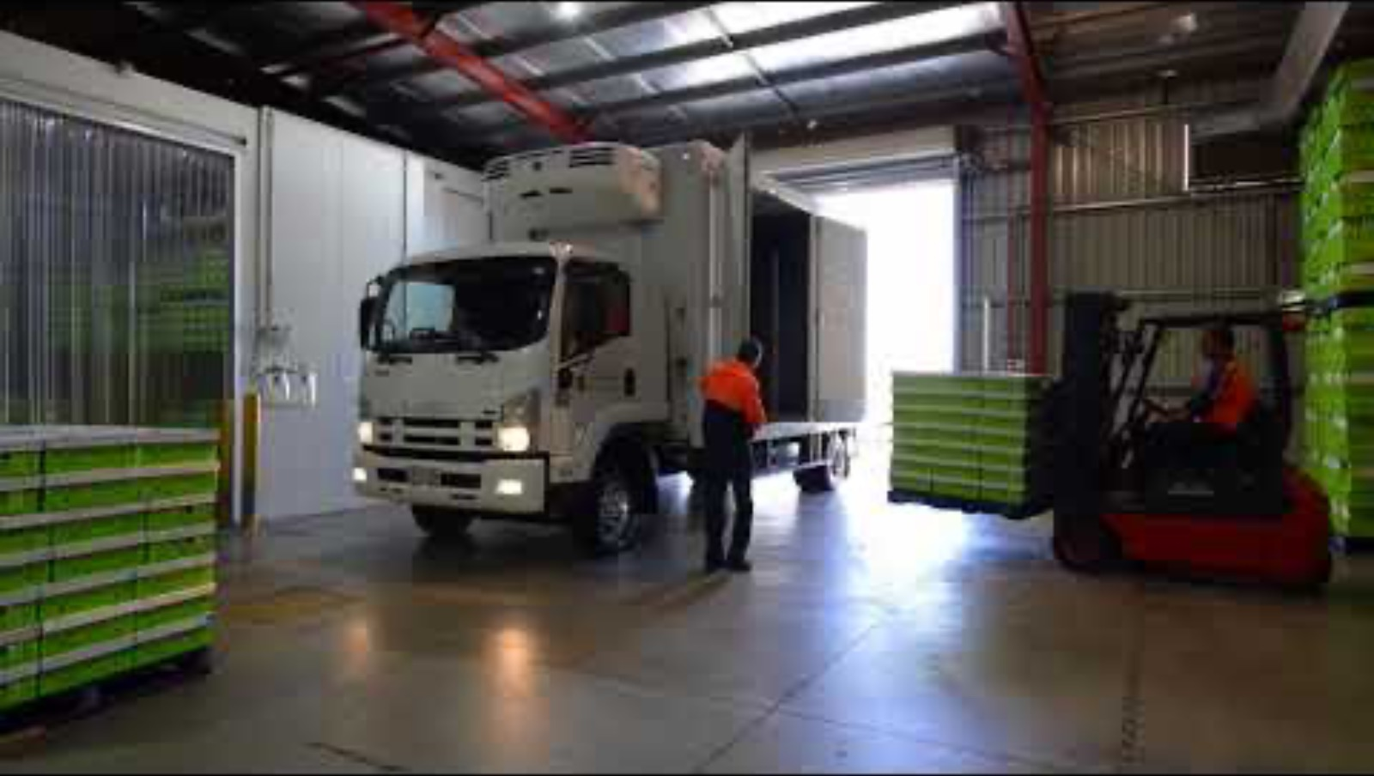
Mushrooms to market
Lesson 2
Watch this video before completing the worksheet

Slide 18
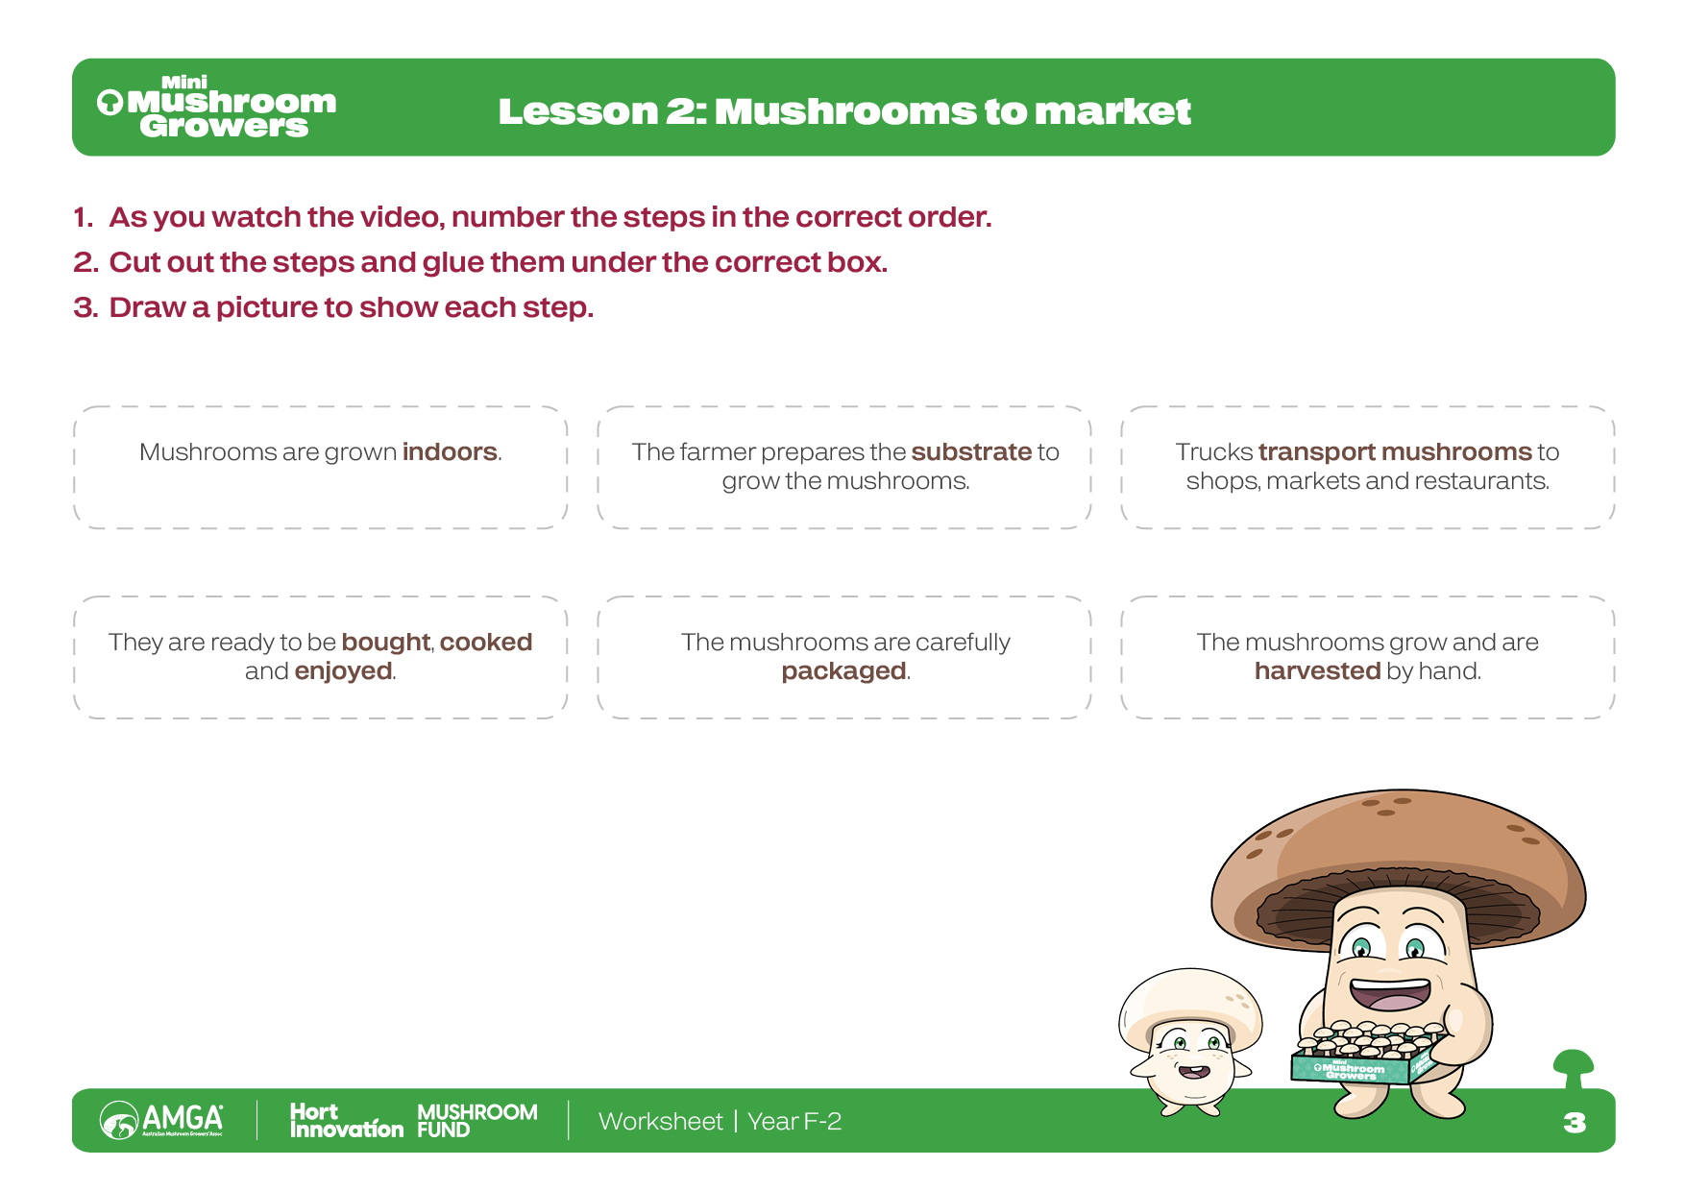
Worksheet
18

Slide 19
Vocabulary
How far food travels from where it is grown or made to where it is eaten.
Food miles
Using resources in a way that is good for the planet now and for the future.
Sustainability
Click on the words to reveal the definition
19

Slide 20
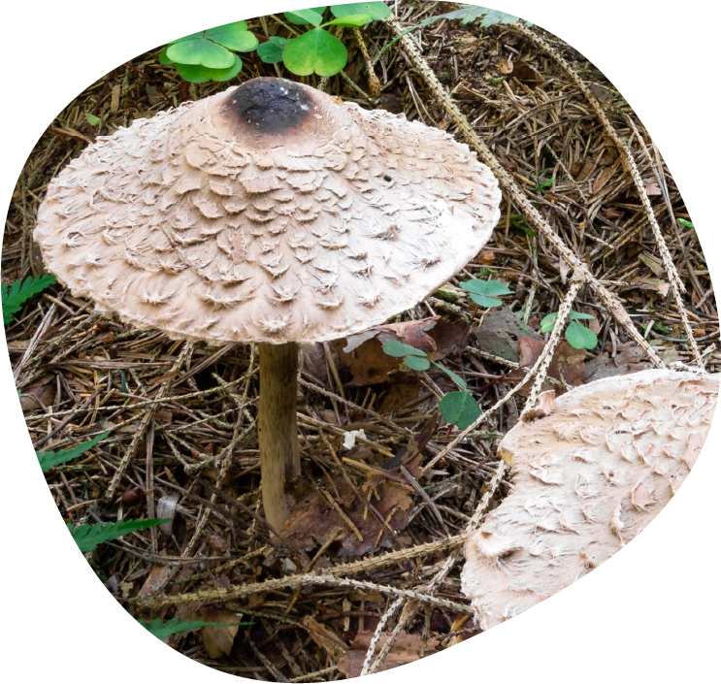
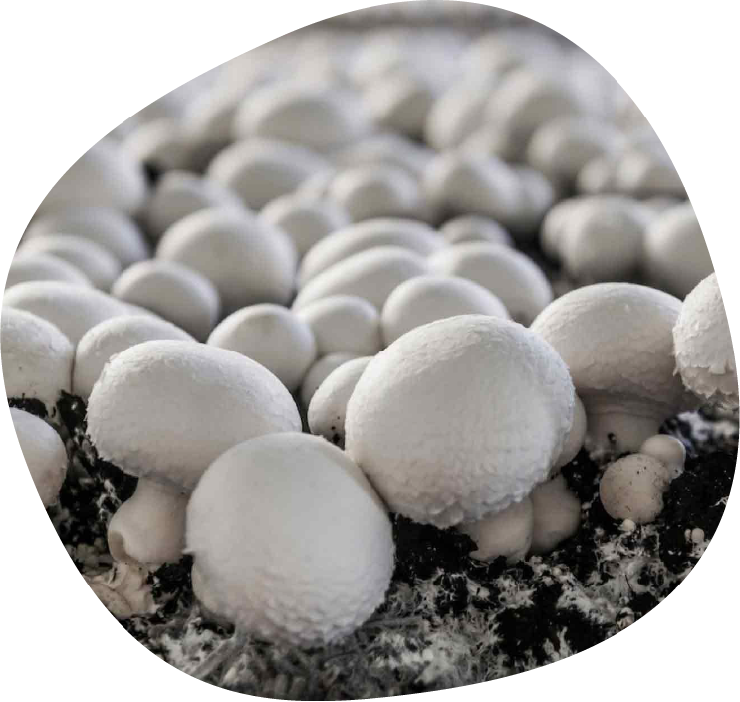
Outdoor versus indoor mushroom farms
What do you notice about the different ways the mushrooms are growing?
How are they similar?
How are they different?
20

Slide 21
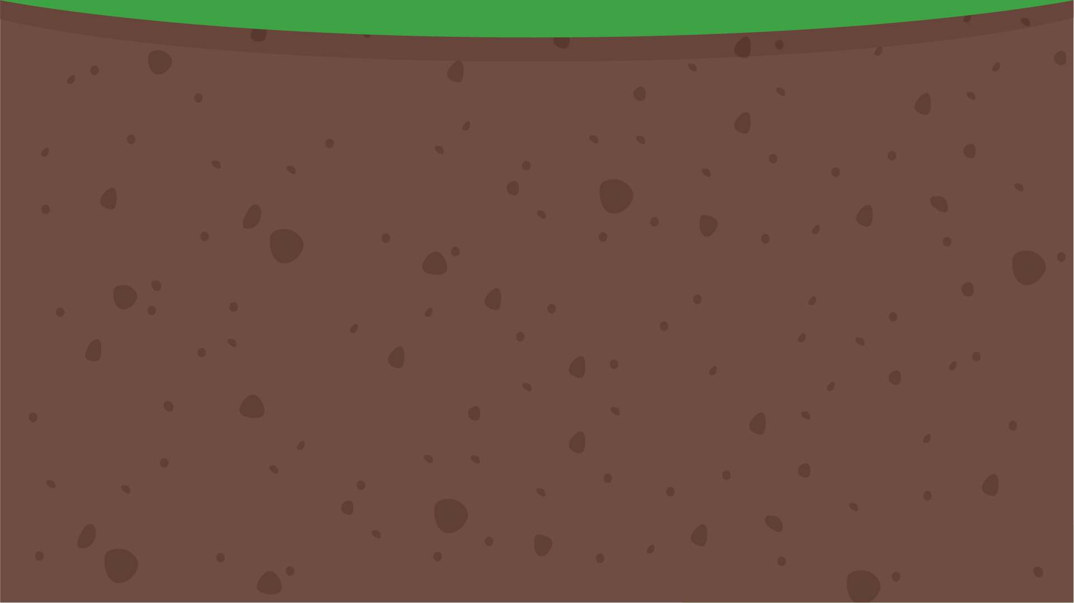
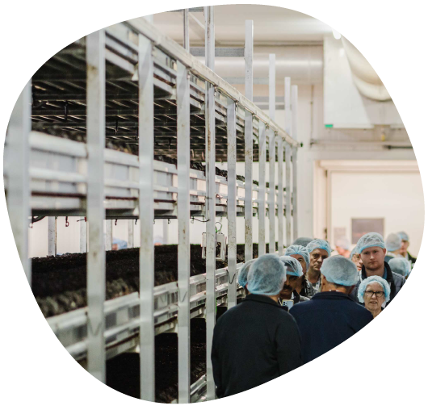
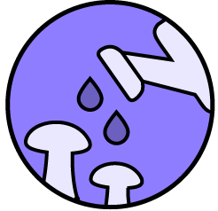




Sustainable farming
Why do farmers grow mushrooms indoors?
Farmers grow mushrooms indoors because it helps them control their growing environment:
Did you know:
Mushrooms are grown indoors to control climate, so they can grow all year round.
Temperature
Humidity
Airflow
how much water they get
How can growing mushrooms indoors help the planet?

Slide 22

Sustainable choices
What other ways can we help the planet when we think about our food?
How can we grow food sustainably?
How can we make sustainable food choices?

Slide 23
What are mushrooms?
Why do you think mushrooms (fungi) are special and could be a 'future food' – meaning they will be even more important for us to eat in the future?
Agaricus bisporus mushrooms are good for the Earth. They are a sustainable food source – because they use up old things, don't need much to grow, and don't take up a lot of space.
They use waste materials from other farms to make the substrate, and when the mushrooms have finished growing, farmers sell the substrate for other farmers to use, to grow more food. (Circular farming is extremely important)
They grow really quickly, so we can produce a lot of food very quickly (this is important because of the growing population).
23

Slide 24
Vocabulary
Special helpers in food that keep our bodies healthy and strong.
Antioxidants
How our bodies break down food so we can get energy and grow.
Digestion
Being in contact with something, like being in the sun.
Exposure
A part of plant food that helps our tummies work well.
Fibre
Having a happy and healthy tummy.
Gut health
Our bodies defence system that fights off sickness and keeps us from getting ill.
Immune system
Click on the words to reveal the definition
24

Slide 25
Vocabulary
Being strong and not getting sick easily because your immune system is working well.
Immunity
Important tiny things in food that our bodies need to stay healthy, like calcium for strong bones.
Minerals
All the good things in food that help our bodies grow and be healthy, like vitamins and minerals.
Nutrients
Food that is full of good things (nutrients) that are good for you.
Nutritious
Being special and different from everything else.
Unique
Different kinds of helpers in food that do special jobs to keep our bodies healthy, like Vitamin D that helps make our teeth and bones strong.
Vitamins
Click on the words to reveal the definition
25

Slide 26



I can eat a rainbow
Why do you think it's important to eat many different coloured foods?
26

Slide 27






Fruit and veg superheroes
Eating fruits and vegetables of different colours is like eating a rainbow!
Red
Foods like strawberries, tomatoes, and red apples help to keep your heart happy and strong.
Brown/ White
Brown and white foods like mushrooms, bananas, potatoes, and garlic have have helpers that help your body fight off bad germs and keep you feeling good. Bananas and potatoes are also good for your muscles.
Each colour has special things inside that help your body stay strong and healthy.
Orange/ Yellow
Foods like carrots, sweet potatoes, and oranges have helpers that help you see well and keep your skin healthy.
Green
Green foods like broccoli, spinach, and peas have lots of different good things inside that can help your body grow and also fight off sickness.
Purple/ Blue
Foods like blueberries, eggplant and grapes have helpers that protect your body from getting sick.
27

Slide 28
Fruit and veg superheroes
Think of fruits and vegetables as having special little helpers inside them. Every colour has a different team of helpers. Eating lots of different colours is like getting all the different superhero teams for your body!
28

Slide 29

Fruit and veg superheroes
29

Slide 30

Fruit and veg superheroes
Vitamins help our bodies stay healthy and grown strong.
Vitamins boost your immunity.

Slide 31






Fruit and veg superheroes
B
Vitamin
Vitamin
A
C
Found in foods like carrots and spinach.
Found in foods like eggs, mushrooms and fish.
Found in foods like oranges and berries.
Vitamins
Helps you see.
Gives you energy and helps your brain.
Helps your skin and immune defence.
Vitamin
Vitamin
Vitamin
D
E
K
Found in mushrooms, milk and sunshine!
Found in seeds and nuts.
Found in food like tomatoes and bananas.
Helps your bones grow strong.
Helps your skin.
Helps heal cuts and bruises.
31

Slide 32









Mushrooms are a superfood
Mushrooms are unique and, even though they are often white, they are full of special nutrients that our bodies need.
They help our immune system, give us energy, and make our bones strong.
Brain & mood
Energy & metabolism
Gut & digestion
Heart & cardiovascular
Immune system
Teeth & bones
Nervous system
Hair, skin & nails
Muscles & activity
A
B
C
D
Mushrooms contain antioxidants that keep our body and immune system healthy.
Mushrooms contain B vitamins that give us energy. They also help our brain to work well.
Mushrooms contain fibre that helps our gut health and keeps our tummies happy.
Mushrooms are the only non-animal food with vitamin D. They help make our teeth and bones strong.
32

Slide 33







Mushrooms supercharge in the sun!
Did you know:
We can make vitamin D in our skin when we are in the sun.
Sun
Put mushrooms in direct sunlight – whole stem side up, or slided. 15 mins in bright peak sunlight (longer, e.g. one hour, in lower light.) Exposure to sunlight helps mushrooms make vitamin D.
Store
You can put the mushrooms in the fridge after they've been in the sun. The vitamin D they make will stay for about a week. You can also use them right away.
Use
Eat however you enjoy mushrooms – raw or cooked.
Buy
from your local shop or market.
33

Slide 34

Worksheet
34

Slide 35
Mushroom quiz
1. Mushrooms are a type of vegetable.
2. Mushrooms can grow in the dark.
3. Eating mushrooms can help make your bones strong
4. All mushrooms are safe to eat.
False - they are fungi!
True
False
True
True
False
True - they have vitamin D
True
False
False - some wild mushrooms are poisonous!
True
False

Slide 36
Mushroom quiz
5. Exposure to sunlight helps mushrooms make vitamin D.
6. You need to eat lots of coloured fruit and vegetables to stay healthy.
7. Some mushrooms are tiny, and some can be really big.
8. White foods like mushrooms are important for our health.
True - sunlight helps make vitamin D
True
False
True - eating lots of coloured fruit and vegetables helps you stay healthy.
True
False
True
True
False
True
True
False

Slide 37
Vocabulary
A person who cooks food.
Chef
Food that has been heated.
Cooked
Food that has not been cooked.
Raw
Instructions on how to make a dish.
Recipe
The ways we explore the world (sight, smell, touch, taste, hearing).
Senses
What we experience when we eat food (sweet, savory, bitter, sour, umami).
Taste
How something feels when we touch or eat it (smooth, bumpy, crunchy, soft).
Texture
A special savoury taste, like the taste of mushrooms or cheese.
Umami
Click on the words to reveal the definition
37

Slide 38

Worksheet
38

Slide 39




Mushroom tasting station
Did you know there are five different tastes?
Can you guess what they are?
Sweet
Sour
Bitter
S
S
B
lollies, cake, ripe bananas
plain yoghurt, lemon, kimchi
dark chocolate, coffee, kale
Umami is a yummy savoury taste - like cheese, vegemite or mushrooms.
Umami
Salty
U
S
mushrooms, parmesan cheese, seaweed
potato chips, bacon, pretzels

Slide 40






Mushroom Cooking
When can we eat mushrooms?
Click on each to find out.
Breakfast?
Lunch?
Dinner?
Mushroom Omelette
Big Breakfast (with grilled mushrooms)
Teriyaki Mushroom Sushi Rolls
Mushroom & Cheese Toastie
Beef Stroganoff
Mushroom Risotto

Slide 41

Mushroom Cooking

Slide 42






Classroom cook up
Teriyaki Mushroom Sushi Rolls
Cheesy Mushroom Quesadillas
Mushroom Omelette Wrap
Here are some simple mushroom recipes you might want to try.
Recipes
42

Slide 43
Congratulations!
You are now a Mini Mushroom Grower
Download certificate
Teacher feedback
Click on the link to complete the teacher and student post-survey with your class.
Student survey
43

